Slide 1
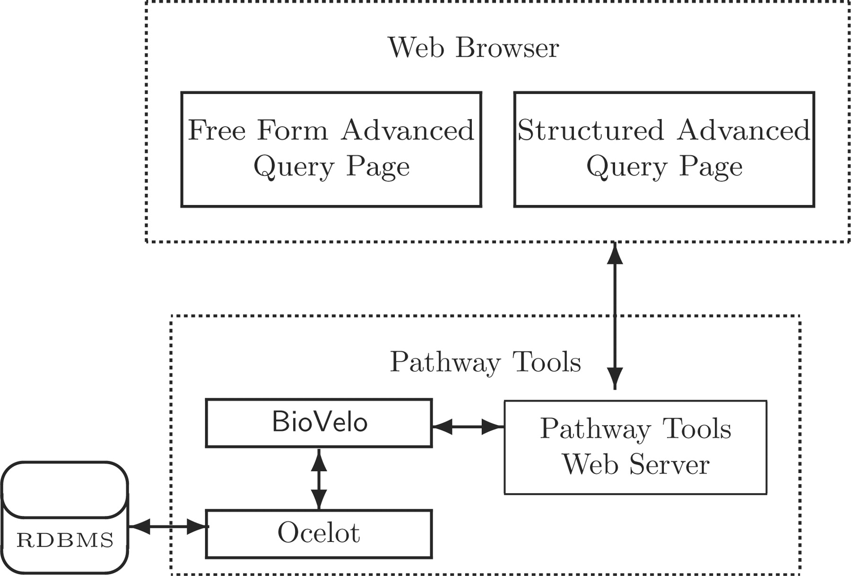
Figure 1. Two web page interfaces for constructing BioVelo queries interact with the Pathway Tools web server that ...
Notes:
Figure 1. Two web page interfaces for constructing BioVelo queries interact with the Pathway Tools web server that communicates with a BioVelo query processor. Ocelot is an object-oriented DB system that can use a relational DB back end. The FFAQP and the SAQP are accessible at the web site BioCyc.org/query.shtml.
Unless provided in the caption above, the following copyright applies to the content of this slide: © The Author(s) 2010. Published by Oxford University Press.This is Open Access article distributed under the terms of the Creative Commons Attribution Non-Commercial License (http://creativecommons.org/licenses/by-nc/2.5), which permits unrestricted non-commercial use, distribution, and reproduction in any medium, provided the original work is properly cited.

