Slide 1
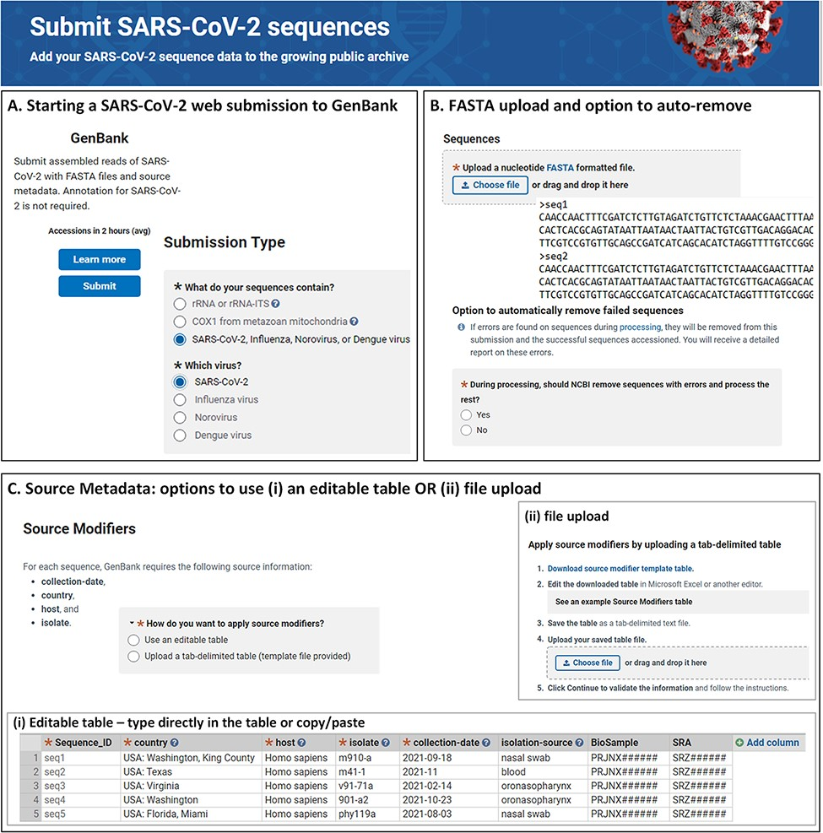
Figure 1. NLM/NCBI SARS-CoV-2 web submission forms for starting a submission (A), uploading sequences (B) and providing ...
Notes:
Figure 1. NLM/NCBI SARS-CoV-2 web submission forms for starting a submission (A), uploading sequences (B) and providing source metadata (C). Screenshots are from https://submit.ncbi.nlm.nih.gov/sarscov2/ and https://submit.ncbi.nlm.nih.gov/subs/genbank/.
Unless provided in the caption above, the following copyright applies to the content of this slide: Published by Oxford University Press 2022. This work is written by (a) US Government employee(s) and is in the public domain in the US.This work is written by (a) US Government employee(s) and is in the public domain in the US.

Slide 2
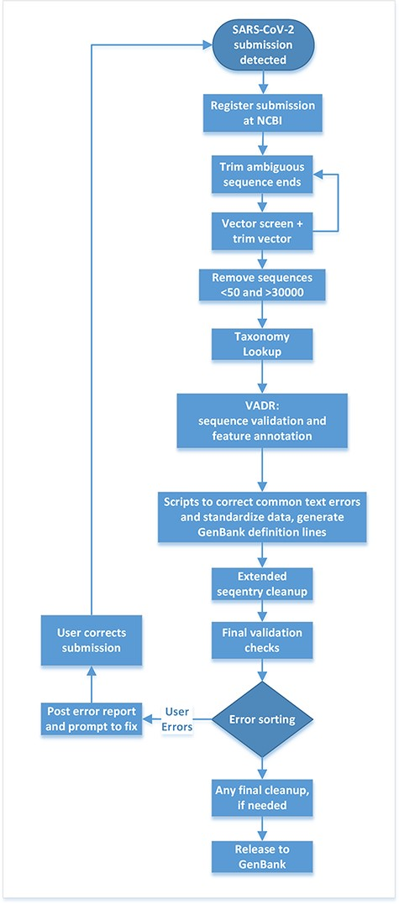
Figure 2. Post-submission processing steps performed at NLM/NCBI to evaluate, annotate and prepare SARS-CoV-2 sequence ...
Notes:
Figure 2. Post-submission processing steps performed at NLM/NCBI to evaluate, annotate and prepare SARS-CoV-2 sequence data for public release to the GenBank database.
Unless provided in the caption above, the following copyright applies to the content of this slide: Published by Oxford University Press 2022. This work is written by (a) US Government employee(s) and is in the public domain in the US.This work is written by (a) US Government employee(s) and is in the public domain in the US.

Slide 3
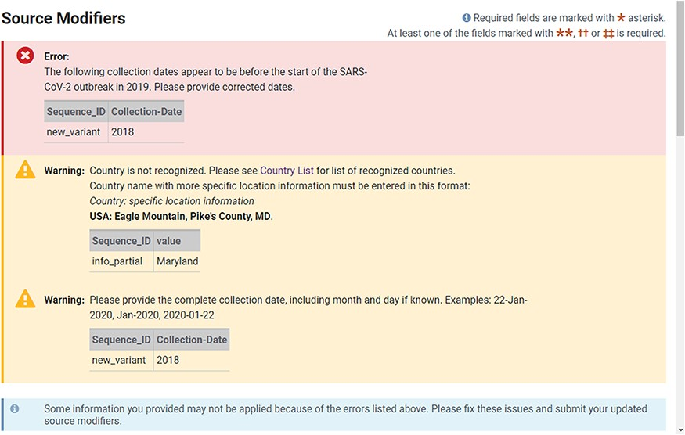
Figure 3. Example of real-time validation of source metadata during the web submission process prompting for immediate ...
Notes:
Figure 3. Example of real-time validation of source metadata during the web submission process prompting for immediate feedback and correction.
Unless provided in the caption above, the following copyright applies to the content of this slide: Published by Oxford University Press 2022. This work is written by (a) US Government employee(s) and is in the public domain in the US.This work is written by (a) US Government employee(s) and is in the public domain in the US.

Slide 4
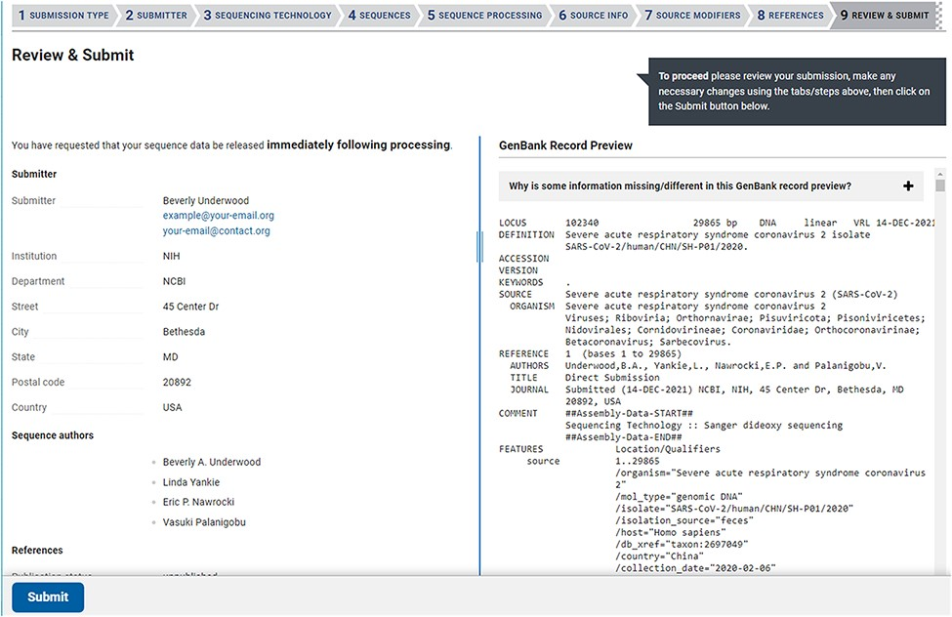
Figure 4. The Review & Submit page in a SARS-CoV-2 web submission. The left side of the page contains a summary of ...
Notes:
Figure 4. The Review & Submit page in a SARS-CoV-2 web submission. The left side of the page contains a summary of information, data files, and pre-submission sequence processing reports. The right side of the page displays a preview of the GenBank flatfiles prior to feature annotation and full submission processing. The preview is a familiar, human-readable format that allows submitters to confirm the author names, publications (if provided), contact information, sequencing technology and source information are correct before submitting.
Unless provided in the caption above, the following copyright applies to the content of this slide: Published by Oxford University Press 2022. This work is written by (a) US Government employee(s) and is in the public domain in the US.This work is written by (a) US Government employee(s) and is in the public domain in the US.

Slide 5
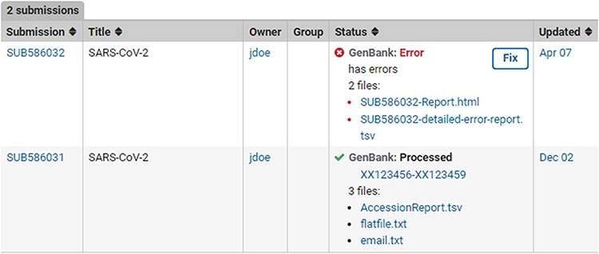
Figure 5. Post-submission processing reports. Example SUB586032 shows a (test) submission with errors with an error ...
Notes:
Figure 5. Post-submission processing reports. Example SUB586032 shows a (test) submission with errors with an error summary (SUB586032-Report.html) as well as a detailed VADR alert report (SUB586032-detailed-error-report.tsv). The error reports list the sequence_IDs with errors, instruction on how to correct the submission via the fix button or by contacting NLM/NCBI staff with more information. Example SUB586031 displays a successfully processed (test) submission with downloadable files containing GenBank Accessions, tab-delimited accession report with original sequence_IDs mapped to GenBank Accession numbers (AccessionReport.tsv), a copy of the fully processed annotated records (flatfile.txt) and a copy of the email sent upon successful processing (email.txt).
Unless provided in the caption above, the following copyright applies to the content of this slide: Published by Oxford University Press 2022. This work is written by (a) US Government employee(s) and is in the public domain in the US.This work is written by (a) US Government employee(s) and is in the public domain in the US.

