Slide 1
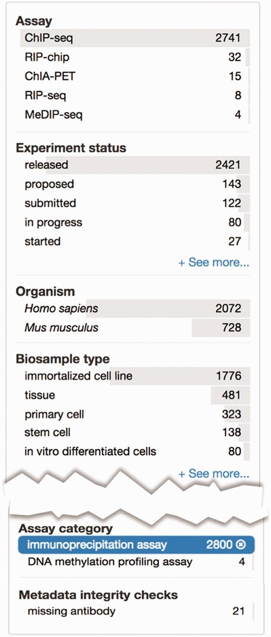
Figure 5. Metadata integrity using facets in the curation interface. This view highlights two additional facets: ‘Assay ...
Notes:
Figure 5. Metadata integrity using facets in the curation interface. This view highlights two additional facets: ‘Assay category’ and ‘Metadata integrity checks’ found on the curator interface for experimental assays. The selected term filters the ‘Assay’ facet, based on the assay slim described in the text, to only display a list of assays that can be categorized as immunoprecipitation assays. For these experiments, the ‘Metadata integrity checks’ facet can be used to filter for the experiments that are missing antibody information.
Unless provided in the caption above, the following copyright applies to the content of this slide: © The Author(s) 2015. Published by Oxford University Press.This is an Open Access article distributed under the terms of the Creative Commons Attribution License (http://creativecommons.org/licenses/by/4.0/), which permits unrestricted reuse, distribution, and reproduction in any medium, provided the original work is properly cited.

