Slide 1
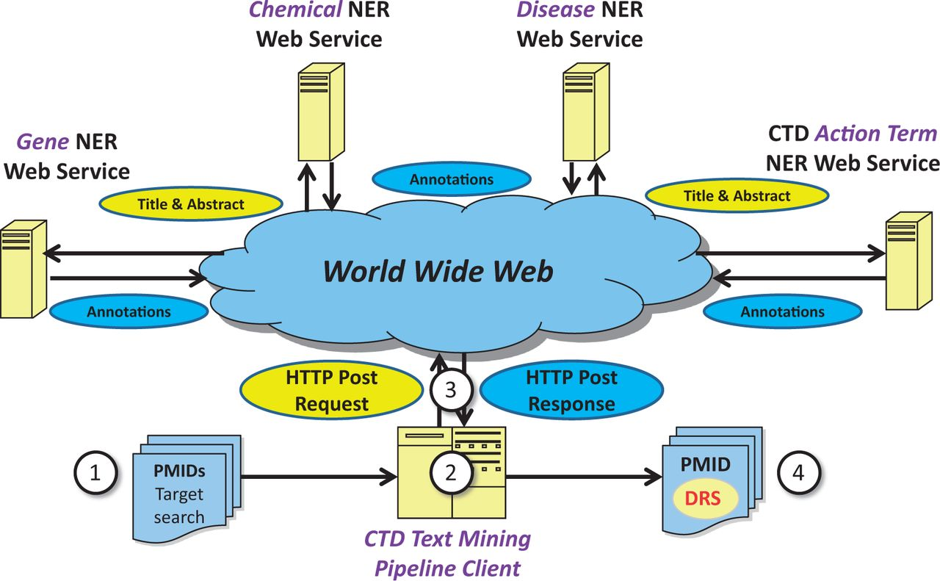
Figure 1. Web service-based NER logical design. Under a Web service-based conceptual design, (1) a list of potentially ...
Notes:
Figure 1. Web service-based NER logical design. Under a Web service-based conceptual design, (1) a list of potentially relevant PubMed IDs (PMIDs) is secured via a search of PubMed, typically for a target chemical. (2) The list is processed asynchronously by batch-oriented processes. Rather than performing NER using locally installed NER tools, (3) HTTP calls containing text passages are made to remote Web services; the results of NER are used as a key component in document ranking algorithms. (4) PMIDs are then assigned a DRS by the document ranking algorithms.
Unless provided in the caption above, the following copyright applies to the content of this slide: © The Author(s) 2014. Published by Oxford University Press.This is an Open Access article distributed under the terms of the Creative Commons Attribution License (http://creativecommons.org/licenses/by/3.0/), which permits unrestricted reuse, distribution, and reproduction in any medium, provided the original work is properly cited.

Slide 2
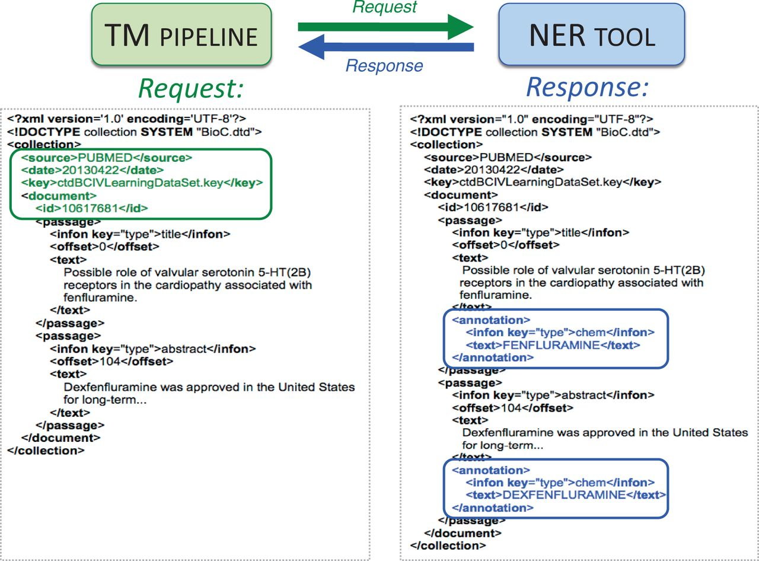
Figure 2. BioC-based high-level inter-process communications. A sample request in BioC format is sent by Web service ...
Notes:
Figure 2. BioC-based high-level inter-process communications. A sample request in BioC format is sent by Web service from the text-mining (TM) pipeline to the NER tool (green arrow). The PubMed ID, title, abstract and designated key file describing the semantics of the data are included within the XML request (left, green box). A chemical-specific response is returned from the NER tool to the TM pipeline (blue arrow). The NER Web service reads the BioC XML and attempts to identify chemicals in the title and abstract. Here, two chemical entities (fenfluramine and dexfenfluramine) are identified as BioC annotation objects for the NER chemical category in the response (right, blue boxes).
Unless provided in the caption above, the following copyright applies to the content of this slide: © The Author(s) 2014. Published by Oxford University Press.This is an Open Access article distributed under the terms of the Creative Commons Attribution License (http://creativecommons.org/licenses/by/3.0/), which permits unrestricted reuse, distribution, and reproduction in any medium, provided the original work is properly cited.

Slide 3
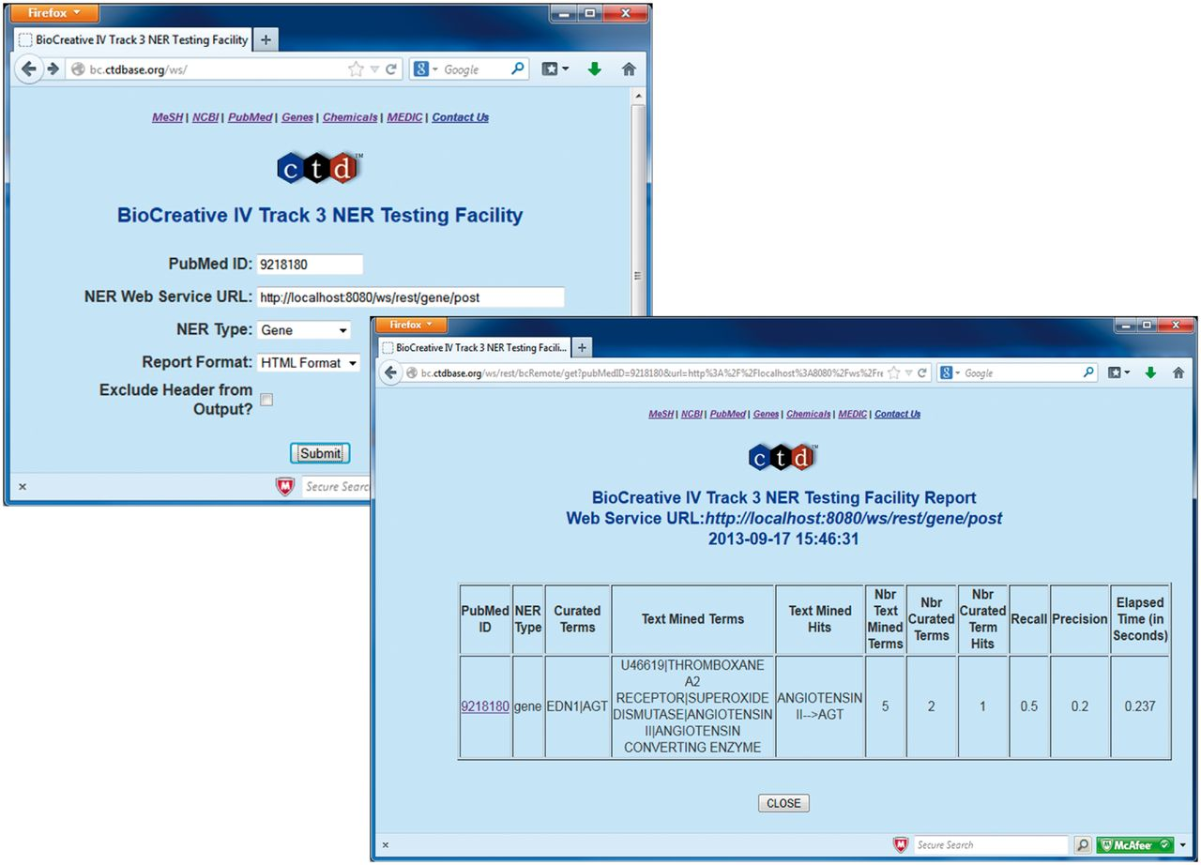
Figure 3. BioCreative IV Track 3 NER Testing Facility. Participants were provided with the BioCreative IV Track 3 NER ...
Notes:
Figure 3. BioCreative IV Track 3 NER Testing Facility. Participants were provided with the BioCreative IV Track 3 NER Testing Facility developed by CTD. This testing facility provided a front-end to a CTD Web service that on execution called the participant's Web service using BioC XML associated with a specified PubMed ID for inter-process communications (top left screenshot). CTD's Web service would in turn receive text-mined annotations from the participant's Web service (using BioC XML). CTD's Web service then processed the annotations and computed the results against the curated data set, providing the user with recall, precision, response time and a detailed list of curated terms, text-mined terms and text-mined term hits (bottom right screenshot).
Unless provided in the caption above, the following copyright applies to the content of this slide: © The Author(s) 2014. Published by Oxford University Press.This is an Open Access article distributed under the terms of the Creative Commons Attribution License (http://creativecommons.org/licenses/by/3.0/), which permits unrestricted reuse, distribution, and reproduction in any medium, provided the original work is properly cited.

Slide 4
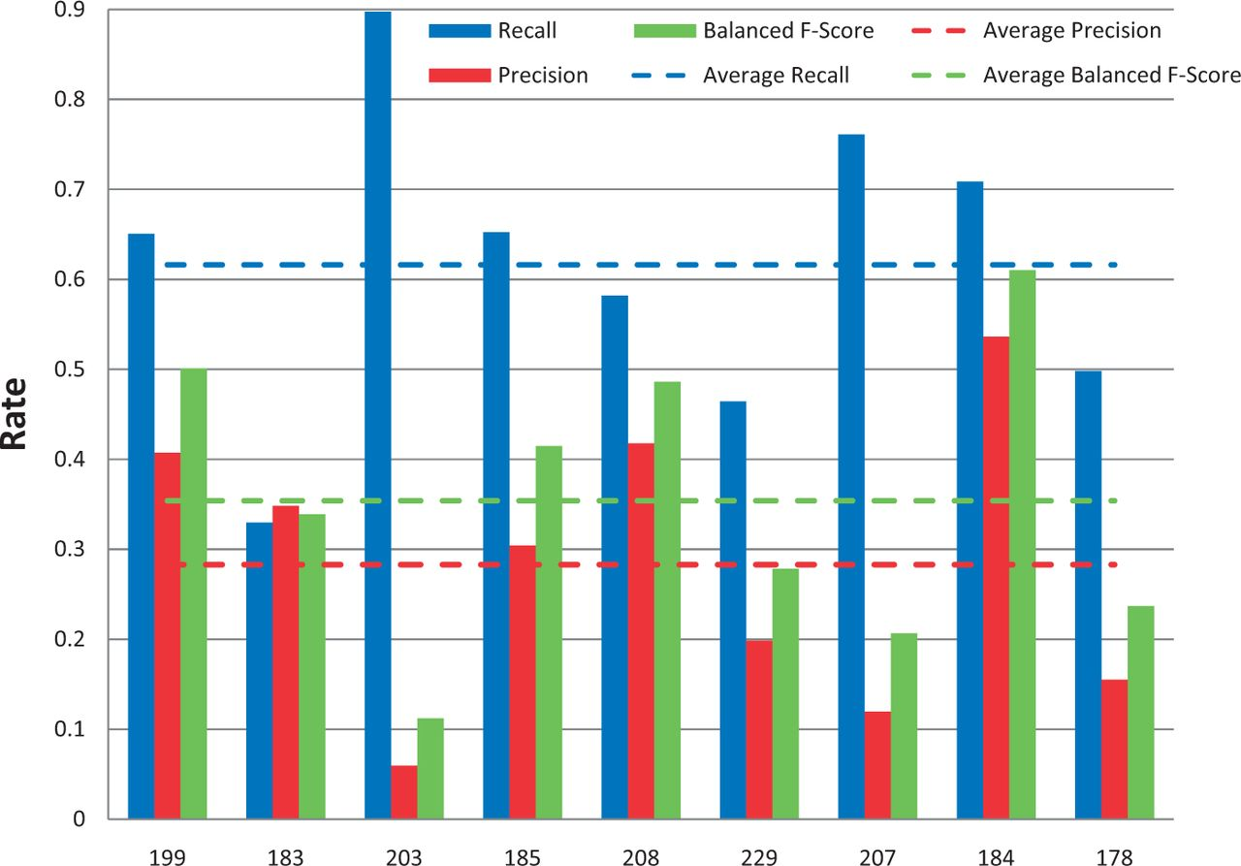
Figure 4. Gene/protein named-entity recognition. Gene recall (blue), precision (red) and balanced F-score (green) ...
Notes:
Figure 4. Gene/protein named-entity recognition. Gene recall (blue), precision (red) and balanced F-score (green) results are shown for each participating group (anonymously identified by group number on x-axis). Average scores for each metric (dotted lines) are also provided.
Unless provided in the caption above, the following copyright applies to the content of this slide: © The Author(s) 2014. Published by Oxford University Press.This is an Open Access article distributed under the terms of the Creative Commons Attribution License (http://creativecommons.org/licenses/by/3.0/), which permits unrestricted reuse, distribution, and reproduction in any medium, provided the original work is properly cited.

Slide 5
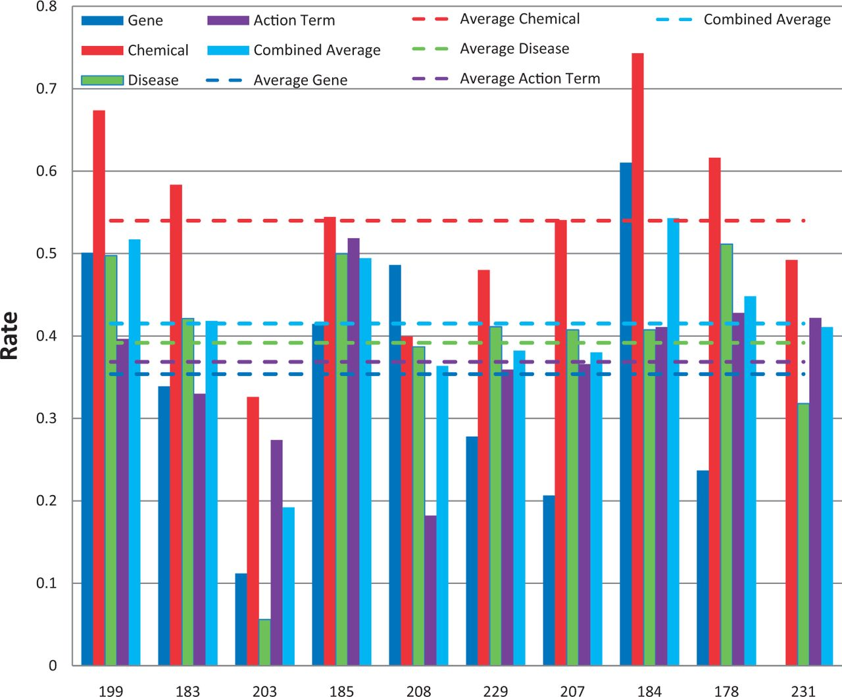
Figure 5. Balanced F-scores by group. Balanced F-score results for each NER category, as well as a combined average, ...
Notes:
Figure 5. Balanced F-scores by group. Balanced F-score results for each NER category, as well as a combined average, are provided for each participating group (anonymously identified by group number on x-axis). Average scores for each metric (dotted lines) are also provided.
Unless provided in the caption above, the following copyright applies to the content of this slide: © The Author(s) 2014. Published by Oxford University Press.This is an Open Access article distributed under the terms of the Creative Commons Attribution License (http://creativecommons.org/licenses/by/3.0/), which permits unrestricted reuse, distribution, and reproduction in any medium, provided the original work is properly cited.

Slide 6
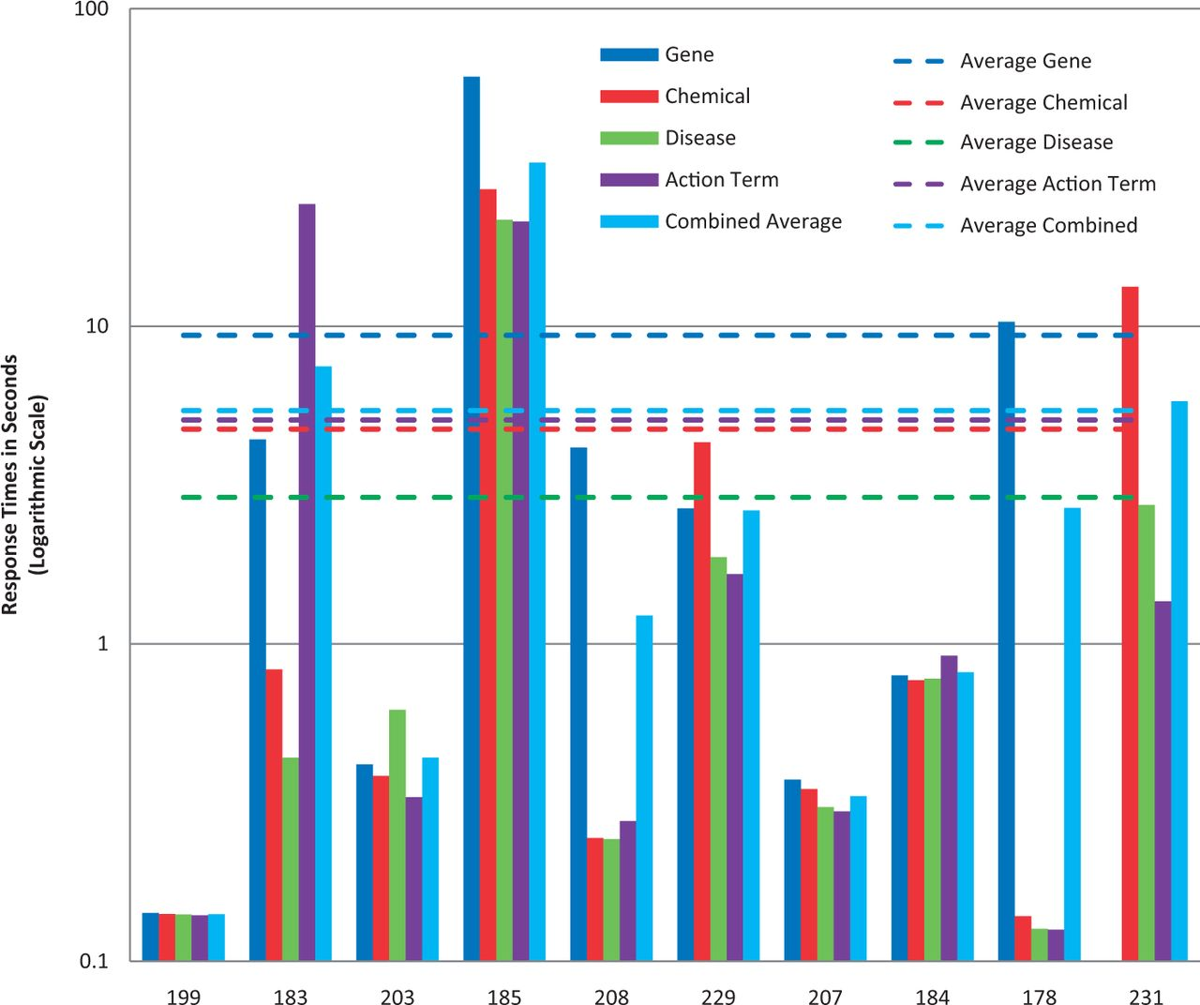
Figure 6. Response times. Response time results for each NER category, as well as a combined average, are provided for ...
Notes:
Figure 6. Response times. Response time results for each NER category, as well as a combined average, are provided for each participating group (anonymously identified by group number on x-axis). Note : the response time in seconds (y-axis) uses a logarithmic scale.
Unless provided in the caption above, the following copyright applies to the content of this slide: © The Author(s) 2014. Published by Oxford University Press.This is an Open Access article distributed under the terms of the Creative Commons Attribution License (http://creativecommons.org/licenses/by/3.0/), which permits unrestricted reuse, distribution, and reproduction in any medium, provided the original work is properly cited.

Slide 7
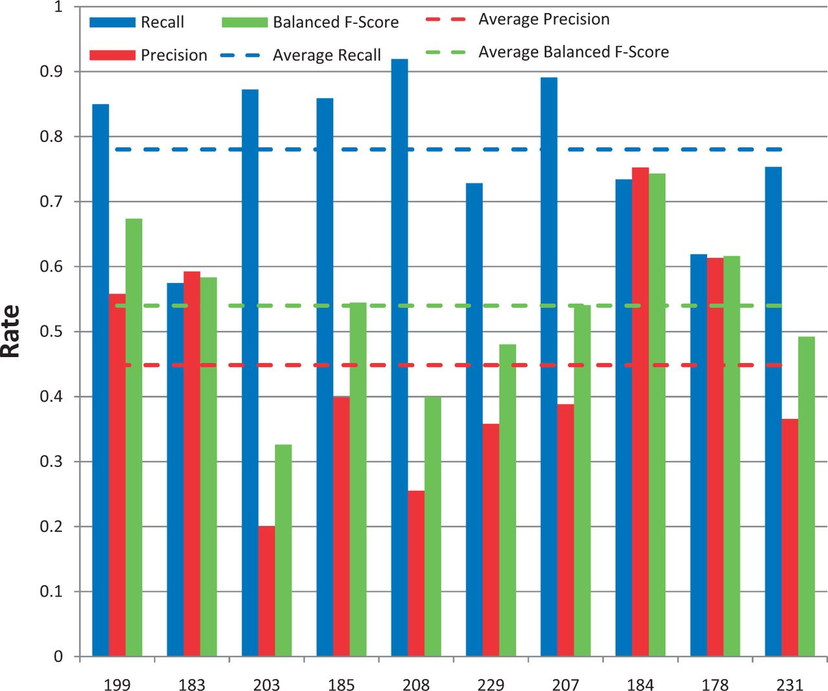
Figure 7. Chemical/drug named-entity recognition. Chemical recall (blue), precision (red) and balanced F-score (green) ...
Notes:
Figure 7. Chemical/drug named-entity recognition. Chemical recall (blue), precision (red) and balanced F-score (green) results are shown for each participating group (anonymously identified by group number on x-axis). Average scores for each metric (dotted lines) are also provided.
Unless provided in the caption above, the following copyright applies to the content of this slide: © The Author(s) 2014. Published by Oxford University Press.This is an Open Access article distributed under the terms of the Creative Commons Attribution License (http://creativecommons.org/licenses/by/3.0/), which permits unrestricted reuse, distribution, and reproduction in any medium, provided the original work is properly cited.

Slide 8
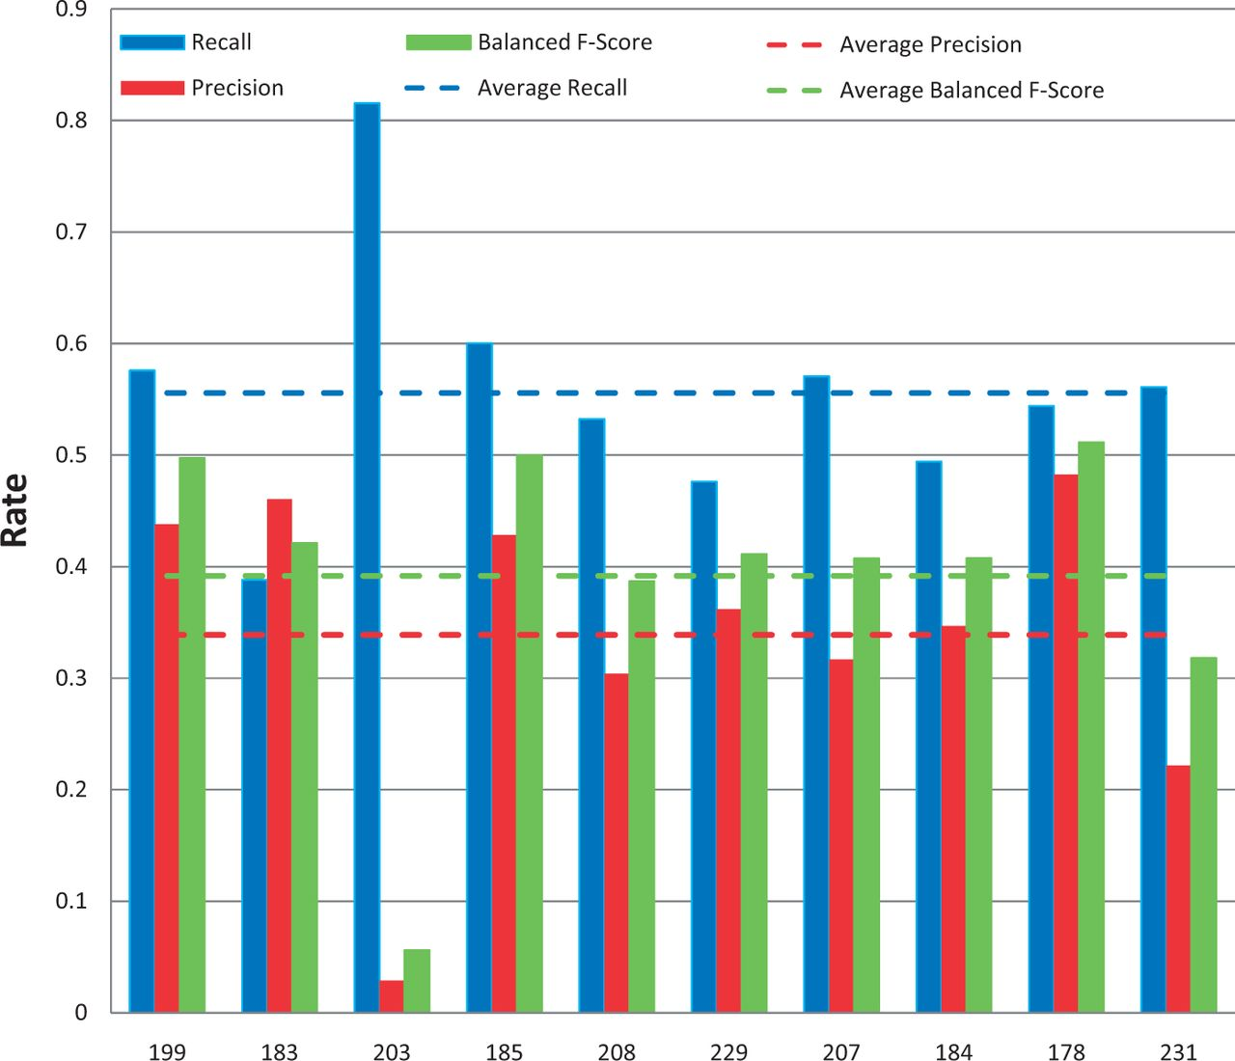
Figure 8. Disease named-entity recognition. Disease recall (blue), precision (red) and balanced F-score (green) results ...
Notes:
Figure 8. Disease named-entity recognition. Disease recall (blue), precision (red) and balanced F-score (green) results are shown for each participating group (anonymously identified by group number on x-axis). Average scores for each metric (dotted lines) are also provided.
Unless provided in the caption above, the following copyright applies to the content of this slide: © The Author(s) 2014. Published by Oxford University Press.This is an Open Access article distributed under the terms of the Creative Commons Attribution License (http://creativecommons.org/licenses/by/3.0/), which permits unrestricted reuse, distribution, and reproduction in any medium, provided the original work is properly cited.

Slide 9
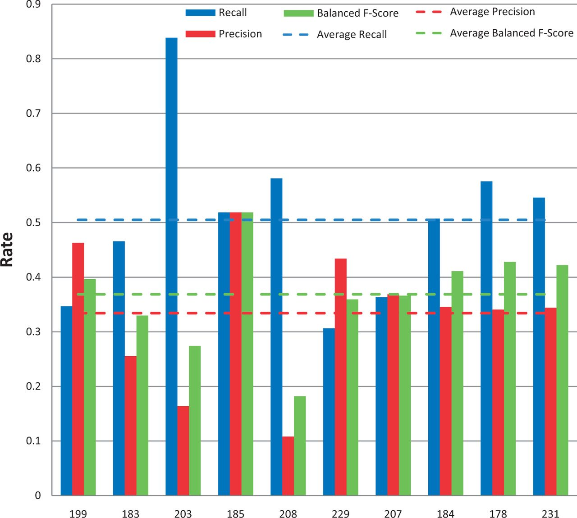
Figure 9. Action term named-entity recognition. Chemical/gene action term recall (blue), precision (red) and balanced ...
Notes:
Figure 9. Action term named-entity recognition. Chemical/gene action term recall (blue), precision (red) and balanced F-score (green) results are shown for each participating group (anonymously identified by group number on x-axis). Average scores for each metric (dotted lines) are also provided.
Unless provided in the caption above, the following copyright applies to the content of this slide: © The Author(s) 2014. Published by Oxford University Press.This is an Open Access article distributed under the terms of the Creative Commons Attribution License (http://creativecommons.org/licenses/by/3.0/), which permits unrestricted reuse, distribution, and reproduction in any medium, provided the original work is properly cited.

Slide 10
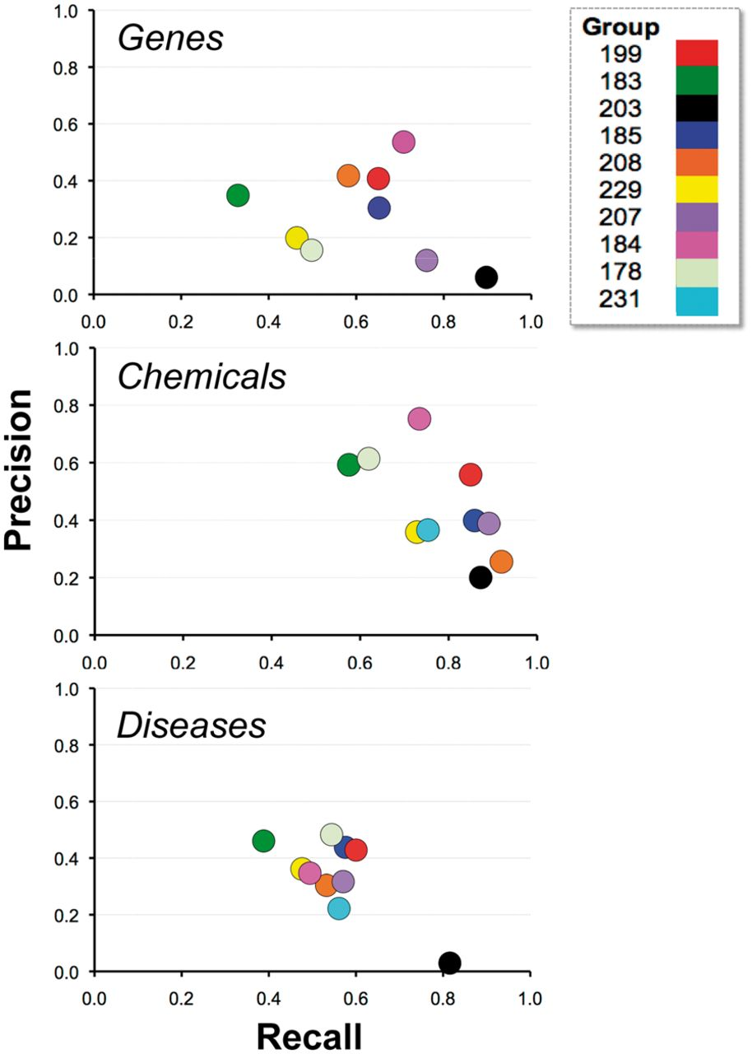
Figure 10. Recall and precision. Combined average recall (x-axis) and precision (y-axis) results are shown for each ...
Notes:
Figure 10. Recall and precision. Combined average recall (x-axis) and precision (y-axis) results are shown for each participating group (color-coded by group number) within major NER category. For some groups there appeared to be a clear trade-off between recall and precision (e.g. 203), whereas for other groups trade-offs were less apparent (e.g. 184 and 199).
Unless provided in the caption above, the following copyright applies to the content of this slide: © The Author(s) 2014. Published by Oxford University Press.This is an Open Access article distributed under the terms of the Creative Commons Attribution License (http://creativecommons.org/licenses/by/3.0/), which permits unrestricted reuse, distribution, and reproduction in any medium, provided the original work is properly cited.

Slide 11
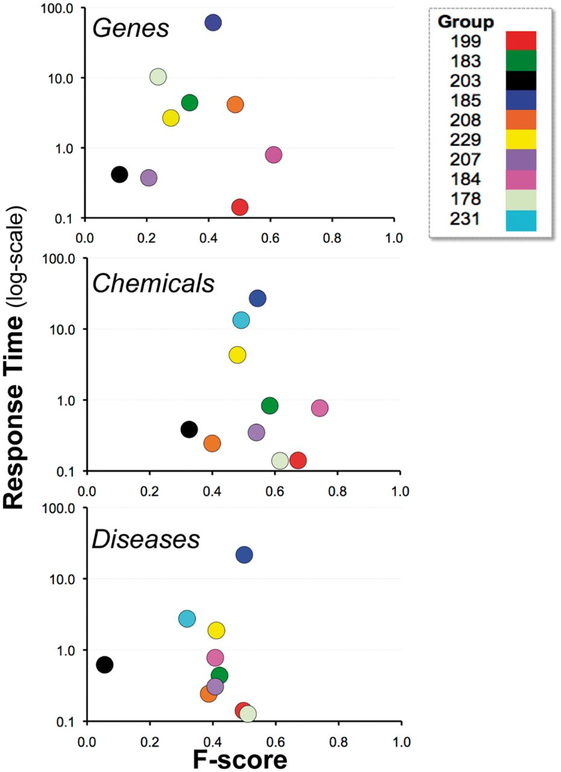
Figure 11. Balanced F-score and response time. Combined average balanced F-score (x-axis) and response time (y-axis) ...
Notes:
Figure 11. Balanced F-score and response time. Combined average balanced F-score (x-axis) and response time (y-axis) results are shown for each participating group (color-coded by group number) within major NER category. There was no clear relationship between response time and F-score. Note : the response time in seconds (y-axis) uses a logarithmic scale.
Unless provided in the caption above, the following copyright applies to the content of this slide: © The Author(s) 2014. Published by Oxford University Press.This is an Open Access article distributed under the terms of the Creative Commons Attribution License (http://creativecommons.org/licenses/by/3.0/), which permits unrestricted reuse, distribution, and reproduction in any medium, provided the original work is properly cited.

