Slide 1
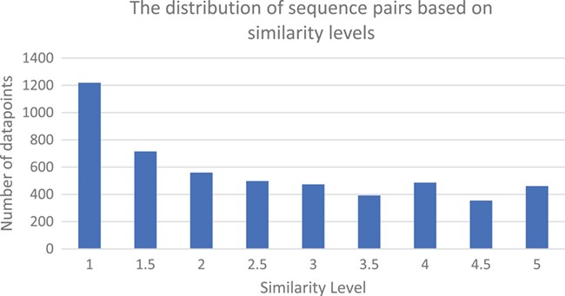
Figure 2 The similarity levels distribution of the judged pairs of sentences in the CDD sentence similarity dataset.
Notes:
Figure 2 The similarity levels distribution of the judged pairs of sentences in the CDD sentence similarity dataset.
Unless provided in the caption above, the following copyright applies to the content of this slide: Published by Oxford University Press 2019.This work is written by US Government employees and is in the public domain in the US.

