Slide 1
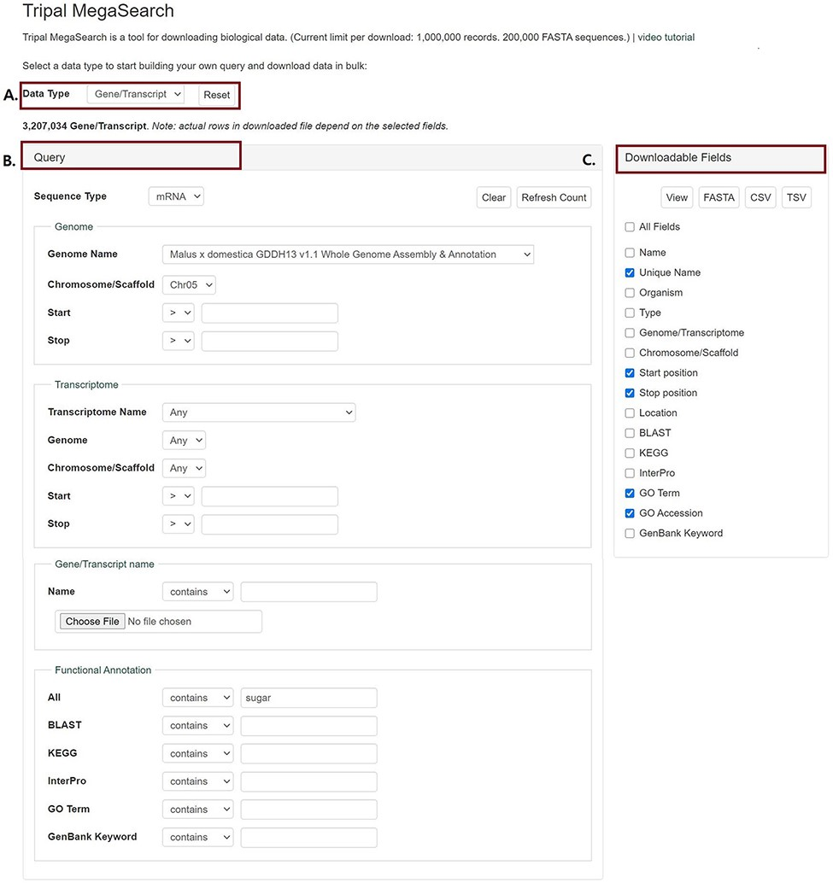
Figure 1. An example interface of complex static forms of Tripal MegaSearch (A). Data Type section where users can ...
Notes:
Figure 1. An example interface of complex static forms of Tripal MegaSearch (A). Data Type section where users can choose data type (B). Query section that provides a query form that allows users to perform complex queries using various metadata as filters (C). Downloadable Fields section where users can choose data fields to view and download.
Unless provided in the caption above, the following copyright applies to the content of this slide: © The Author(s) 2021. Published by Oxford University Press.This is an Open Access article distributed under the terms of the Creative Commons Attribution License (http://creativecommons.org/licenses/by/4.0/), which permits unrestricted reuse, distribution, and reproduction in any medium, provided the original work is properly cited.

Slide 2
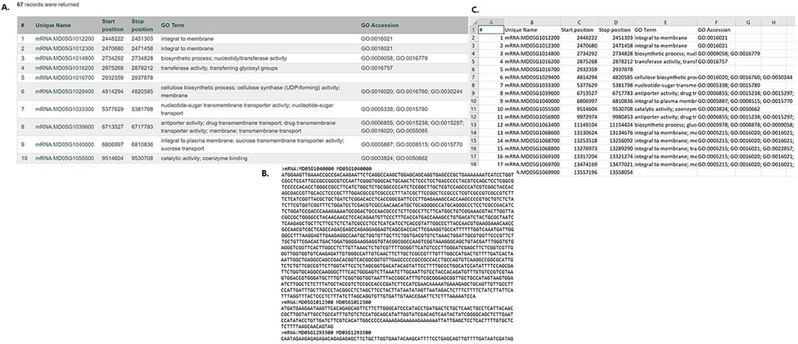
Figure 2. Examples of result table and downloaded files from MegaSearch (A). A result table with the chosen data fields ...
Notes:
Figure 2. Examples of result table and downloaded files from MegaSearch (A). A result table with the chosen data fields is displayed with hyperlinks to appropriate pages such as JBrowse and gene/transcript page (B). A downloaded FASTA file for the data types with sequences, such as gene/transcript and marker (C). A CSV file that with the chosen data fields.
Unless provided in the caption above, the following copyright applies to the content of this slide: © The Author(s) 2021. Published by Oxford University Press.This is an Open Access article distributed under the terms of the Creative Commons Attribution License (http://creativecommons.org/licenses/by/4.0/), which permits unrestricted reuse, distribution, and reproduction in any medium, provided the original work is properly cited.

Slide 3
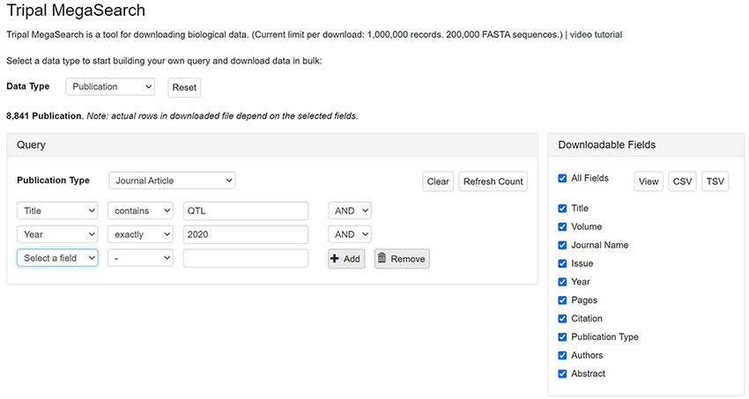
Figure 3. An example interface of flexible dynamic query forms of Tripal MegaSearch. The filters, pre-populated with ...
Notes:
Figure 3. An example interface of flexible dynamic query forms of Tripal MegaSearch. The filters, pre-populated with values mapped to the underlying data source columns, can be added dynamically in this type of interface.
Unless provided in the caption above, the following copyright applies to the content of this slide: © The Author(s) 2021. Published by Oxford University Press.This is an Open Access article distributed under the terms of the Creative Commons Attribution License (http://creativecommons.org/licenses/by/4.0/), which permits unrestricted reuse, distribution, and reproduction in any medium, provided the original work is properly cited.

Slide 4
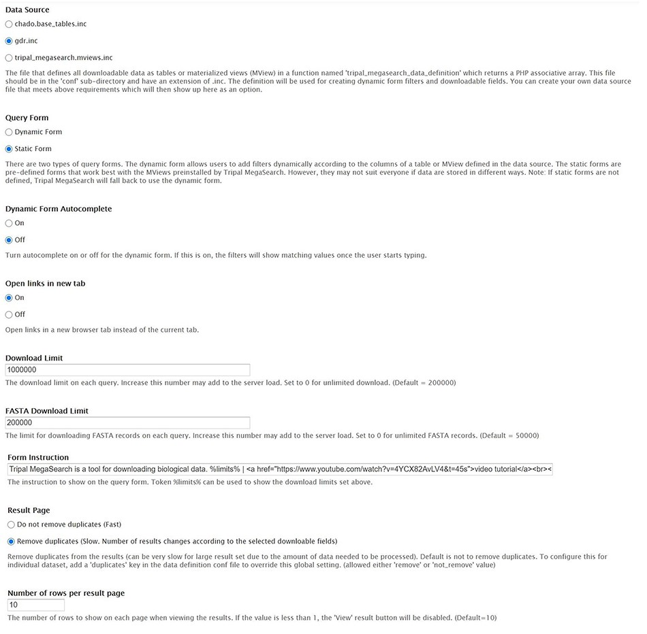
Figure 4. The Tripal MegaSearch Administration page that supports configuration of various settings.
Notes:
Figure 4. The Tripal MegaSearch Administration page that supports configuration of various settings.
Unless provided in the caption above, the following copyright applies to the content of this slide: © The Author(s) 2021. Published by Oxford University Press.This is an Open Access article distributed under the terms of the Creative Commons Attribution License (http://creativecommons.org/licenses/by/4.0/), which permits unrestricted reuse, distribution, and reproduction in any medium, provided the original work is properly cited.

