Slide 1
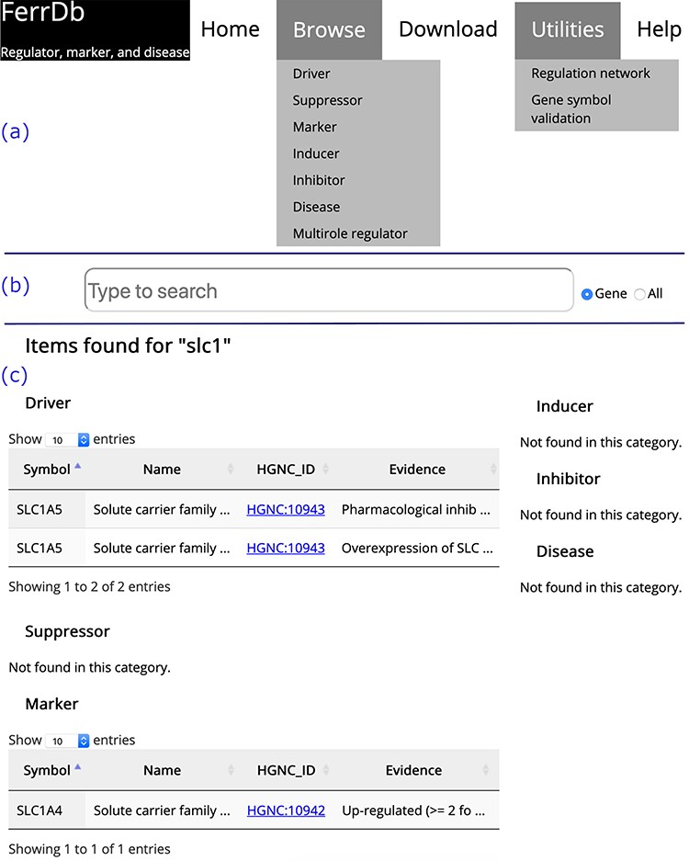
Figure 2 Overview of the FerrDb interface. (a) Navigation bar. (b) Search box. (c) Results of an example search. ...
Notes:
Figure 2 Overview of the FerrDb interface. (a) Navigation bar. (b) Search box. (c) Results of an example search. Tables in (c) are truncated.
Unless provided in the caption above, the following copyright applies to the content of this slide: © The Author(s) 2020. Published by Oxford University Press.This is an Open Access article distributed under the terms of the Creative Commons Attribution License (http://creativecommons.org/licenses/by/4.0/), which permits unrestricted reuse, distribution, and reproduction in any medium, provided the original work is properly cited.

