Slide 1
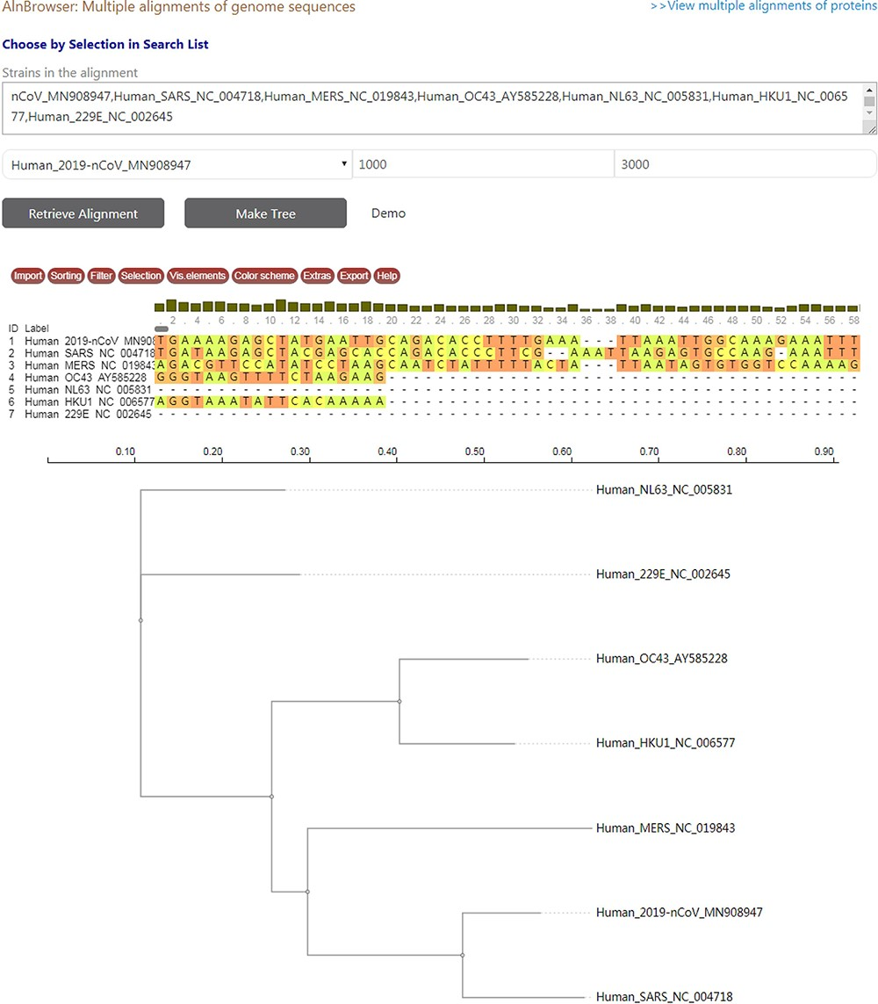
Figure 3. A snapshot displaying the usage of ‘Aln Browser’, where users need to select the reference strain, the start ...
Notes:
Figure 3. A snapshot displaying the usage of ‘Aln Browser’, where users need to select the reference strain, the start position, the end position and the strains to be put in alignment. If clicking on the button ‘Retrieve Alignment’, a multiple alignment of selected strains will be shown below. If clicking on ‘Make Tree’, a phylogenetic tree will be built basing on the alignment and shown at the bottom.
Unless provided in the caption above, the following copyright applies to the content of this slide: © The Author(s) 2020. Published by Oxford University Press.This is an Open Access article distributed under the terms of the Creative Commons Attribution License (http://creativecommons.org/licenses/by/4.0/), which permits unrestricted reuse, distribution, and reproduction in any medium, provided the original work is properly cited.

