Slide 1
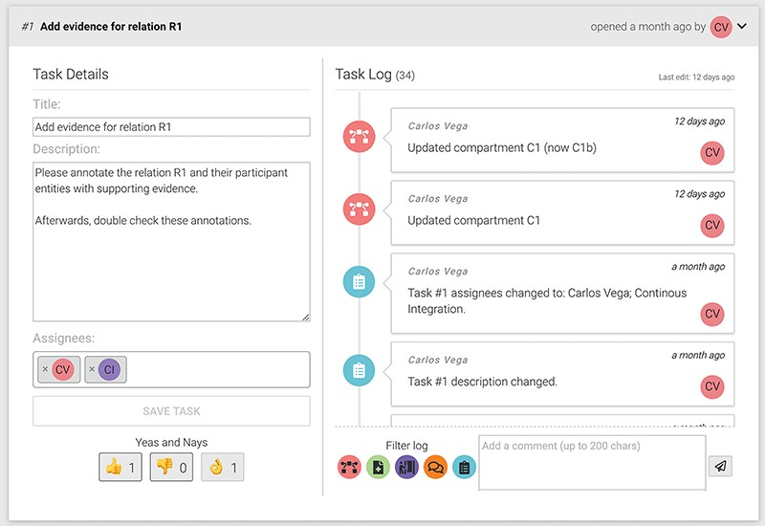
Figure 5. An example of a task showing the title, description, assigned users and cast votes on the left. The right ...
Notes:
Figure 5. An example of a task showing the title, description, assigned users and cast votes on the left. The right side shows the task log and the comment input box.
Unless provided in the caption above, the following copyright applies to the content of this slide: © The Author(s) 2024. Published by Oxford University Press.This is an Open Access article distributed under the terms of the Creative Commons Attribution License (https://creativecommons.org/licenses/by/4.0/), which permits unrestricted reuse, distribution, and reproduction in any medium, provided the original work is properly cited.

