Slide 1
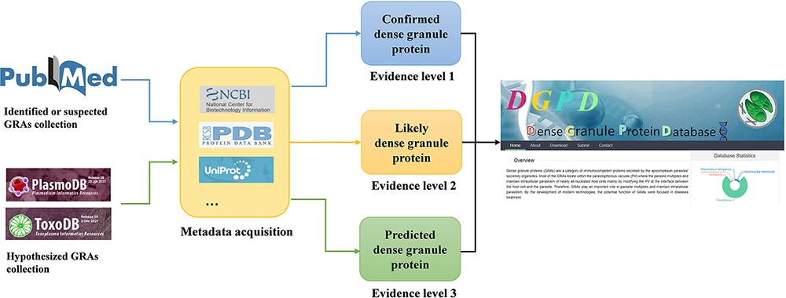
Figure 1. Workflow for data curation in DGPD database. Experimentally validated GRAs are classified as the group of ...
Notes:
Figure 1. Workflow for data curation in DGPD database. Experimentally validated GRAs are classified as the group of ‘confirmed GRAs’ (with blue arrows). Highly suspected GRAs existing in the main text or attachment of literature are included in the group of ‘likely GRAs’ (with orange arrows). Homologous proteins of known dense granule proteins in PlasmoDB and ToxoDB database are included in the group of ‘predicted GRAs’ (with green arrows).
Unless provided in the caption above, the following copyright applies to the content of this slide: © The Author(s) 2022. Published by Oxford University Press.This is an Open Access article distributed under the terms of the Creative Commons Attribution-NonCommercial License (https://creativecommons.org/licenses/by-nc/4.0/), which permits non-commercial re-use, distribution, and reproduction in any medium, provided the original work is properly cited. For commercial re-use, please contact journals.permissions@oup.com

