Slide 1
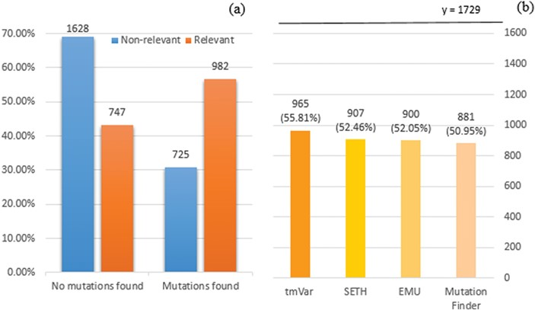
Figure 1 (a) Distribution of documents having a mutation identified by at least one of four mutation detection tools. ...
Notes:
Figure 1 (a) Distribution of documents having a mutation identified by at least one of four mutation detection tools. Relevant: documents labelled as relevant for PPIm in the training set, otherwise non-relevant. Mutations found: documents have a mutation mention identified by at least one of the tools, otherwise no mutations found. The y-axis corresponds to the proportion relative to the relevant or non-relevant document collections, respectively. For instance, almost 70% of non-relevant documents (1628 out of 2353) have no detected mutation mentions. (b) Distribution of relevant documents having mutations identified by individual tools; y = 1729 is the total number of relevant documents, in which we would expect to have at least one mutation mentioned per task definition.
Unless provided in the caption above, the following copyright applies to the content of this slide: © The Author(s) 2018. Published by Oxford University Press.This is an Open Access article distributed under the terms of the Creative Commons Attribution License (http://creativecommons.org/licenses/by/4.0/), which permits unrestricted reuse, distribution, and reproduction in any medium, provided the original work is properly cited.

Slide 2
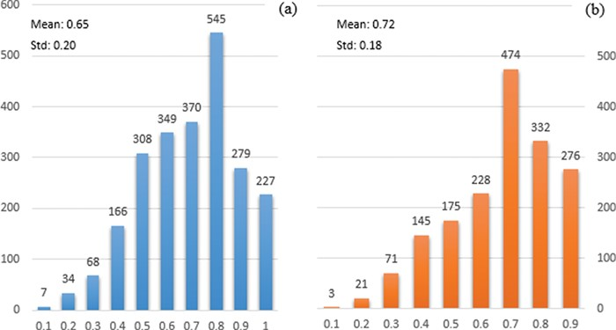
Figure 2 Distribution of the probability of documents having interactions identified by PIE the search. The x-axis ...
Notes:
Figure 2 Distribution of the probability of documents having interactions identified by PIE the search. The x-axis displays the probability score output by PIE the search (normalized to [0, 1]); a higher score indicates higher probability of having interaction. The y-axis reflects the number of documents. (a) and (b) represent the distribution for non-relevant (blue) and relevant documents (orange), respectively.
Unless provided in the caption above, the following copyright applies to the content of this slide: © The Author(s) 2018. Published by Oxford University Press.This is an Open Access article distributed under the terms of the Creative Commons Attribution License (http://creativecommons.org/licenses/by/4.0/), which permits unrestricted reuse, distribution, and reproduction in any medium, provided the original work is properly cited.

Slide 3
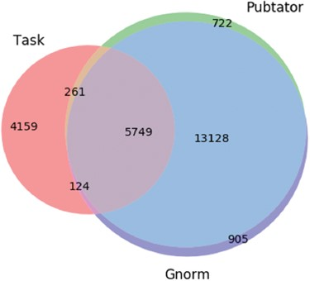
Figure 3 Venn diagram showing the differences in the gene entity annotations over the PPIm dataset. An entity ...
Notes:
Figure 3 Venn diagram showing the differences in the gene entity annotations over the PPIm dataset. An entity annotation is regarded as a triple (document id, character span, entity id). The three sets are the set of annotations given in the task dataset (Task) and from the two entity annotators namely Pubtator and GNormPlus (GNorm).
Unless provided in the caption above, the following copyright applies to the content of this slide: © The Author(s) 2018. Published by Oxford University Press.This is an Open Access article distributed under the terms of the Creative Commons Attribution License (http://creativecommons.org/licenses/by/4.0/), which permits unrestricted reuse, distribution, and reproduction in any medium, provided the original work is properly cited.

Slide 4
Algorithm 1 The algorithm measures the 'impact' of a sentence. If there is a co-occurrence relationship, identified ...
Notes:
Algorithm 1 The algorithm measures the 'impact' of a sentence. If there is a co-occurrence relationship, identified either using intersection, union or complement as mentioned in Counting-based category, it firstly calculates the mutation and interaction scores by summing the total mentions and normalising to [0, 1]. Then it calculates the impact score based on the weight of mutation and interaction scores (α and β). The default weights are 0.5, meaning that mutations and interactions are equally important.
Unless provided in the caption above, the following copyright applies to the content of this slide: © The Author(s) 2018. Published by Oxford University Press.This is an Open Access article distributed under the terms of the Creative Commons Attribution License (http://creativecommons.org/licenses/by/4.0/), which permits unrestricted reuse, distribution, and reproduction in any medium, provided the original work is properly cited.

Slide 5
Figure 4 Illustration of the (partial) dependency graph for the sentence `This result indicates that LAF1 and HFR1 ...
Notes:
Figure 4 Illustration of the (partial) dependency graph for the sentence `This result indicates that LAF1 and HFR1 function in largely independent pathways’. The entities (genes) are shown in blue.
Unless provided in the caption above, the following copyright applies to the content of this slide: © The Author(s) 2018. Published by Oxford University Press.This is an Open Access article distributed under the terms of the Creative Commons Attribution License (http://creativecommons.org/licenses/by/4.0/), which permits unrestricted reuse, distribution, and reproduction in any medium, provided the original work is properly cited.

Slide 6
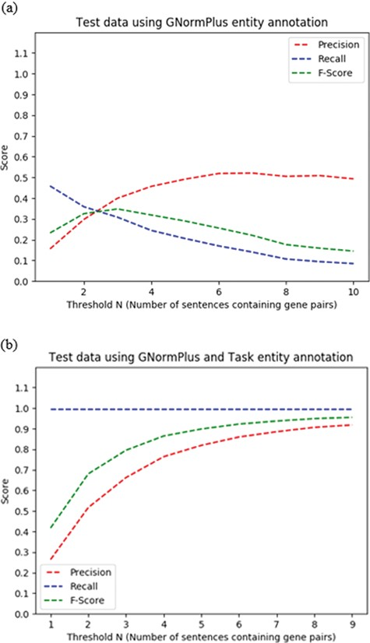
Figure 5 Impact of choice of threshold N = number of sentences containing a given protein pair on performance of ...
Notes:
Figure 5 Impact of choice of threshold N = number of sentences containing a given protein pair on performance of heuristic co-occurrence approach on the test data set, for (a) automated protein/gene named entity recognition and (b) oracle protein named entity recognition scenarios.
Unless provided in the caption above, the following copyright applies to the content of this slide: © The Author(s) 2018. Published by Oxford University Press.This is an Open Access article distributed under the terms of the Creative Commons Attribution License (http://creativecommons.org/licenses/by/4.0/), which permits unrestricted reuse, distribution, and reproduction in any medium, provided the original work is properly cited.

Slide 7
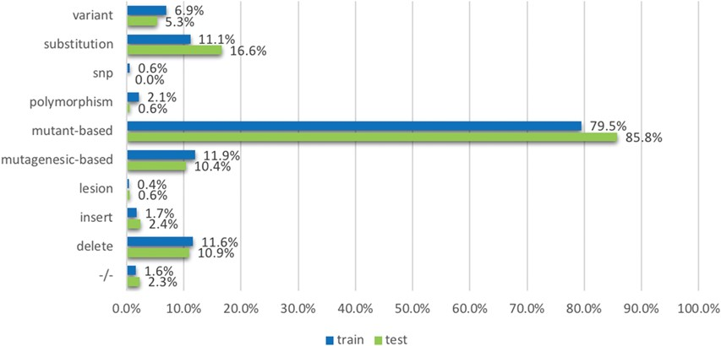
Figure 6 The proportion of relevant documents containing individual mutation terms, across training and testing data ...
Notes:
Figure 6 The proportion of relevant documents containing individual mutation terms, across training and testing data sets. The terms (or the groups of terms) are mentioned in the model development section.
Unless provided in the caption above, the following copyright applies to the content of this slide: © The Author(s) 2018. Published by Oxford University Press.This is an Open Access article distributed under the terms of the Creative Commons Attribution License (http://creativecommons.org/licenses/by/4.0/), which permits unrestricted reuse, distribution, and reproduction in any medium, provided the original work is properly cited.

Slide 8
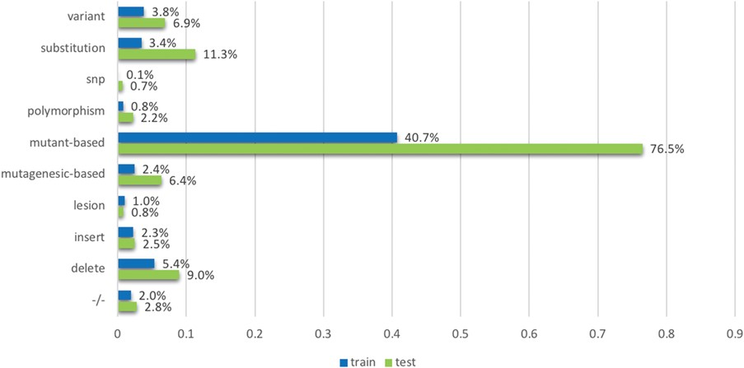
Figure 7 The proportion of non-relevant documents containing individual mutation terms, across training and testing ...
Notes:
Figure 7 The proportion of non-relevant documents containing individual mutation terms, across training and testing data sets. The terms (or the groups of terms) are mentioned in the model development section.
Unless provided in the caption above, the following copyright applies to the content of this slide: © The Author(s) 2018. Published by Oxford University Press.This is an Open Access article distributed under the terms of the Creative Commons Attribution License (http://creativecommons.org/licenses/by/4.0/), which permits unrestricted reuse, distribution, and reproduction in any medium, provided the original work is properly cited.

Slide 9
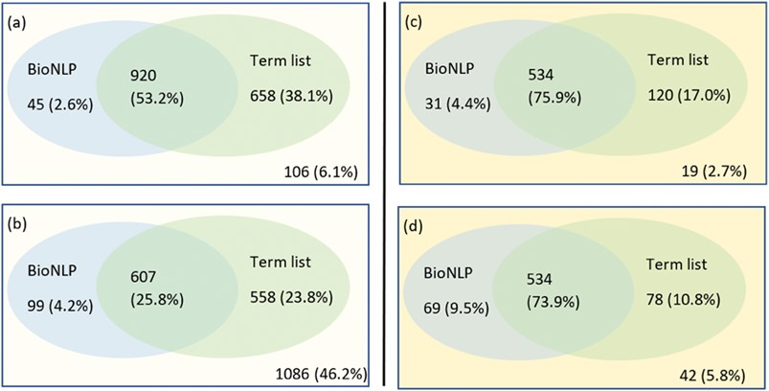
Figure 8 A Venn representation on number of documents have been identified having mutations using a combination of ...
Notes:
Figure 8 A Venn representation on number of documents have been identified having mutations using a combination of BioNLP tools and term lists. The left side shows the results on the training set: (a) for relevant documents and (b) for non-relevant documents; the right side (c) and (d) shows the results for relevant documents and non-relevant documents respectively in the testing set.
Unless provided in the caption above, the following copyright applies to the content of this slide: © The Author(s) 2018. Published by Oxford University Press.This is an Open Access article distributed under the terms of the Creative Commons Attribution License (http://creativecommons.org/licenses/by/4.0/), which permits unrestricted reuse, distribution, and reproduction in any medium, provided the original work is properly cited.

Slide 10
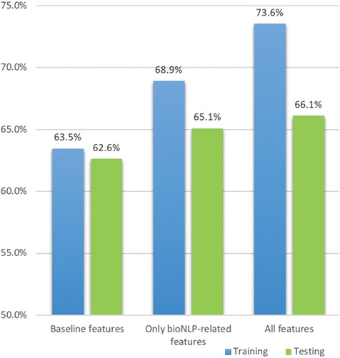
Figure 9 Comparative F1 scores for boosting logistic regression over the training and testing sets. The legend shows ...
Notes:
Figure 9 Comparative F1 scores for boosting logistic regression over the training and testing sets. The legend shows the features used in the training set and the corresponding columns are presented in the testing set.
Unless provided in the caption above, the following copyright applies to the content of this slide: © The Author(s) 2018. Published by Oxford University Press.This is an Open Access article distributed under the terms of the Creative Commons Attribution License (http://creativecommons.org/licenses/by/4.0/), which permits unrestricted reuse, distribution, and reproduction in any medium, provided the original work is properly cited.

