Slide 1
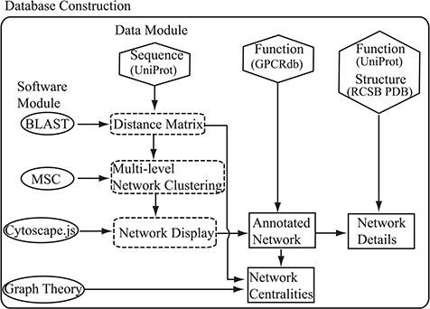
Figure 1 Flowchart of the construction of the SeQuery. Hexagons denote the source databases, and ovals denote ...
Notes:
Figure 1 Flowchart of the construction of the SeQuery. Hexagons denote the source databases, and ovals denote computational methods. Intermediate data derived during computation is represented by dashed squares, while the generated graphs for visualization are represented by solid squares.
Unless provided in the caption above, the following copyright applies to the content of this slide: © The Author(s) 2019. Published by Oxford University Press.This is an Open Access article distributed under the terms of the Creative Commons Attribution License (http://creativecommons.org/licenses/by/4.0/), which permits unrestricted reuse, distribution, and reproduction in any medium, provided the original work is properly cited.

Slide 2
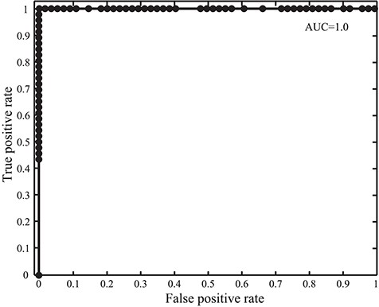
Figure 2 Receiver operating characteristic and AUC in the GPCR detection with SeQuery for the 100 tested protein ...
Notes:
Figure 2 Receiver operating characteristic and AUC in the GPCR detection with SeQuery for the 100 tested protein sequences.
Unless provided in the caption above, the following copyright applies to the content of this slide: © The Author(s) 2019. Published by Oxford University Press.This is an Open Access article distributed under the terms of the Creative Commons Attribution License (http://creativecommons.org/licenses/by/4.0/), which permits unrestricted reuse, distribution, and reproduction in any medium, provided the original work is properly cited.

Slide 3
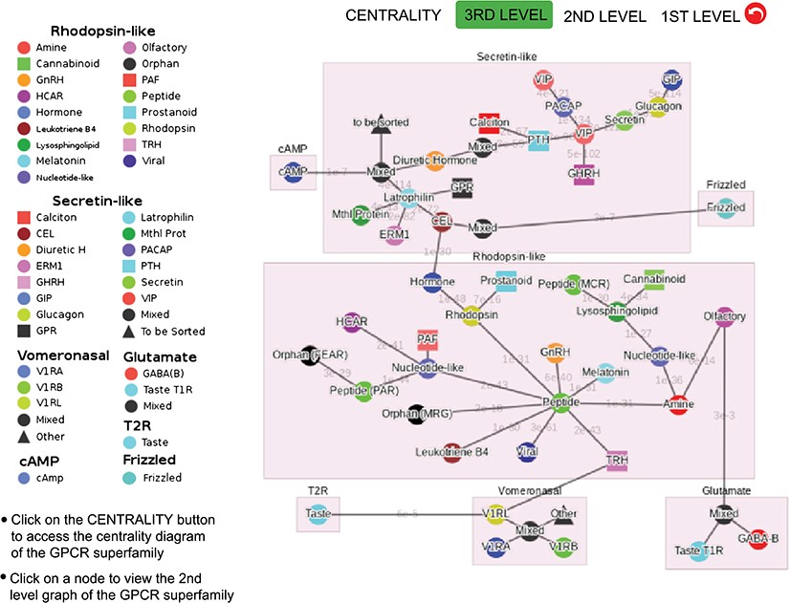
Figure 3 Third-level minimum spanning tree diagram of the GPCR superfamily with the base dataset. Each node represents ...
Notes:
Figure 3 Third-level minimum spanning tree diagram of the GPCR superfamily with the base dataset. Each node represents a GPCR family. The legend shows the scheme of nodes’ colors and shapes that is used to distinguish GPCR functions annotated in GPCRdb (also labeled on the nodes).
Unless provided in the caption above, the following copyright applies to the content of this slide: © The Author(s) 2019. Published by Oxford University Press.This is an Open Access article distributed under the terms of the Creative Commons Attribution License (http://creativecommons.org/licenses/by/4.0/), which permits unrestricted reuse, distribution, and reproduction in any medium, provided the original work is properly cited.

Slide 4
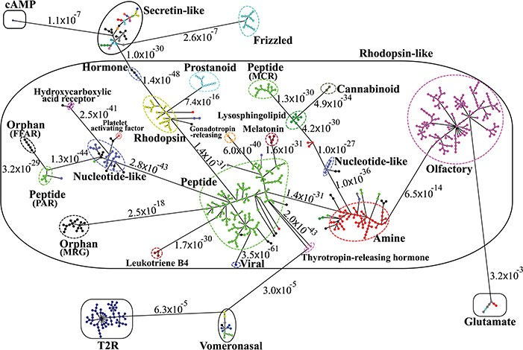
Figure 4 Minimum spanning tree diagram of the GPCR network in the dataset GPCR2841 (outliers not shown). Each circle ...
Notes:
Figure 4 Minimum spanning tree diagram of the GPCR network in the dataset GPCR2841 (outliers not shown). Each circle represents an MSC cluster, which is colored according to the functions of its constituents. The lengths of the edges are not proportional to their distances, but the distances between subfamilies and classes are labeled to visualize their sequence similarities.
Unless provided in the caption above, the following copyright applies to the content of this slide: © The Author(s) 2019. Published by Oxford University Press.This is an Open Access article distributed under the terms of the Creative Commons Attribution License (http://creativecommons.org/licenses/by/4.0/), which permits unrestricted reuse, distribution, and reproduction in any medium, provided the original work is properly cited.

Slide 5
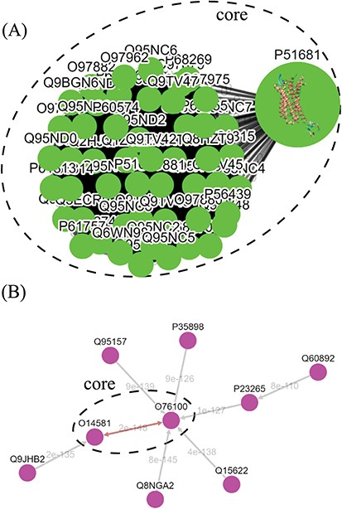
Figure 5 Tree diagrams of the first-level GPCR clusters, showing member sequences of cluster Pe001, which has a ...
Notes:
Figure 5 Tree diagrams of the first-level GPCR clusters, showing member sequences of cluster Pe001, which has a conservative core (A); and member sequences of cluster Ol001, which has no conservative core (B). In (A), the 3D protein structure of P51681 is displayed in its node, and a line segment is used to represent a zero-distance edge connecting two nodes in the core. In (B), a double-headed arrow is used to represent the shortest edge connecting two nodes in the core, and a single-headed arrow (directed toward the node closer to the core) is used to represent all other edges connecting two nodes in the cluster. Each edge is labeled with its length.
Unless provided in the caption above, the following copyright applies to the content of this slide: © The Author(s) 2019. Published by Oxford University Press.This is an Open Access article distributed under the terms of the Creative Commons Attribution License (http://creativecommons.org/licenses/by/4.0/), which permits unrestricted reuse, distribution, and reproduction in any medium, provided the original work is properly cited.

Slide 6
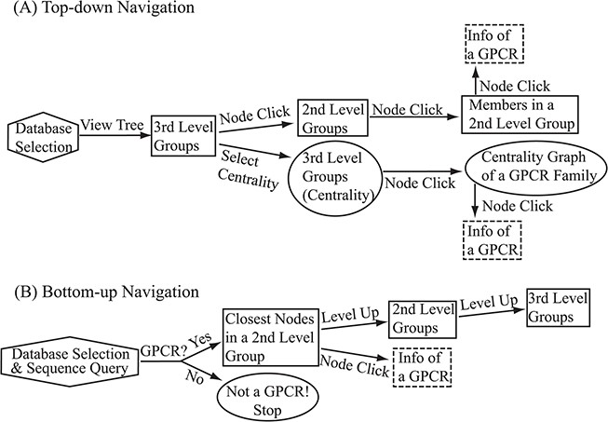
Figure 6 Flowchart of the two navigation interfaces of the SeQuery database, including the top-down navigation scheme ...
Notes:
Figure 6 Flowchart of the two navigation interfaces of the SeQuery database, including the top-down navigation scheme (A) and the bottom-up navigation scheme (B). Source databases are represented by hexagons. In the top-down and bottom-up interface designs, we use solid squares to represent generated MSC graphs and ovals to represent alternative centrality graphs or warnings of detected non-GPCR. Dashed squares represent modal boxes providing information about a GPCR sequence when its corresponding node is clicked.
Unless provided in the caption above, the following copyright applies to the content of this slide: © The Author(s) 2019. Published by Oxford University Press.This is an Open Access article distributed under the terms of the Creative Commons Attribution License (http://creativecommons.org/licenses/by/4.0/), which permits unrestricted reuse, distribution, and reproduction in any medium, provided the original work is properly cited.

Slide 7
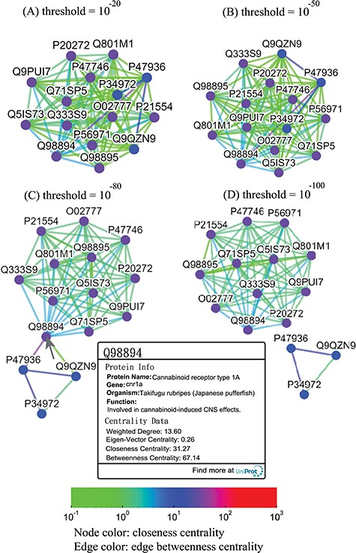
Figure 7 Thresholded sequence similarity network graphs of the cannabinoid receptor family with threshold distances of ...
Notes:
Figure 7 Thresholded sequence similarity network graphs of the cannabinoid receptor family with threshold distances of 10−20 (A), 10−50 (B), 10−80 (C) and 10−100 (D). Nodes and edges are colored by the values of their closeness and betweenness centralities, respectively, according to the legend. Upon clicking on a node such as Q98894, the user is presented with a modal box showing both the protein information and the centrality data of the node.
Unless provided in the caption above, the following copyright applies to the content of this slide: © The Author(s) 2019. Published by Oxford University Press.This is an Open Access article distributed under the terms of the Creative Commons Attribution License (http://creativecommons.org/licenses/by/4.0/), which permits unrestricted reuse, distribution, and reproduction in any medium, provided the original work is properly cited.

Slide 8
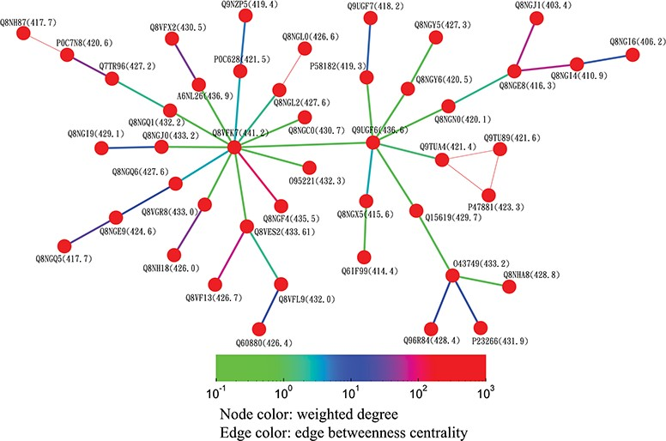
Figure 8 Partial minimum spanning tree of olfactory receptors near the hub sequence Q8VFK7. Nodes are colored based on ...
Notes:
Figure 8 Partial minimum spanning tree of olfactory receptors near the hub sequence Q8VFK7. Nodes are colored based on their closeness centrality values, which are also labeled in parentheses. Edges are colored based on their betweenness centrality values. Thin edges in the graph represent zero-distance sequence pairs.
Unless provided in the caption above, the following copyright applies to the content of this slide: © The Author(s) 2019. Published by Oxford University Press.This is an Open Access article distributed under the terms of the Creative Commons Attribution License (http://creativecommons.org/licenses/by/4.0/), which permits unrestricted reuse, distribution, and reproduction in any medium, provided the original work is properly cited.

Slide 9
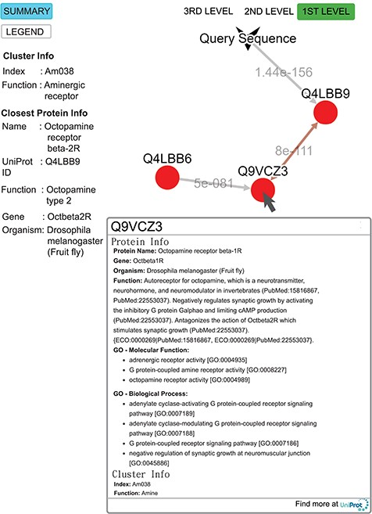
Figure 9 Query result for the submitted sequence G3M4F8 in SeQuery, showing the first-level cluster graph. Information ...
Notes:
Figure 9 Query result for the submitted sequence G3M4F8 in SeQuery, showing the first-level cluster graph. Information about both the cluster and the closest proteins are shown on the left-hand side. Upon clicking on a node such as Q9VCZ3, the user is presented with a modal box showing both the protein information and the cluster information of the node. A double-headed arrow is used to represent the shortest edge connecting two nodes in the core, and a single-headed arrow (directed toward the node closer to the core) is used to represent all other edges connecting two nodes in the cluster. The edge connecting the query sequence to its closest adjacent sequence is also represented by a single-headed arrow. Each edge is labeled with its length.
Unless provided in the caption above, the following copyright applies to the content of this slide: © The Author(s) 2019. Published by Oxford University Press.This is an Open Access article distributed under the terms of the Creative Commons Attribution License (http://creativecommons.org/licenses/by/4.0/), which permits unrestricted reuse, distribution, and reproduction in any medium, provided the original work is properly cited.

