Slide 1
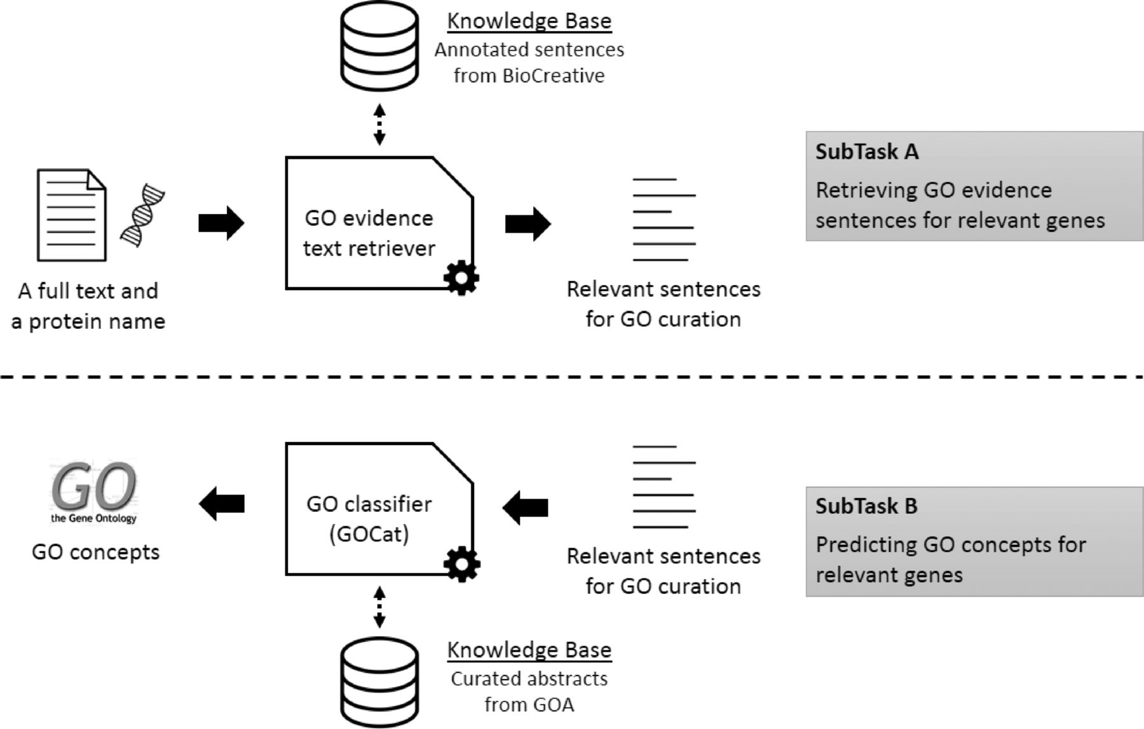
Figure 1. Overall workflow of the BiTeM/SIBtex system for BioCreative IV GO task. First (subtask A ), given a full ...
Notes:
Figure 1. Overall workflow of the BiTeM/SIBtex system for BioCreative IV GO task. First (subtask A ), given a full text and a protein name, the system extracts relevant sentences for GO curation. Then (subtask B ), given these relevant sentences, the system predicts relevant GO concepts for curation. For both subtasks, the system uses machine learning, thanks to KB designed from the BioCreative training data and GOA.
Unless provided in the caption above, the following copyright applies to the content of this slide: © The Author(s) 2014. Published by Oxford University Press.This is an Open Access article distributed under the terms of the Creative Commons Attribution License (http://creativecommons.org/licenses/by/4.0/), which permits unrestricted reuse, distribution, and reproduction in any medium, provided the original work is properly cited.

