Slide 1
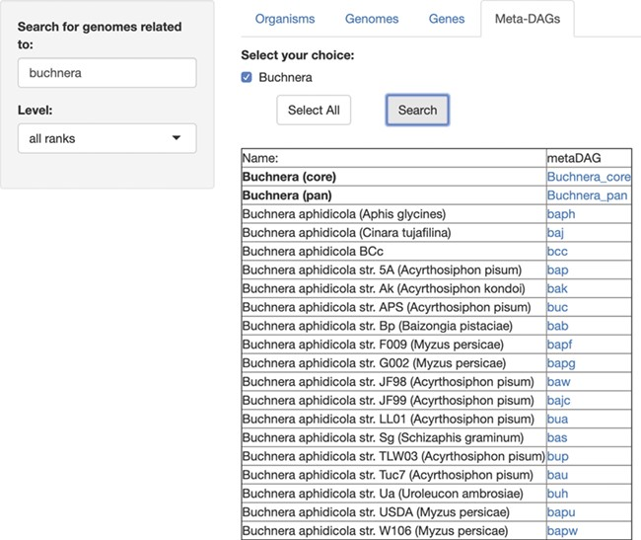
Figure 4 SymGenDB’s new MetaDAGs module. In this example, we search for the symbionts of the genus ‘Buchnera’. The ...
Notes:
Figure 4 SymGenDB’s new MetaDAGs module. In this example, we search for the symbionts of the genus ‘Buchnera’. The output is a list of organisms as bacterial strains, as well as the joint (pan) or intersecting (core) metabolism of the strains resulted in the search, included in the taxonomic level ‘genus’ (in bold). It is important to denote that in the case of the ‘pan’ and ‘core’ interacting metabolism, not only the genomes of the bacterial strains resulting from the search are presented. The complete set of strains of the same genus available in SymGenDB constitutes these MetaDAGs.
Unless provided in the caption above, the following copyright applies to the content of this slide: © The Author(s) 2020. Published by Oxford University Press.This is an Open Access article distributed under the terms of the Creative Commons Attribution License (http://creativecommons.org/licenses/by/4.0/), which permits unrestricted reuse, distribution, and reproduction in any medium, provided the original work is properly cited.

