Slide 1
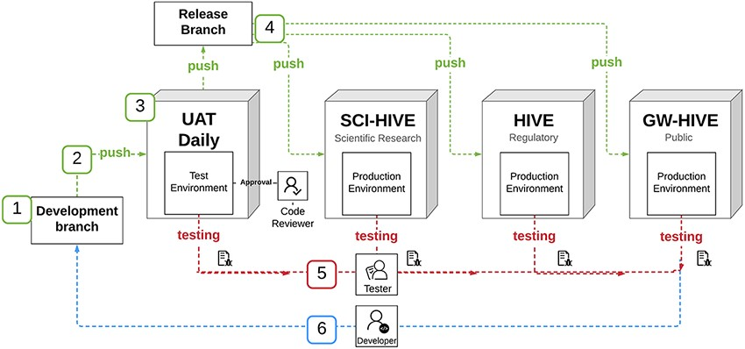
Figure 1. HIVE BCO App deployment diagram.
Notes:
Figure 1. HIVE BCO App deployment diagram. Once the (1) HIVE BCO App was developed in the development branch, (2) the code was then pushed from development branch to testing environment. (3) The code was tested in the User Acceptance Testing (UAT) Daily environment, and (4) once approved, code was pushed out to production environments (FDA-SCI-HIVE, FDA-HIVE and Public-HIVE which are different HIVE installations at FDA and GW). (5) New code was tested and verified on each environment, with the tester submitting a report to the developer, who (6) addresses bugs in the development branch.
Unless provided in the caption above, the following copyright applies to the content of this slide: © Oxford University Press 2021.This is an Open Access article distributed under the terms of the Creative Commons Attribution License (http://creativecommons.org/licenses/by/4.0/), which permits unrestricted reuse, distribution, and reproduction in any medium, provided the original work is properly cited.

