Slide 1
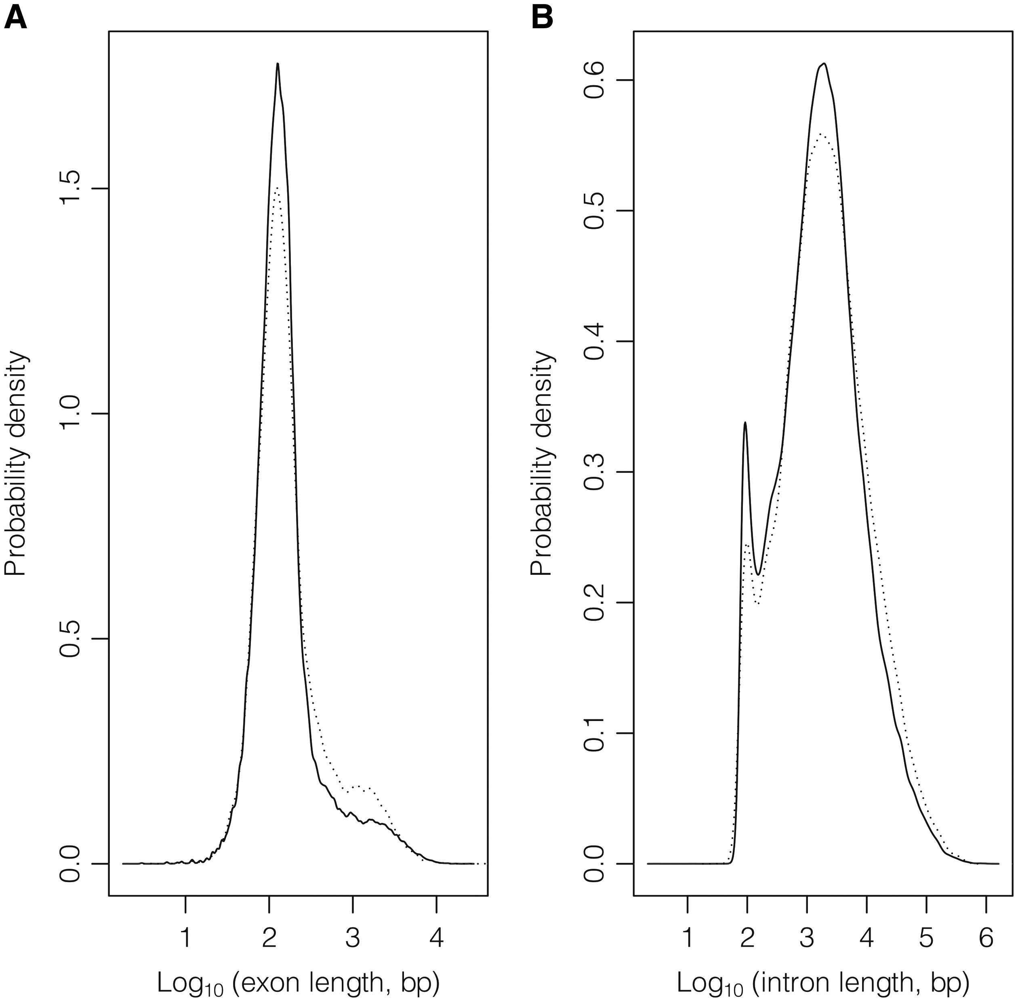
Figure 3. Exon (A) and intron (B) length distributions considering GeneBase 1.1 Human ‘Gene_Table’ records with a ...
Notes:
Figure 3. Exon (A) and intron (B) length distributions considering GeneBase 1.1 Human ‘Gene_Table’ records with a ‘VALIDATED’ or ‘REVIEWED’ RefSeq status, with an ‘NM_’ (protein-coding RNAs, continuous lines) or ‘NR_’ (non-coding RNAs, dotted lines) type of corresponding RefSeq RNA accession number, belonging to ‘REVIEWED’ or ‘VALIDATED’ genes excluding those not in current annotation release.
Unless provided in the caption above, the following copyright applies to the content of this slide: © The Author(s) 2016. Published by Oxford University Press.This is an Open Access article distributed under the terms of the Creative Commons Attribution License (http://creativecommons.org/licenses/by/4.0/), which permits unrestricted reuse, distribution, and reproduction in any medium, provided the original work is properly cited.

