Slide 1
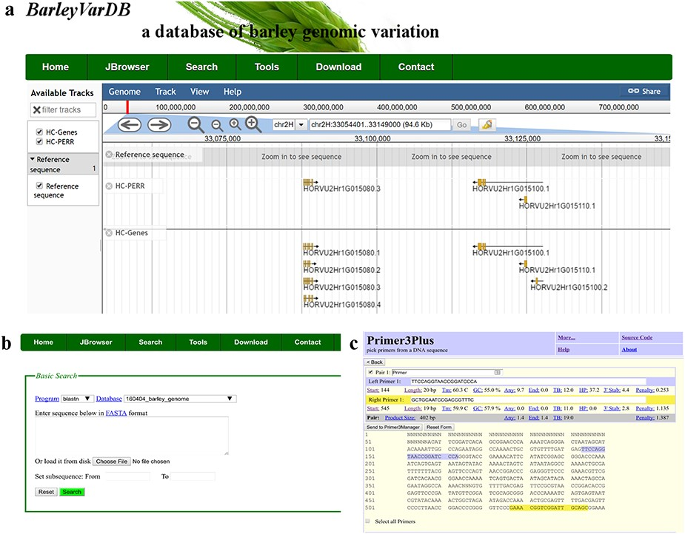
Figure 3. Examples of software applications in BarleyVarDB. (a) Example of gene annotations of barley genome reference ...
Notes:
Figure 3. Examples of software applications in BarleyVarDB. (a) Example of gene annotations of barley genome reference displayed in JBrowse. (b) Search interface of barley reference genome blast server. (c) Example of primer designs in barley using primer3plus.
Unless provided in the caption above, the following copyright applies to the content of this slide: © The Author(s) 2020. Published by Oxford University Press.This is an Open Access article distributed under the terms of the Creative Commons Attribution License (http://creativecommons.org/licenses/by/4.0/), which permits unrestricted reuse, distribution, and reproduction in any medium, provided the original work is properly cited.

