Slide 1
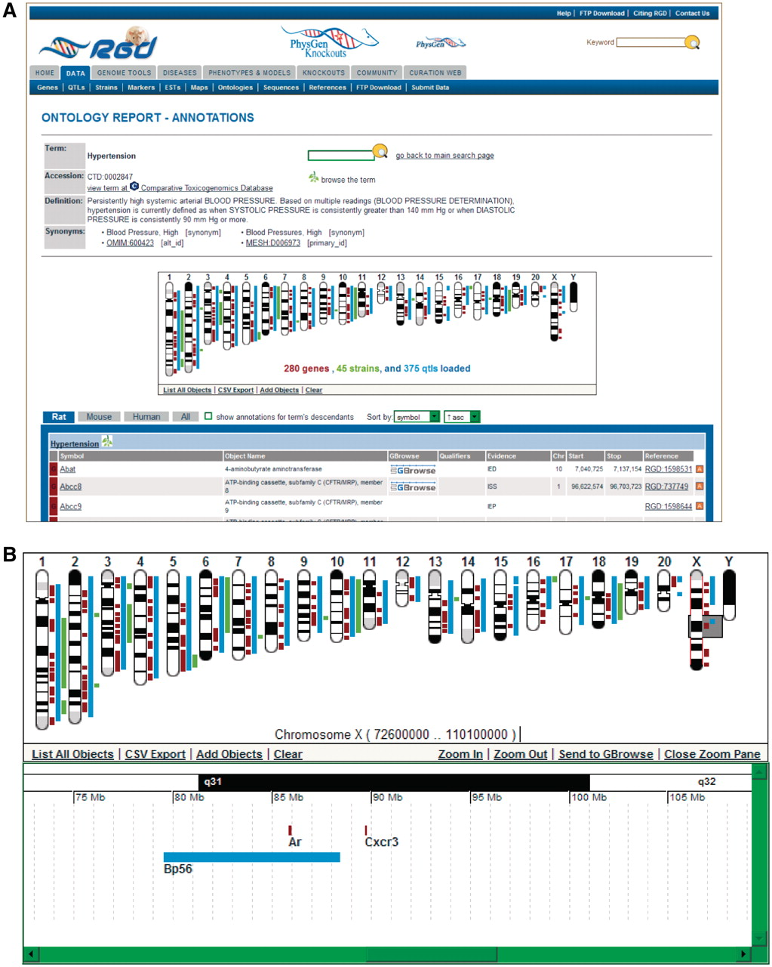
Figure 6. New ontology report page. (A) This example of an ontology report page is for the disease term ‘hypertension’. ...
Notes:
Figure 6. New ontology report page. (A) This example of an ontology report page is for the disease term ‘hypertension’. The GViewer shows that RGD annotations to ‘hypertension’ have been made to genes, QTLs and strains. Part of the list of annotations is shown below the GViewer. (B) This display of the GViewer shows a scrollable slider (gray box) on chromosome X. The zoom pane shows an enlarged view of the part of the chromosome that the slider covers. Two genes (Ar and Cxcr3) and a QTL (Bp56) are identified in the zoom pane.
Unless provided in the caption above, the following copyright applies to the content of this slide: © The Author(s) 2012. Published by Oxford University Press.This is an Open Access article distributed under the terms of the Creative Commons Attribution Non-Commercial License (http://creativecommons.org/licenses/by-nc/3.0), which permits unrestricted non-commercial use, distribution, and reproduction in any medium, provided the original work is properly cited.

