Slide 1
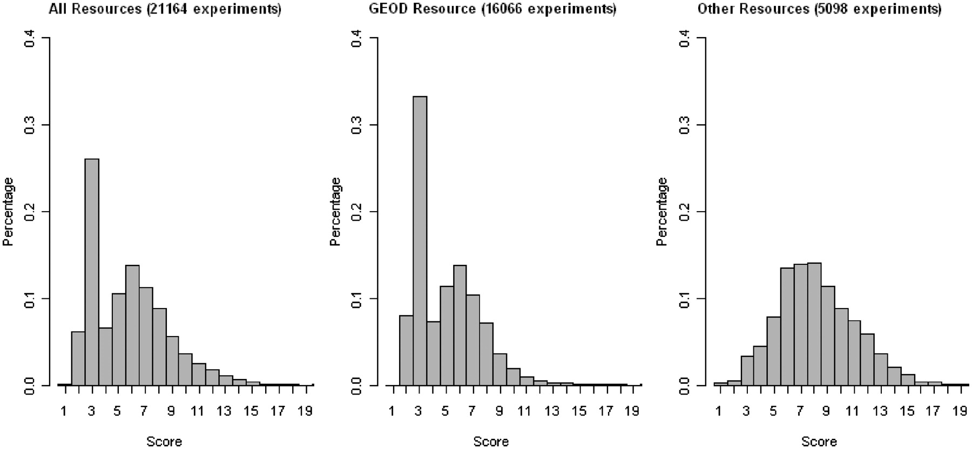
Figure 2. Annotation statistics for the ArrayExpress data set. The score is computed as the total number of extracted ...
Notes:
Figure 2. Annotation statistics for the ArrayExpress data set. The score is computed as the total number of extracted annotations per experiment, and is plotted on the x-axis. Each MAGE-TAB field that contains one or more valid ontology terms increments the score by 1, whereas fields with terms such as ‘unknown’, ‘none’ and ‘N/A’ do not increment the score. The field ‘Biomaterial characteristics’ may contain several ontology annotation categories, and so may increment the score by more than 1. A higher annotation score indicates that an experiment is annotated more richly. The percentage of the data set with a given score is plotted on the y-axis. Data used in the figure was downloaded on 1 August 2011.
Unless provided in the caption above, the following copyright applies to the content of this slide: © The Author(s) 2011. Published by Oxford University Press.This is an Open Access article distributed under the terms of the Creative Commons Attribution Non-Commercial License (http://creativecommons.org/licenses/by-nc/3.0), which permits unrestricted non-commercial use, distribution, and reproduction in any medium, provided the original work is properly cited.

