Slide 1
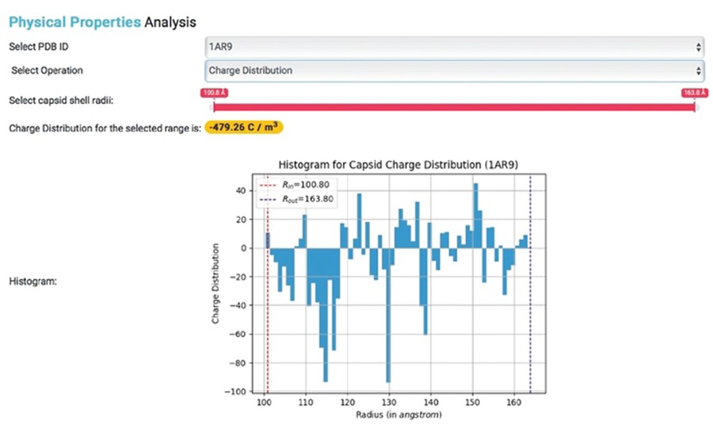
Figure 4 Physical properties analysis. Histogram showing the charge distribution of a selected capsid PDB ID, where ...
Notes:
Figure 4 Physical properties analysis. Histogram showing the charge distribution of a selected capsid PDB ID, where Rin represents inner capsid radii and Rout represents outer capsid radii.
Unless provided in the caption above, the following copyright applies to the content of this slide: © The Author(s) 2019. Published by Oxford University Press.This is an Open Access article distributed under the terms of the Creative Commons Attribution License (http://creativecommons.org/licenses/by/4.0/), which permits unrestricted reuse, distribution, and reproduction in any medium, provided the original work is properly cited.

