Slide 1
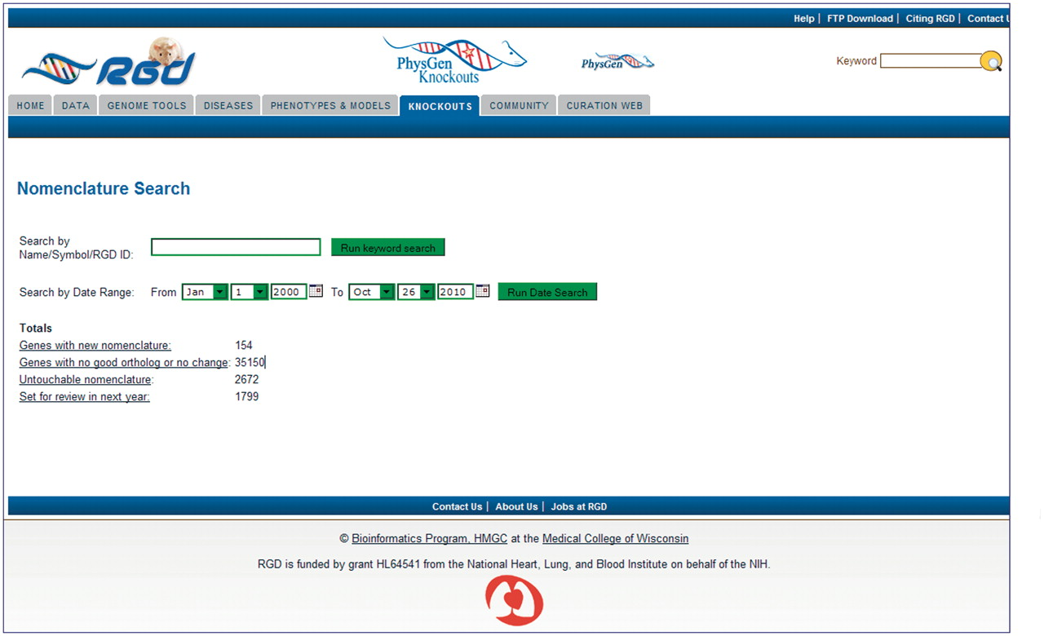
Figure 1. Homepage of the Gene Nomenclature Tool. Pre-loaded categories are displayed as hyperlinks. Individual genes ...
Notes:
Figure 1. Homepage of the Gene Nomenclature Tool. Pre-loaded categories are displayed as hyperlinks. Individual genes or families of genes can be searched by the keyword search box. Genes that are scheduled to be reviewed in the future can be searched through the date search function.
Unless provided in the caption above, the following copyright applies to the content of this slide: © The Author(s) 2011. Published by Oxford University Press.This is Open Access article distributed under the terms of the Creative Commons Attribution Non-Commercial License (http://creativecommons.org/licenses/by-nc/2.5), which permits unrestricted non-commercial use, distribution, and reproduction in any medium, provided the original work is properly cited.

