Slide 1
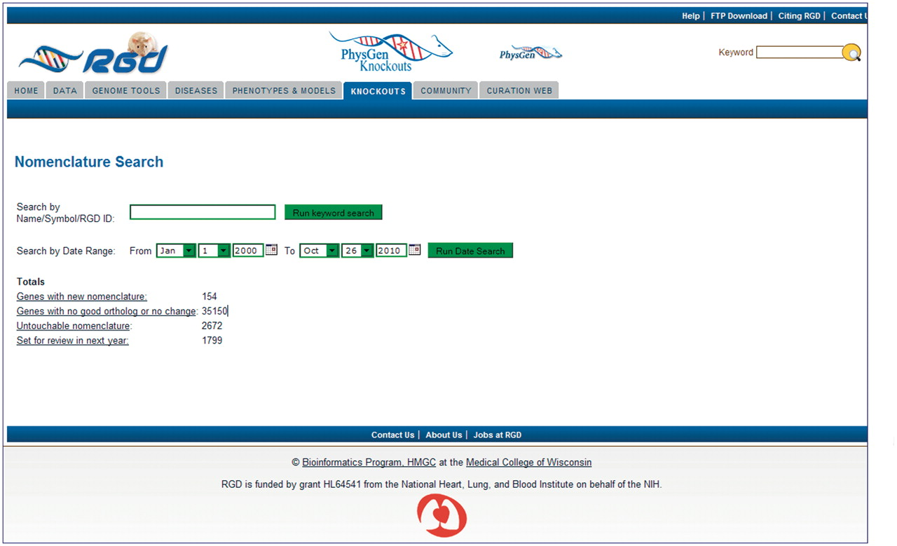
Figure 1. Homepage of the Gene Nomenclature Tool. Pre-loaded categories are displayed as hyperlinks. Individual genes ...
Notes:
Figure 1. Homepage of the Gene Nomenclature Tool. Pre-loaded categories are displayed as hyperlinks. Individual genes or families of genes can be searched by the keyword search box. Genes that are scheduled to be reviewed in the future can be searched through the date search function.
Unless provided in the caption above, the following copyright applies to the content of this slide: © The Author(s) 2011. Published by Oxford University Press.This is Open Access article distributed under the terms of the Creative Commons Attribution Non-Commercial License (http://creativecommons.org/licenses/by-nc/2.5), which permits unrestricted non-commercial use, distribution, and reproduction in any medium, provided the original work is properly cited.

Slide 2
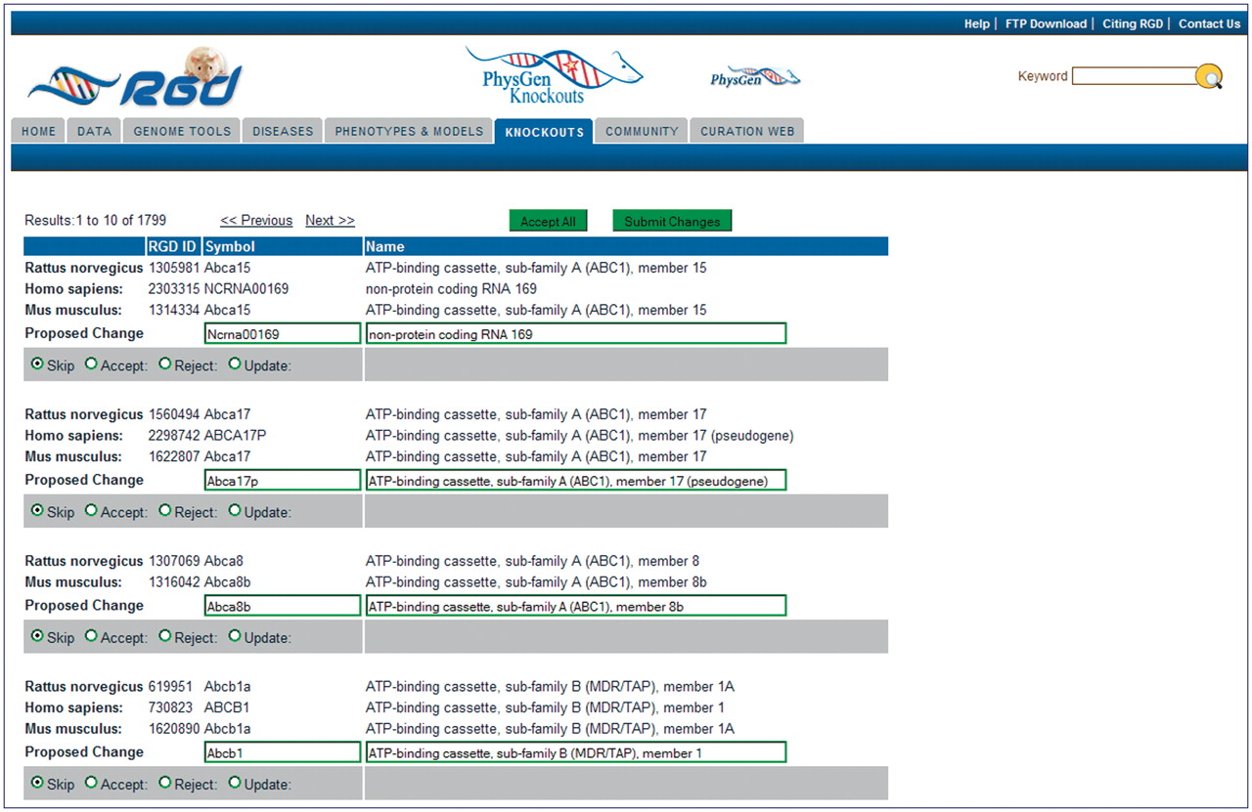
Figure 2. Editing page of the Gene Nomenclature Tool. All ortholog groups are listed in matched sets to simplify ...
Notes:
Figure 2. Editing page of the Gene Nomenclature Tool. All ortholog groups are listed in matched sets to simplify comparison of the rat nomenclature to the mouse and human nomenclature. The proposed change/editing text boxes and action selection radio buttons are at the bottom of every ortholog group. An ‘Accept All’ button is located at the top and bottom of every editing page so that all proposed changes on the page can be approved at once if the curator decides they are acceptable. ‘Submit Changes’ buttons are located next to the ‘Accept All’ buttons to send the changes to the database.
Unless provided in the caption above, the following copyright applies to the content of this slide: © The Author(s) 2011. Published by Oxford University Press.This is Open Access article distributed under the terms of the Creative Commons Attribution Non-Commercial License (http://creativecommons.org/licenses/by-nc/2.5), which permits unrestricted non-commercial use, distribution, and reproduction in any medium, provided the original work is properly cited.

Slide 3
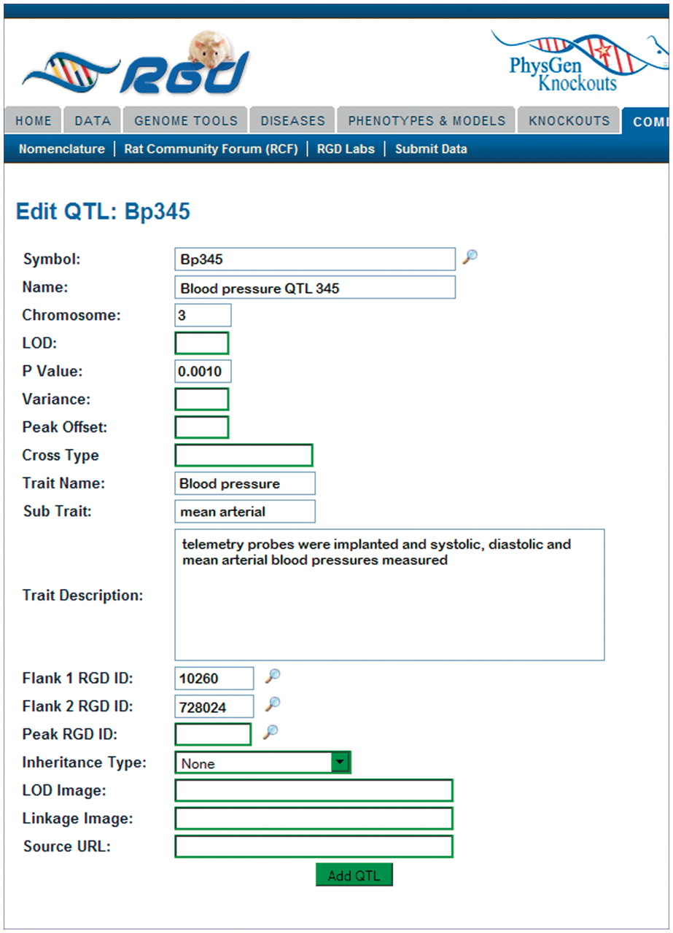
Figure 3. The Object Creation and Editing Tool: QTL entry page. The QTL entry page consists of many text boxes specific ...
Notes:
Figure 3. The Object Creation and Editing Tool: QTL entry page. The QTL entry page consists of many text boxes specific for the different types of information collected by the curator to describe a QTL. Clicking the search icon to the side of the symbol box generates a pop-up window where current QTL symbols may be searched.
Unless provided in the caption above, the following copyright applies to the content of this slide: © The Author(s) 2011. Published by Oxford University Press.This is Open Access article distributed under the terms of the Creative Commons Attribution Non-Commercial License (http://creativecommons.org/licenses/by-nc/2.5), which permits unrestricted non-commercial use, distribution, and reproduction in any medium, provided the original work is properly cited.

Slide 4
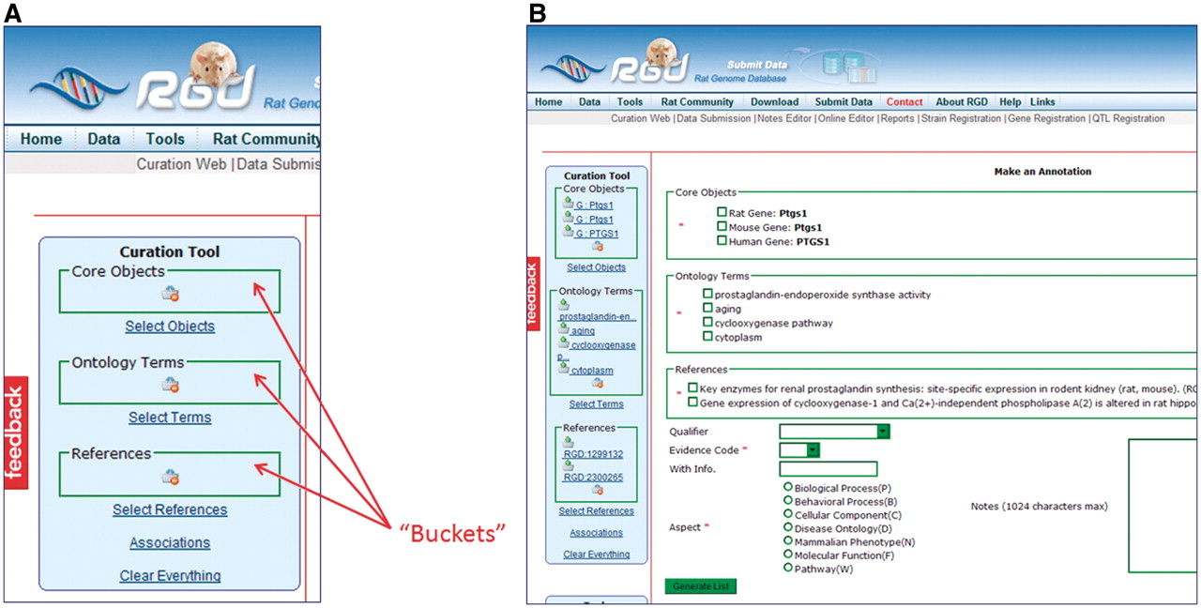
Figure 4. (A) The Ontology Annotation Creation and Editing Tool homepage has ‘buckets’ for holding selected items. Each ...
Notes:
Figure 4. (A) The Ontology Annotation Creation and Editing Tool homepage has ‘buckets’ for holding selected items. Each bucket (core objects, ontology terms and references) has its own search function, which appears in the right frame of the page when ‘Select Objects’, ‘Select Terms’ or ‘Select References’ is clicked. (B) Annotation frame. All the items from the buckets are repeated in the annotation frame to allow them to be selected for annotations. More information choices are available below the bucket items as drop-down text boxes for qualifier terms and evidence codes, radio buttons for ontology aspect and text boxes for free text information.
Unless provided in the caption above, the following copyright applies to the content of this slide: © The Author(s) 2011. Published by Oxford University Press.This is Open Access article distributed under the terms of the Creative Commons Attribution Non-Commercial License (http://creativecommons.org/licenses/by-nc/2.5), which permits unrestricted non-commercial use, distribution, and reproduction in any medium, provided the original work is properly cited.

Slide 5
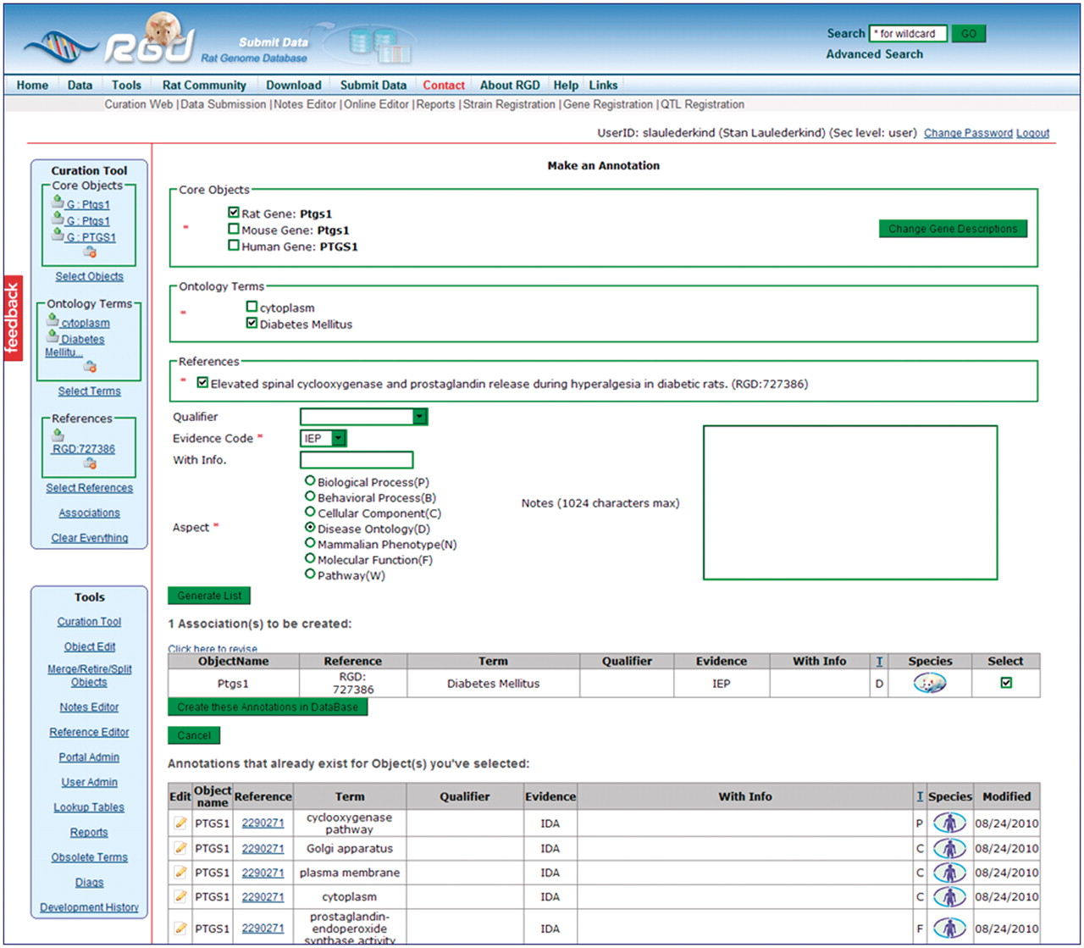
Figure 5. This intermediate annotation page holds the currently constructed annotation for Ptgs1, all existing ...
Notes:
Figure 5. This intermediate annotation page holds the currently constructed annotation for Ptgs1, all existing annotations for objects in the Core Objects bucket (PTGS1/Ptgs1 for human, mouse and rat), and options for editing. The current annotation can be edited by reselecting items above the annotation and re-clicking the ‘Generate List’ button. Any pre-existing annotation at the bottom of the frame can be edited by clicking the edit icon to the left of the annotation.
Unless provided in the caption above, the following copyright applies to the content of this slide: © The Author(s) 2011. Published by Oxford University Press.This is Open Access article distributed under the terms of the Creative Commons Attribution Non-Commercial License (http://creativecommons.org/licenses/by-nc/2.5), which permits unrestricted non-commercial use, distribution, and reproduction in any medium, provided the original work is properly cited.

Slide 6
Figure 6. A list of obsolete ontology terms with links to annotations containing those terms.
Notes:
Figure 6. A list of obsolete ontology terms with links to annotations containing those terms.
Unless provided in the caption above, the following copyright applies to the content of this slide: © The Author(s) 2011. Published by Oxford University Press.This is Open Access article distributed under the terms of the Creative Commons Attribution Non-Commercial License (http://creativecommons.org/licenses/by-nc/2.5), which permits unrestricted non-commercial use, distribution, and reproduction in any medium, provided the original work is properly cited.

