Slide 1
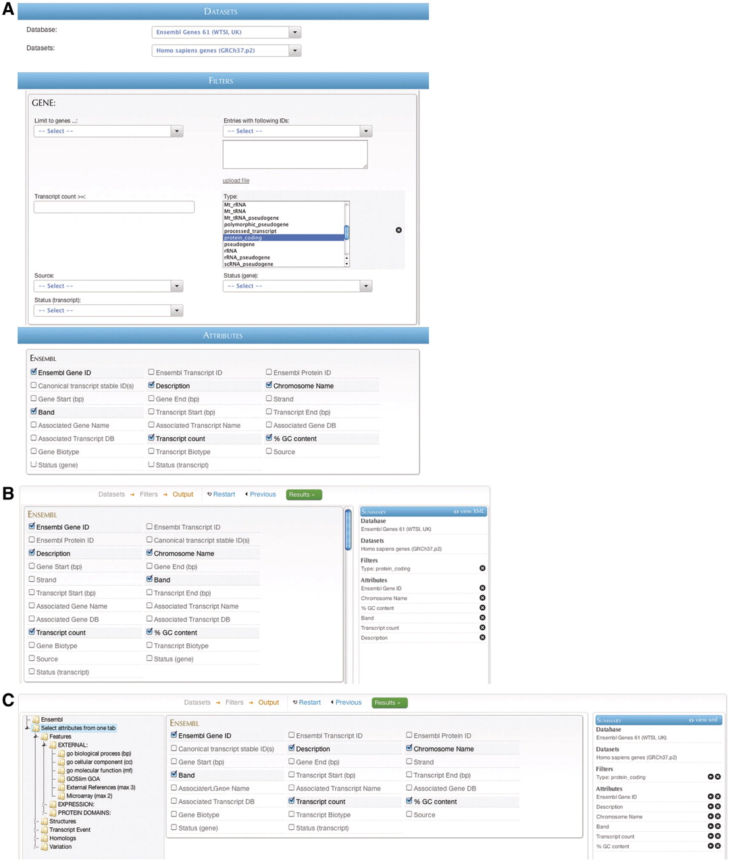
Figure 7. BioMart web GUIs: ‘MartForm’, ‘MartWizard’ and ‘MartExplorer’. (A) ‘MartForm’ presents, from top to bottom, a ...
Notes:
Figure 7. BioMart web GUIs: ‘MartForm’, ‘MartWizard’ and ‘MartExplorer’. (A) ‘MartForm’ presents, from top to bottom, a choice of data sets, filters and attributes. Filters and attributes may be organized in containers and subcontainers, and mutually exclusive sets of filters and attributes can be segregated into separate tabs. MartForm presents all options on a single page, and so is most appropriate for queries that require user-configurability, but that have a relatively small number of filters and attributes. (B) For searches with a larger number of filters and attributes, there is the ‘MartWizard’ interface. In the ‘MartWizard’ interface, data sets, filters and attributes are chosen in successive steps, each step presented on its own page. The query is summarized in the right-hand column as it is being built, and users can move between the filter and attribute pages to modify the query. Within each page, filters and attributes can be presented in containers and as in ‘MartForm’. (C) For maximum flexibility and complex querying, there is the ‘MartExplorer’ interface. As in ‘MartWizard’, in ‘MartExplorer’ data sets, filters and attributes are presented on separate pages. However, instead of being organized into containers on a single page, in ‘MartExplorer’, filters and attributes are organized into a hierarchical folder structure presented in the left-hand column on the screen. As such, ‘MartExplorer’ is most appropriate for queries with a large number of filters and attributes that are organized in a complex directory structure.
Unless provided in the caption above, the following copyright applies to the content of this slide: © The Author(s) 2011. Published by Oxford University Press.This is Open Access article distributed under the terms of the Creative Commons Attribution Non-Commercial License (http://creativecommons.org/licenses/by-nc/2.5), which permits unrestricted non-commercial use, distribution, and reproduction in any medium, provided the original work is properly cited.

