Slide 1
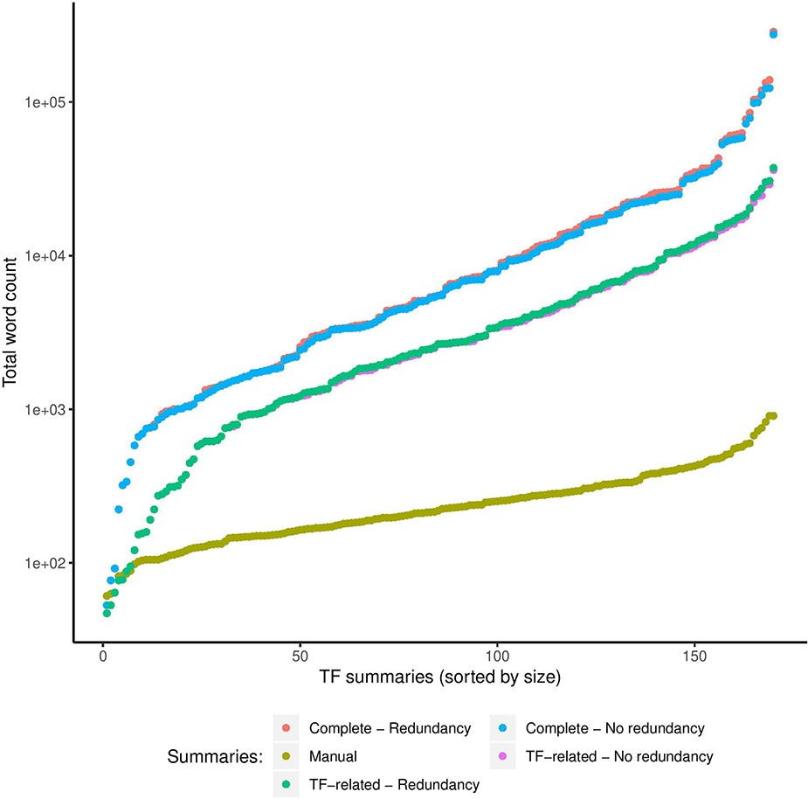
Figure 5. Comparison of sizes in total words (log scale) of manual and automatic summaries. We show the size of ...
Notes:
Figure 5. Comparison of sizes in total words (log scale) of manual and automatic summaries. We show the size of automatic summaries generated from the complete article collection and from the TF-related articles. Also, we show the size of the automatic summaries with (redundancy) and without redundant sentences (no redundancy).
Unless provided in the caption above, the following copyright applies to the content of this slide: © The Author(s) 2020. Published by Oxford University Press.This is an Open Access article distributed under the terms of the Creative Commons Attribution License (http://creativecommons.org/licenses/by/4.0/), which permits unrestricted reuse, distribution, and reproduction in any medium, provided the original work is properly cited.

