Slide 1
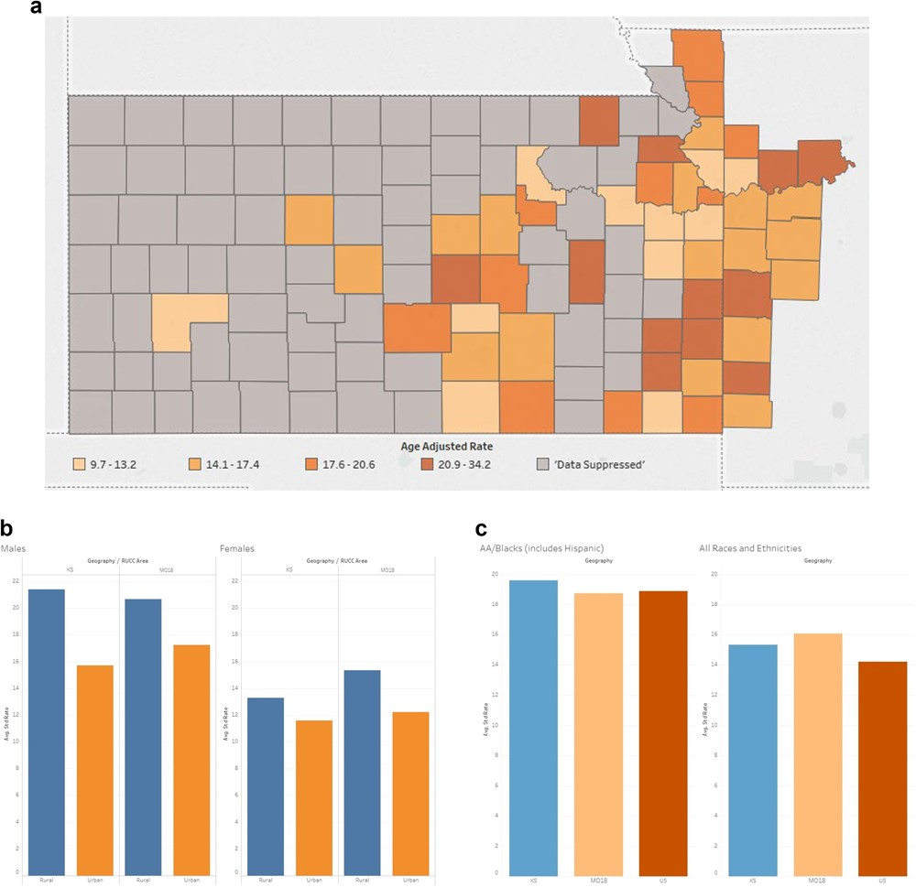
Figure 6 (A) The University of Kansas Cancer Center catchment area counties’ heat map representing the mortality rates ...
Notes:
Figure 6 (A) The University of Kansas Cancer Center catchment area counties’ heat map representing the mortality rates of colorectal cancer. Colorectal cancer mortality data was suppressed in 72 counties, all of which had populations <34 000. (B) The University of Kansas Cancer Center catchment area average standard rate capturing the mortality rates of colorectal cancer comparing rural versus urban. (C) The University of Kansas Cancer Center catchment area average standard rate capturing the mortality rates of colorectal cancer comparing African American versus all the other races.
Unless provided in the caption above, the following copyright applies to the content of this slide: © The Author(s) 2020. Published by Oxford University Press.This is an Open Access article distributed under the terms of the Creative Commons Attribution License (http://creativecommons.org/licenses/by/4.0/), which permits unrestricted reuse, distribution, and reproduction in any medium, provided the original work is properly cited.

