Slide 1
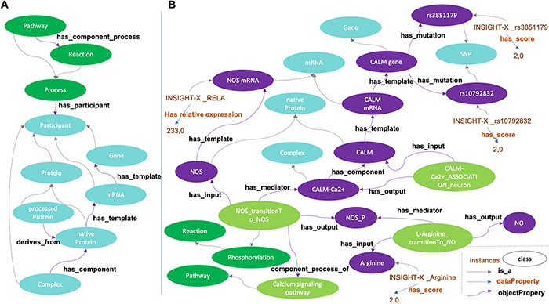
Figure 4. Disease Map Ontology (DMO) pattern (A) and application to Alzheimer Disease Map Ontology (ADMO) (B). ...
Notes:
Figure 4. Disease Map Ontology (DMO) pattern (A) and application to Alzheimer Disease Map Ontology (ADMO) (B). AlzPathway derived-classes (B; illustrated for the Nitric Oxide Synthase phosphorylation and NO production) are now subclasses of DMO classes (A). Each class of ADMO may be instantiated by the corresponding entities as individuals. As illustrated in B, for a subject, scores for SNP rs3851179, RELA mRNA expression and Arginine measurement are linked by biochemical reactions.
Unless provided in the caption above, the following copyright applies to the content of this slide: © The Author(s) 2021. Published by Oxford University Press. All rights reserved. For permissions, please e-mail: journals.permissions@oup.comThis article is published and distributed under the terms of the Oxford University Press, Standard Journals Publication Model (https://academic.oup.com/journals/pages/open_access/funder_policies/chorus/standard_publication_model)

