Slide 1
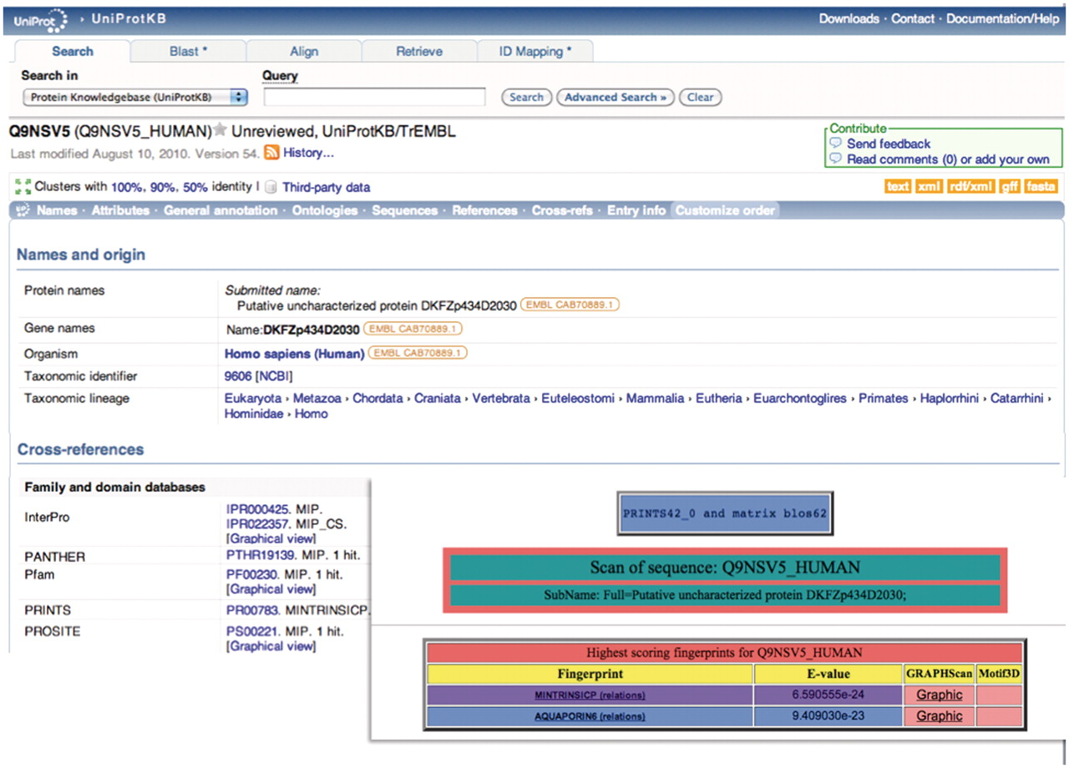
Figure 1. Illustration of a hierarchical PRINTS diagnosis. The UniProtKB/TrEMBL entry Q9NSV5_HUMAN was annotated as ...
Notes:
Figure 1. Illustration of a hierarchical PRINTS diagnosis. The UniProtKB/TrEMBL entry Q9NSV5_HUMAN was annotated as putative uncharacterized protein DKFZp434D2030; the family- and domain-database cross-references suggested membership of the major intrinsic protein (MIP) superfamily, but provided no specific family affiliation. The FingerPRINTScan result (inset) diagnoses the sequence both as a member of the MIP superfamily and as an aquaporin 6 subtype.
Unless provided in the caption above, the following copyright applies to the content of this slide: © The Author(s) 2012. Published by Oxford University Press.This is an Open Access article distributed under the terms of the Creative Commons Attribution Non-Commercial License (http://creativecommons.org/licenses/by-nc/3.0), which permits unrestricted non-commercial use, distribution, and reproduction in any medium, provided the original work is properly cited.

