Slide 1
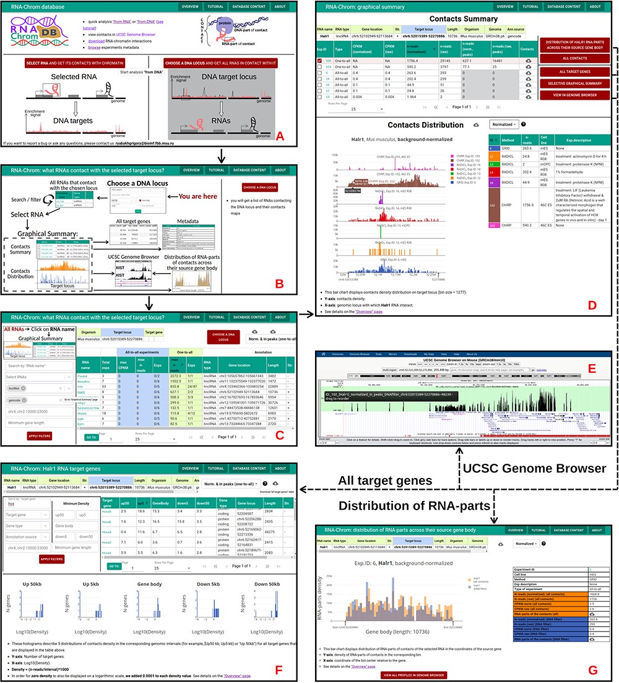
Figure 6. ‘From DNA’ analysis for HoxA cluster (chr6:52 015 389-52 270 886, M. musculus). The arrows reflect the ...
Notes:
Figure 6. ‘From DNA’ analysis for HoxA cluster (chr6:52 015 389-52 270 886, M. musculus). The arrows reflect the workflow. A. A user chooses ‘from DNA’ analysis and B. clicks on the ‘CHOOSE A DNA LOCUS’ button, selects the organism, enters the approximate coordinates of the HoxA cluster and clicks on the ‘APPLY’ button. C. All RNAs that contact with the chosen locus are presented in the table. A user applies filters if necessary. To go to the ‘Graphical Summary’ page, the user clicks on the RNA name of interest (for example, Halr1). D. The ‘Graphic Summary’ page is divided into two blocks: ‘Contacts Summary’ and ‘Contacts Distribution’. Five buttons located to the right of the ‘Contacts Summary’ table represent five options for further work with the Halr1 contacts. E. To get more details about the locus, a user sends contact maps to the UCSC Genome Browser. F. ‘All target genes’ page displays the association of contacts with genes located at the selected locus and their upstream and downstream regions. The gene list can be filtered in different ways. From this point, a user continues the analysis in the ‘from DNA’ way. G. ‘Distribution of Halr1 RNA-parts across their source gene body’ bar chart is plotted both for all contacts and for contacts with the target locus. These distributions can be downloaded or sent to the UCSC Genome Browser for a more detailed study.
Unless provided in the caption above, the following copyright applies to the content of this slide: © The Author(s) 2023. Published by Oxford University Press.This is an Open Access article distributed under the terms of the Creative Commons Attribution License (https://creativecommons.org/licenses/by/4.0/), which permits unrestricted reuse, distribution, and reproduction in any medium, provided the original work is properly cited.

