Slide 1
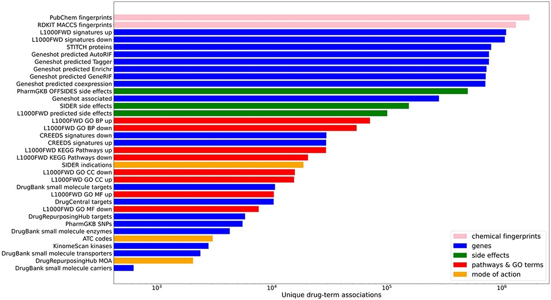
Figure 1. Counts of unique drug–term associations for each library. Terms are colored by their term type groupings.
Notes:
Figure 1. Counts of unique drug–term associations for each library. Terms are colored by their term type groupings.
Unless provided in the caption above, the following copyright applies to the content of this slide: © The Author(s) 2021. Published by Oxford University Press.This is an Open Access article distributed under the terms of the Creative Commons Attribution License (http://creativecommons.org/licenses/by/4.0/), which permits unrestricted reuse, distribution, and reproduction in any medium, provided the original work is properly cited.

Slide 2
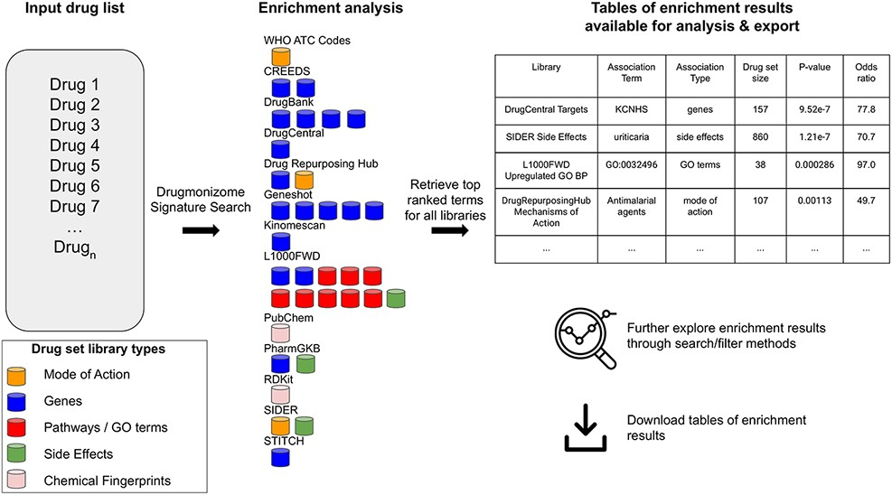
Figure 2. The Drugmonizome signature search workflow. A set of drugs is submitted for enrichment analysis across all ...
Notes:
Figure 2. The Drugmonizome signature search workflow. A set of drugs is submitted for enrichment analysis across all the Drugmonizome gene set libraries. The enrichment results are provided in tables that enable further exploration of the overlapping drugs.
Unless provided in the caption above, the following copyright applies to the content of this slide: © The Author(s) 2021. Published by Oxford University Press.This is an Open Access article distributed under the terms of the Creative Commons Attribution License (http://creativecommons.org/licenses/by/4.0/), which permits unrestricted reuse, distribution, and reproduction in any medium, provided the original work is properly cited.

Slide 3
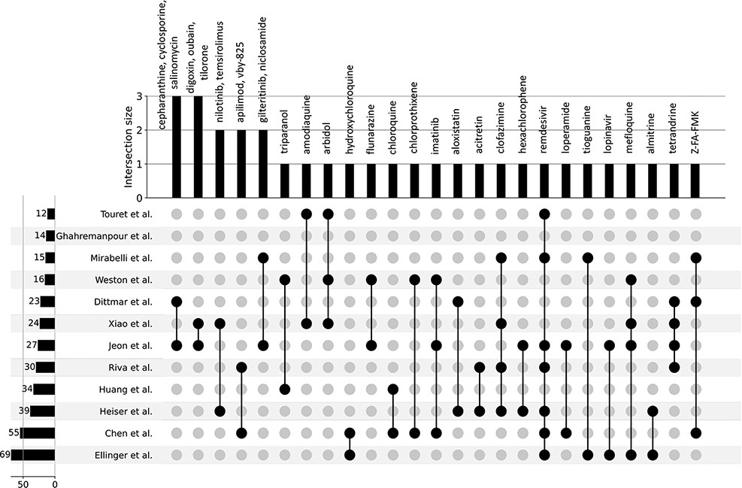
Figure 3. UpSet plot detailing the overlap among drug hits across 12 independent published in vitro drug screen ...
Notes:
Figure 3. UpSet plot detailing the overlap among drug hits across 12 independent published in vitro drug screen studies.
Unless provided in the caption above, the following copyright applies to the content of this slide: © The Author(s) 2021. Published by Oxford University Press.This is an Open Access article distributed under the terms of the Creative Commons Attribution License (http://creativecommons.org/licenses/by/4.0/), which permits unrestricted reuse, distribution, and reproduction in any medium, provided the original work is properly cited.

Slide 4
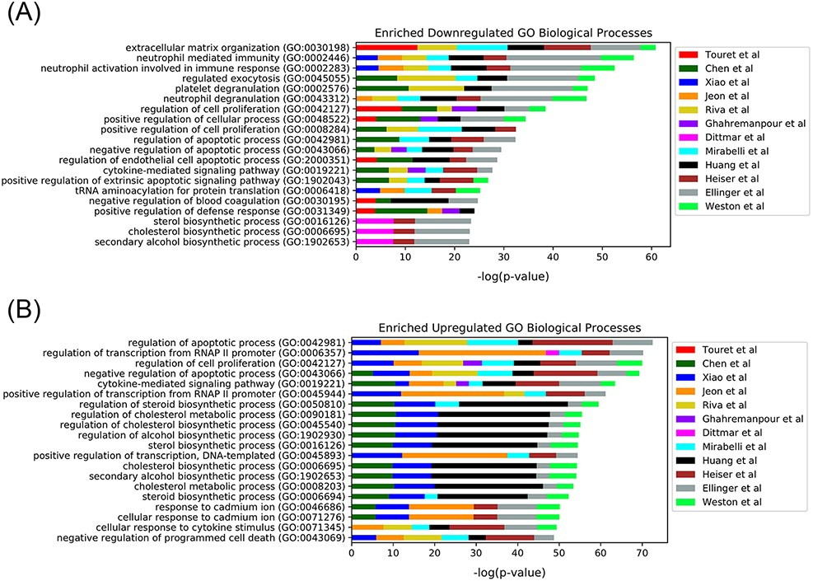
Figure 4. Top 20 enriched GO Biological Processes terms for the 12 in vitro SARS-CoV-2 drug screens. Enriched terms ...
Notes:
Figure 4. Top 20 enriched GO Biological Processes terms for the 12 in vitro SARS-CoV-2 drug screens. Enriched terms are ranked by the sum of the −log(P-value) of the term across all screens. The enriched terms are applied to the consensus downregulated (A) and upregulated (B) genes for each drug in each set based on the data provided from L1000FWD (29).
Unless provided in the caption above, the following copyright applies to the content of this slide: © The Author(s) 2021. Published by Oxford University Press.This is an Open Access article distributed under the terms of the Creative Commons Attribution License (http://creativecommons.org/licenses/by/4.0/), which permits unrestricted reuse, distribution, and reproduction in any medium, provided the original work is properly cited.

Slide 5
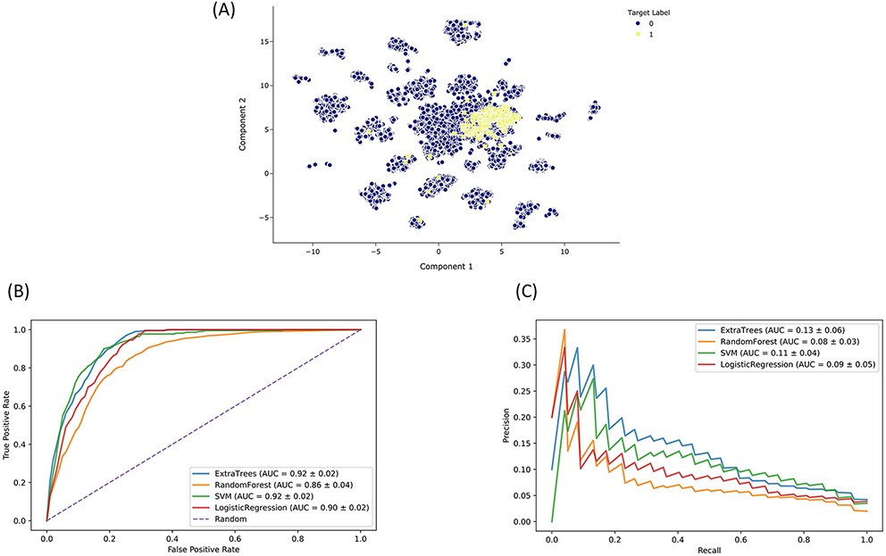
Figure 5. Drugmonizome-ML classifier for prioritizing drugs that may induce peripheral neuropathy. (A) Input feature ...
Notes:
Figure 5. Drugmonizome-ML classifier for prioritizing drugs that may induce peripheral neuropathy. (A) Input feature space with Uniform Manifold Approximation and Projection (UMAP) dimensionality reduction. Each point represents one of 19 898 compounds with 3026 features per compound. Compounds with the known side effect of peripheral neuropathy are highlighted in yellow. (B) ROC and (C) PRC across cross-validation splits after hyperparameter optimization for each classifier to predict peripheral neuropathy. Each curve shows the mean ROC and standard deviation after 10-fold cross-validation for each classifier.
Unless provided in the caption above, the following copyright applies to the content of this slide: © The Author(s) 2021. Published by Oxford University Press.This is an Open Access article distributed under the terms of the Creative Commons Attribution License (http://creativecommons.org/licenses/by/4.0/), which permits unrestricted reuse, distribution, and reproduction in any medium, provided the original work is properly cited.

