Slide 1
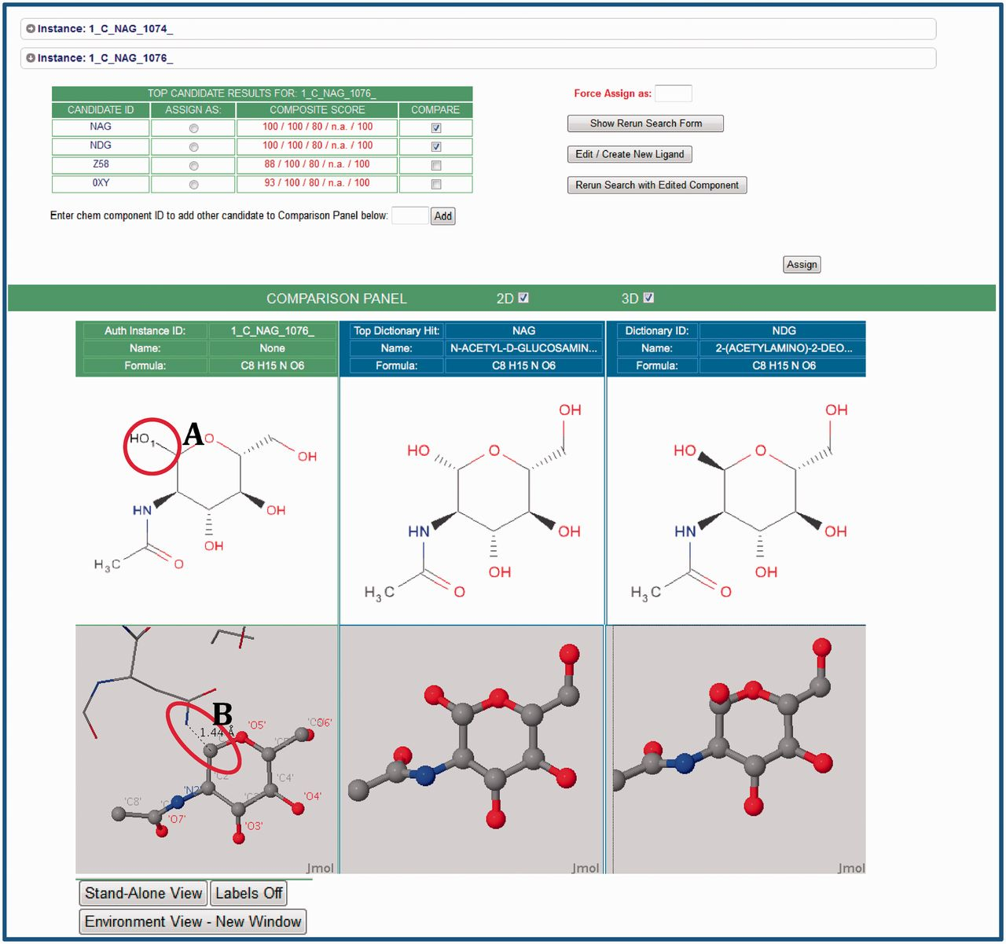
Figure 3. The Instance Search View (Step 2.2 in Figure 1). This example shows two instances in the deposited entry, ...
Notes:
Figure 3. The Instance Search View (Step 2.2 in Figure 1). This example shows two instances in the deposited entry, both labeled NAG (N-acetyl-beta-d-glucosamine), that are analogs of the matches found in the CCD. For these instances, the annotator can launch 2D and 3D comparisons by selecting the arrow next to the instance of interest. Visual comparisons of deposited instances (green column) and CCD definitions (blue columns) are available. To suggest CCD matches, the CCA Tool uses the deposited chemical environment for the prediction of the complete chemical description. This environment is displayed as sticks in the visual displays. In this example, the tool has recognized the adjacent atoms, and has added the leaving group as a black stick (labeled A) to provide the absolute stereochemistry. The 3D view reveals the glycosylation interaction of the deposited instance of NAG with asparagine (ASN) (in stick representation, labeled B). The annotator can use this environmental information to correctly assign components.
Unless provided in the caption above, the following copyright applies to the content of this slide: © The Author(s) 2013. Published by Oxford University Press.This is an Open Access article distributed under the terms of the Creative Commons Attribution License (http://creativecommons.org/licenses/by/3.0/), which permits unrestricted reuse, distribution, and reproduction in any medium, provided the original work is properly cited.

