Slide 1
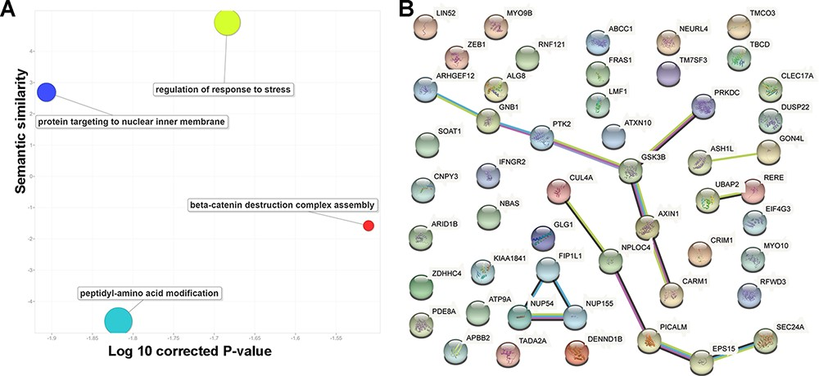
Figure 3. Basic functions of 52 circRNA differentially expressed parental genes found in 32 TCGA studies. (A) Key gene ...
Notes:
Figure 3. Basic functions of 52 circRNA differentially expressed parental genes found in 32 TCGA studies. (A) Key gene ontology (biological process) terms (B) The molecular network constructed from the STRING web server includes gene–gene association pairs (light green lines) gathered by text mining, gene co-expression pairs (black lines), evolutionary homolog-inferred interactions (blue lines), and large-scale experimentally validated protein–protein interactions (pink lines).
Unless provided in the caption above, the following copyright applies to the content of this slide: © The Author(s) 2021. Published by Oxford University Press.This is an Open Access article distributed under the terms of the Creative Commons Attribution License (http://creativecommons.org/licenses/by/4.0/), which permits unrestricted reuse, distribution, and reproduction in any medium, provided the original work is properly cited.

