Slide 1
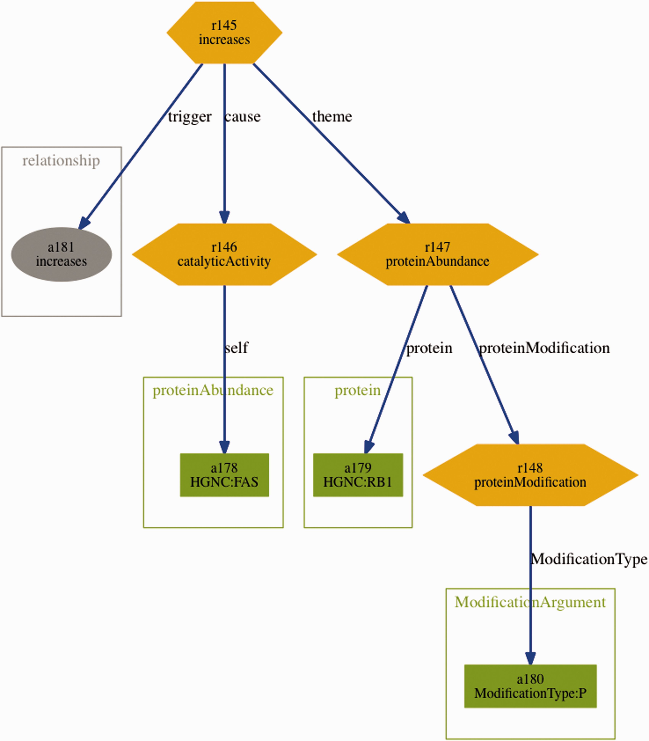
Figure 3 Visualization of the BEL statement ‘ cat(p(HGNC:FAS)) increases p(HGNC:RB1,pmod(P)) ’ derived from the ...
Notes:
Figure 3 Visualization of the BEL statement ‘ cat(p(HGNC:FAS)) increases p(HGNC:RB1,pmod(P)) ’ derived from the sentence ‘Fas stimulation of Jurkat cells is known to induce p38 kinase and we find a pronounced increase in Rb phosphorylation within 30 min of Fas stimulation’.
Unless provided in the caption above, the following copyright applies to the content of this slide: © The Author(s) 2016. Published by Oxford University Press. This is an Open Access article distributed under the terms of the Creative Commons Attribution License ( http://creativecommons.org/licenses/by/4.0/ ), which permits unrestricted reuse, distribution, and reproduction in any medium, provided the original work is properly cited.

