Slide 1
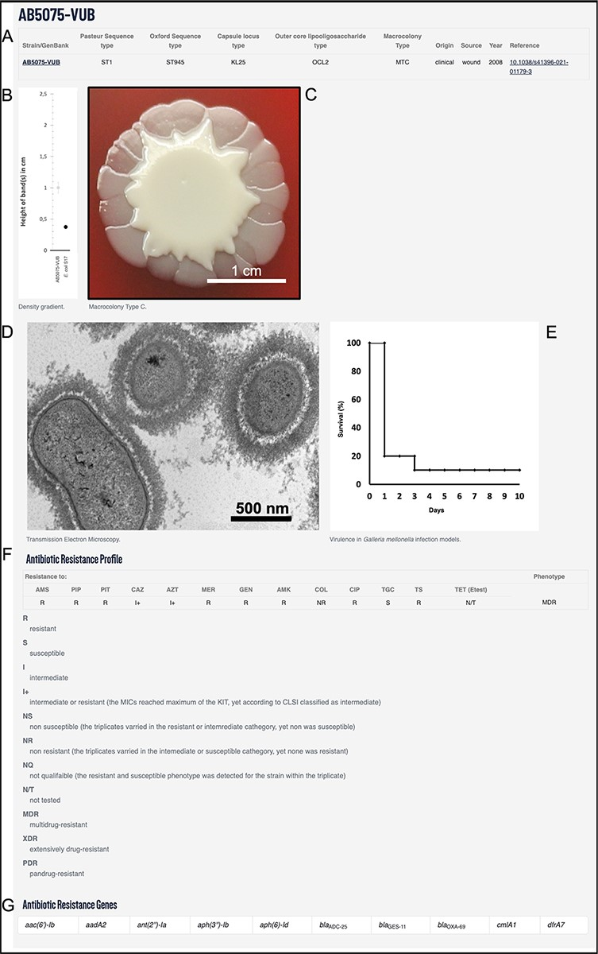
Figure 2. Example using AB5075-VUB entry depicting: (A) description of the genotype (KL, STOx/Pas and OCL), origin, ...
Notes:
Figure 2. Example using AB5075-VUB entry depicting: (A) description of the genotype (KL, STOx/Pas and OCL), origin, source and year of isolation with a hyperlink for the complete chromosomal sequence and a reference publication; (B) quantification of the capsule; (C) macrocolony type; (D) TEM micrograph of the capsule; (E) virulence in G. mellonella infection model; (F) antibiotic resistance profile and (G) ARGs.
Unless provided in the caption above, the following copyright applies to the content of this slide: © The Author(s) 2022. Published by Oxford University Press.This is an Open Access article distributed under the terms of the Creative Commons Attribution-NonCommercial License (https://creativecommons.org/licenses/by-nc/4.0/), which permits non-commercial re-use, distribution, and reproduction in any medium, provided the original work is properly cited. For commercial re-use, please contact journals.permissions@oup.com

