Slide 1
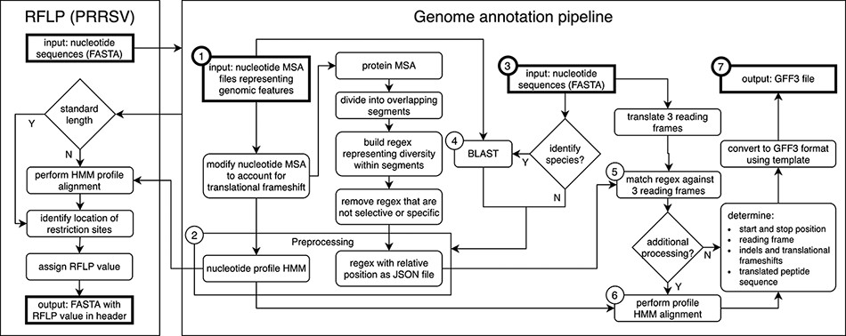
Figure 2. Genome annotation for the United States Swine Pathogen Database. Genome annotation begins with preprocessing, ...
Notes:
Figure 2. Genome annotation for the United States Swine Pathogen Database. Genome annotation begins with preprocessing, which requires nucleotide multiple sequence alignment files (MSA) representing genomic features as input (①). The products of preprocessing (②) are a nucleotide profile hidden Markov model (HMM) and a structured file containing regular expression patterns representative of diversity within sections of translated input MSAs. Following preprocessing, query nucleotide sequences in FASTA format (③) may be supplied to the annotation pipeline. If species identification is necessary (e.g. differentiating type 1 and 2 PRRSV), BLAST is performed (④) using preprocessing input files (①) as a reference. Once the query sequence species is known, relevant preprocessing files (②) are selected. Regular expressions are matched against three reading frames (⑤) of query sequence (③) to determine the location of genomic features. If more processing is necessary due to frame changes or uncertainty in the start or stop position, a profile HMM alignment is performed (⑥). These steps produce genome annotation and additional information with high confidence. The output produced by the pipeline is general feature format (GFF3) file, a standard nucleic acid or protein feature file format (⑦). The annotation pipeline is available at https://github.com/us-spd/.
Unless provided in the caption above, the following copyright applies to the content of this slide: Published by Oxford University Press 2021. This work is written by (a) US Government employee(s) and is in the public domain in the US.This work is written by (a) US Government employee(s) and is in the public domain in the US.

