Slide 1
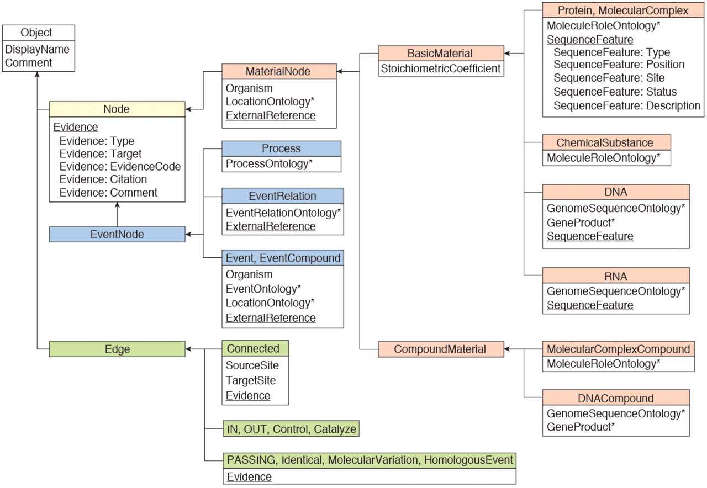
Figure 1. INOH data model. Boxes represent class objects (nodes and edges) and their attribute(s), and arrows show ...
Notes:
Figure 1. INOH data model. Boxes represent class objects (nodes and edges) and their attribute(s), and arrows show inheritance relationships. Multiple values are allowed at underlined attributes. Asterisks indicate that the value for the attribute is filled from INOH ontology terms.
Unless provided in the caption above, the following copyright applies to the content of this slide: © The Author(s) 2011. Published by Oxford University Press.This is an Open Access article distributed under the terms of the Creative Commons Attribution Non-Commercial License (http://creativecommons.org/licenses/by-nc/3.0), which permits unrestricted non-commercial use, distribution, and reproduction in any medium, provided the original work is properly cited.

