Slide 1
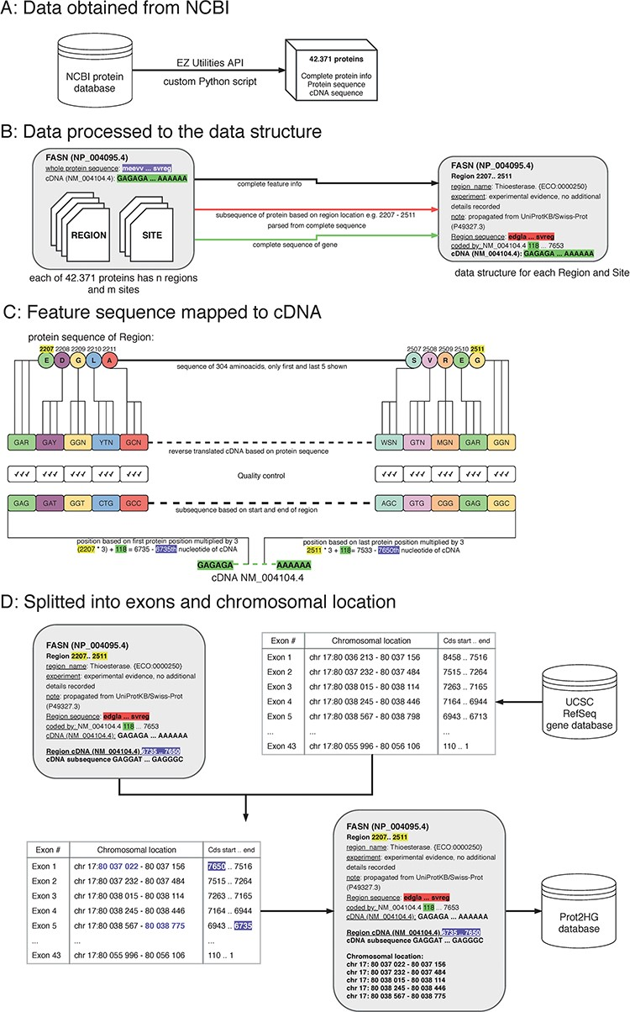
Figure 1 The process of protein domain mapping to human genome. (A) Data obtained from NCBI—data were downloaded about ...
Notes:
Figure 1 The process of protein domain mapping to human genome. (A) Data obtained from NCBI—data were downloaded about all proteins and stored into data structure for further analysis. (B) Data processed to the data structure—during this step, we record each protein domain with its subsequence and complete information. (C) Feature sequence mapped to cDNA—in this step, the protein subsequence is translated into a DNA sequence. A matching sequence in cDNA is then found and compared to a translated sequence to give a match. (D) Data split into exons and chromosomal location was assigned—some domains cover more than one exon, and in this step, using the UCSC gene database, we identify the chromosome location of every exon that codes to the domain. Then, the completed record is stored in the Prot2HG database.
Unless provided in the caption above, the following copyright applies to the content of this slide: © The Author(s) 2020. Published by Oxford University Press.This is an Open Access article distributed under the terms of the Creative Commons Attribution License (http://creativecommons.org/licenses/by/4.0/), which permits unrestricted reuse, distribution, and reproduction in any medium, provided the original work is properly cited.

Slide 2
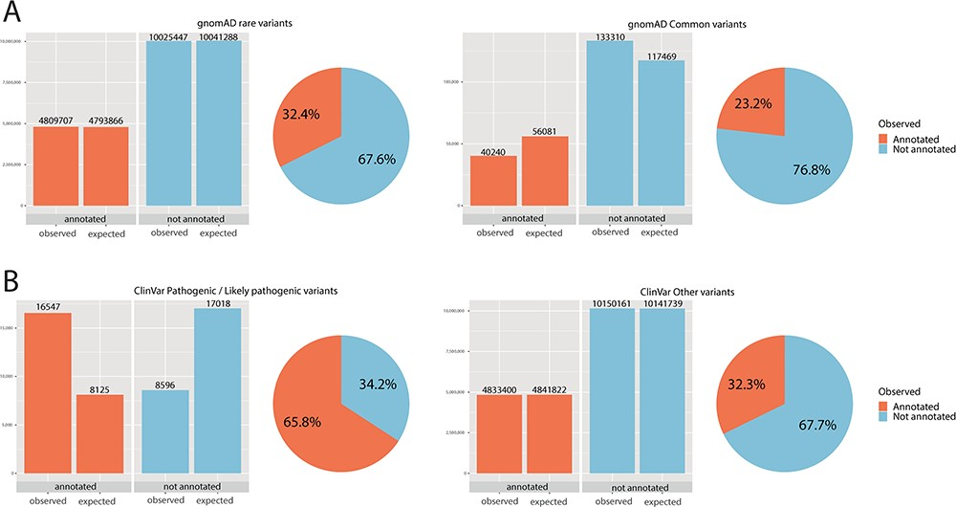
Figure 2 Chi-square statistics. From observed (real) data, we were able to calculate the expected data distribution. ...
Notes:
Figure 2 Chi-square statistics. From observed (real) data, we were able to calculate the expected data distribution. The difference between the two columns (observed vs. expected) is proportional to the dependence of the data and accordingly statistical significance. The difference is also proportional to the odds ratio. The pie chart is calculated from observed (real) data only. (A) For rare variants, 32% were annotated, while only 23% of common variants fall onto a conserved protein domain. The results show the dependence of distribution, and the difference was evaluated as significant with P < 0.01 and odds ratio of 1.59. (B) For ClinVar, the difference was even more obvious: 66% of pathogenic/likely pathogenic variants were annotated, while only 32% of other ClinVar variants fall onto a domain. The results show the dependence of distribution, and the difference was evaluated as significant with P < 0.01 and odds ratio of 4.04.
Unless provided in the caption above, the following copyright applies to the content of this slide: © The Author(s) 2020. Published by Oxford University Press.This is an Open Access article distributed under the terms of the Creative Commons Attribution License (http://creativecommons.org/licenses/by/4.0/), which permits unrestricted reuse, distribution, and reproduction in any medium, provided the original work is properly cited.

