Slide 1
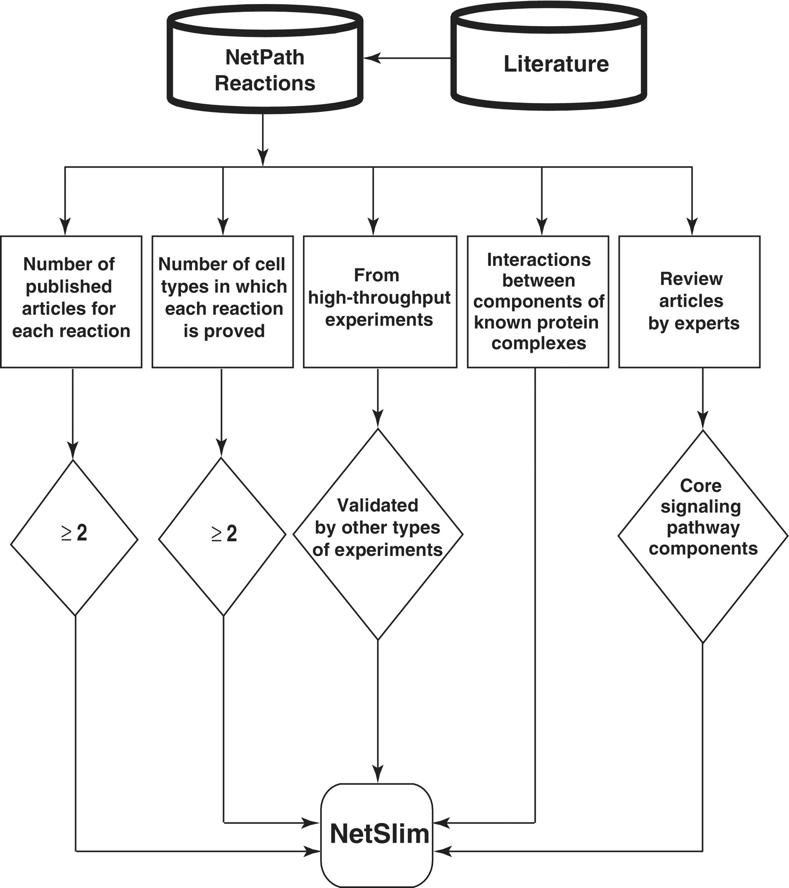
Figure 1. Schematic representation of the criteria used to select high-confidence pathway reactions from NetPath for ...
Notes:
Figure 1. Schematic representation of the criteria used to select high-confidence pathway reactions from NetPath for NetSlim. Reactions supported by at least two research articles are considered confident. Reactions shown to occur in multiple cell types for specific pathways are also included. NetSlim further incorporates reactions reported through high-throughput analyses which were validated by a focused experiment (in the same research article or another research article). The interactions between components of known protein complexes are included to obtain a general view of a pathway. Molecules or reactions established through expert review articles are considered for NetSlim in order to provide the core set of reactions in a given pathway.
Unless provided in the caption above, the following copyright applies to the content of this slide: © The Author(s) 2011. Published by Oxford University Press.This is Open Access article distributed under the terms of the Creative Commons Attribution Non-Commercial License (http://creativecommons.org/licenses/by-nc/2.5), which permits unrestricted non-commercial use, distribution, and reproduction in any medium, provided the original work is properly cited.

Slide 2
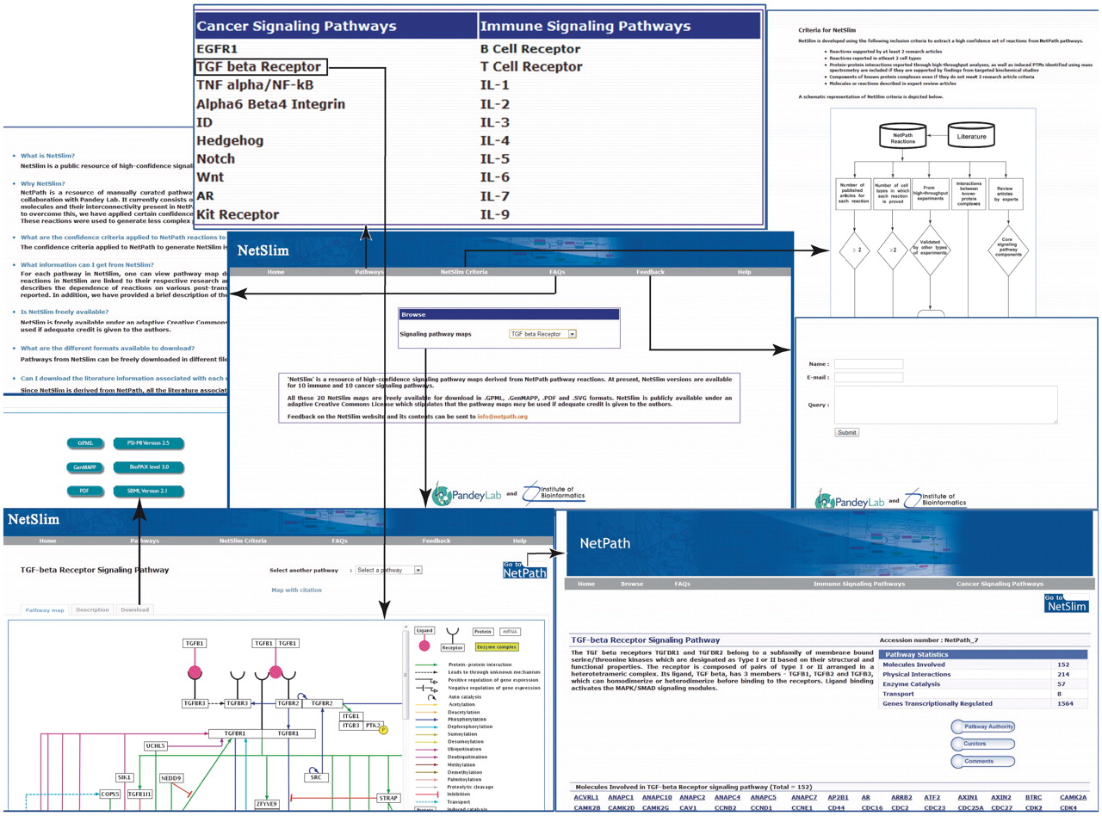
Figure 2. An overview of NetSlim. The NetSlim home page has options to browse the pathway maps. A description of the ...
Notes:
Figure 2. An overview of NetSlim. The NetSlim home page has options to browse the pathway maps. A description of the criteria used for NetSlim is available as a separate tab. Choosing a pathway such as the TGF beta signaling pathway, the ‘Pathway map’ tab provides access to the TGF-β NetSlim pathway map image and the ‘Description’ tab which has a brief description of the pathway. The ‘map with citation’ provided in the NetSlim pathway page contains molecules linked to specific NetPath molecule pages and their reactions linked to their corresponding citations. NetSlim maps can be downloaded in different file formats from specific pathway pages. The NetSlim data is also available to download in BioPAX, PSI-MI and SBML formats. A ‘Feedback’ page allows users to provide comments about the NetSlim resource. A link to NetSlim is provided on each pathway page in NetPath and vice versa.
Unless provided in the caption above, the following copyright applies to the content of this slide: © The Author(s) 2011. Published by Oxford University Press.This is Open Access article distributed under the terms of the Creative Commons Attribution Non-Commercial License (http://creativecommons.org/licenses/by-nc/2.5), which permits unrestricted non-commercial use, distribution, and reproduction in any medium, provided the original work is properly cited.

Slide 3
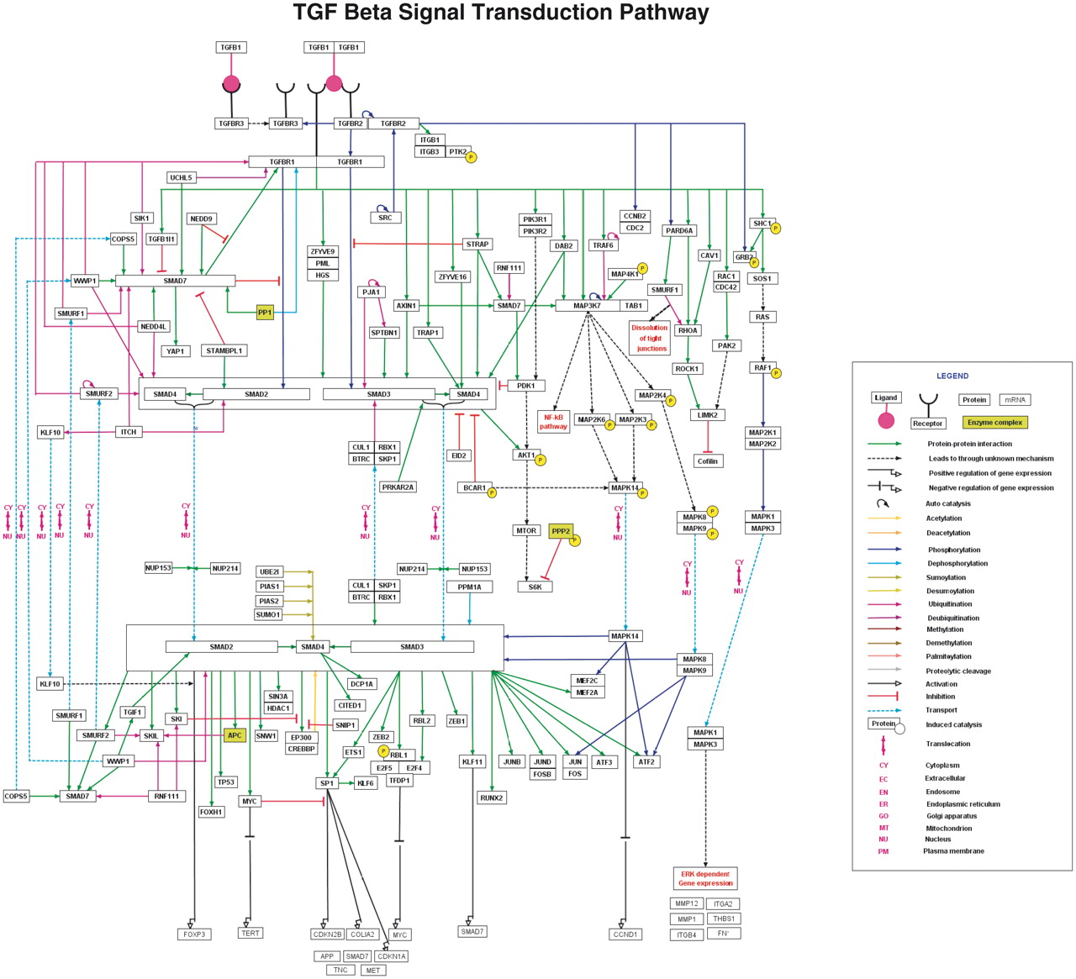
Figure 3. TGF-β pathway in NetSlim. The TGF-β pathway map represents the molecular reactions induced by the binding of ...
Notes:
Figure 3. TGF-β pathway in NetSlim. The TGF-β pathway map represents the molecular reactions induced by the binding of TGF-β 1 to TGF-β receptor complex. The annotated NetSlim pathway for TGF-β possesses 121 proteins involved in 252 reactions with 173 molecular associations, 60 enzyme catalysis reactions and 19 translocation events. The nodes and edges represent the molecules and their reactions, respectively. A key for the various symbols, colors and abbreviations used in the pathway diagram is provided.
Unless provided in the caption above, the following copyright applies to the content of this slide: © The Author(s) 2011. Published by Oxford University Press.This is Open Access article distributed under the terms of the Creative Commons Attribution Non-Commercial License (http://creativecommons.org/licenses/by-nc/2.5), which permits unrestricted non-commercial use, distribution, and reproduction in any medium, provided the original work is properly cited.

Slide 4
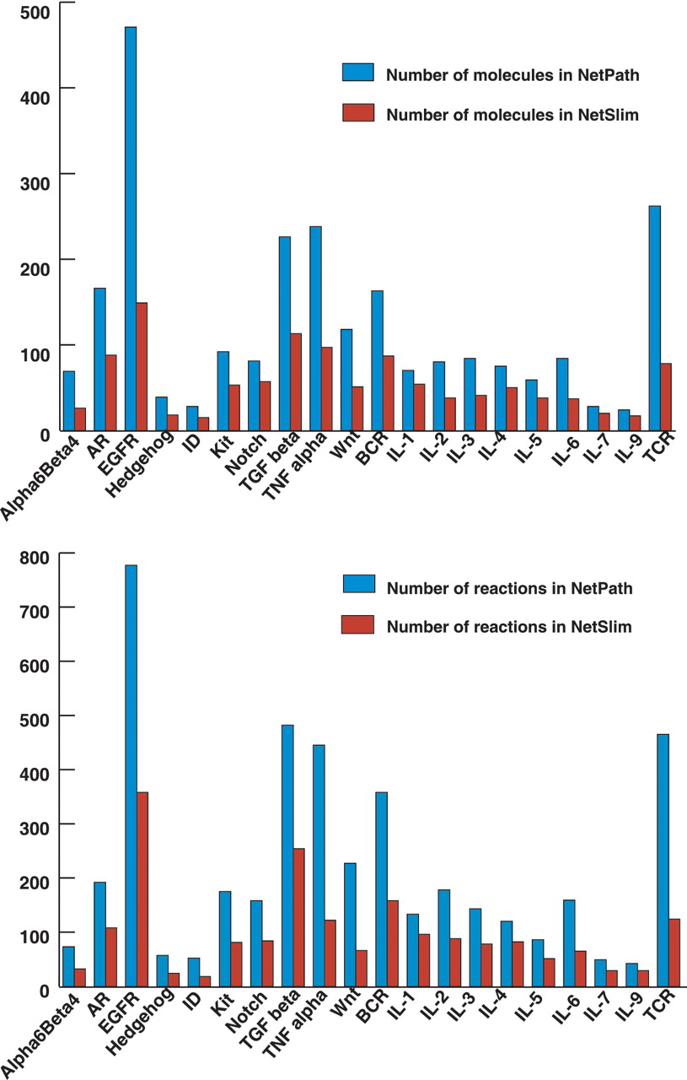
Figure 4. Comparative statistics of molecules and reactions in NetPath and NetSlim. The bar diagram represents the ...
Notes:
Figure 4. Comparative statistics of molecules and reactions in NetPath and NetSlim. The bar diagram represents the total number of molecules (A) and reactions (B) in signaling pathways in NetSlim and NetPath.
Unless provided in the caption above, the following copyright applies to the content of this slide: © The Author(s) 2011. Published by Oxford University Press.This is Open Access article distributed under the terms of the Creative Commons Attribution Non-Commercial License (http://creativecommons.org/licenses/by-nc/2.5), which permits unrestricted non-commercial use, distribution, and reproduction in any medium, provided the original work is properly cited.

