Slide 1
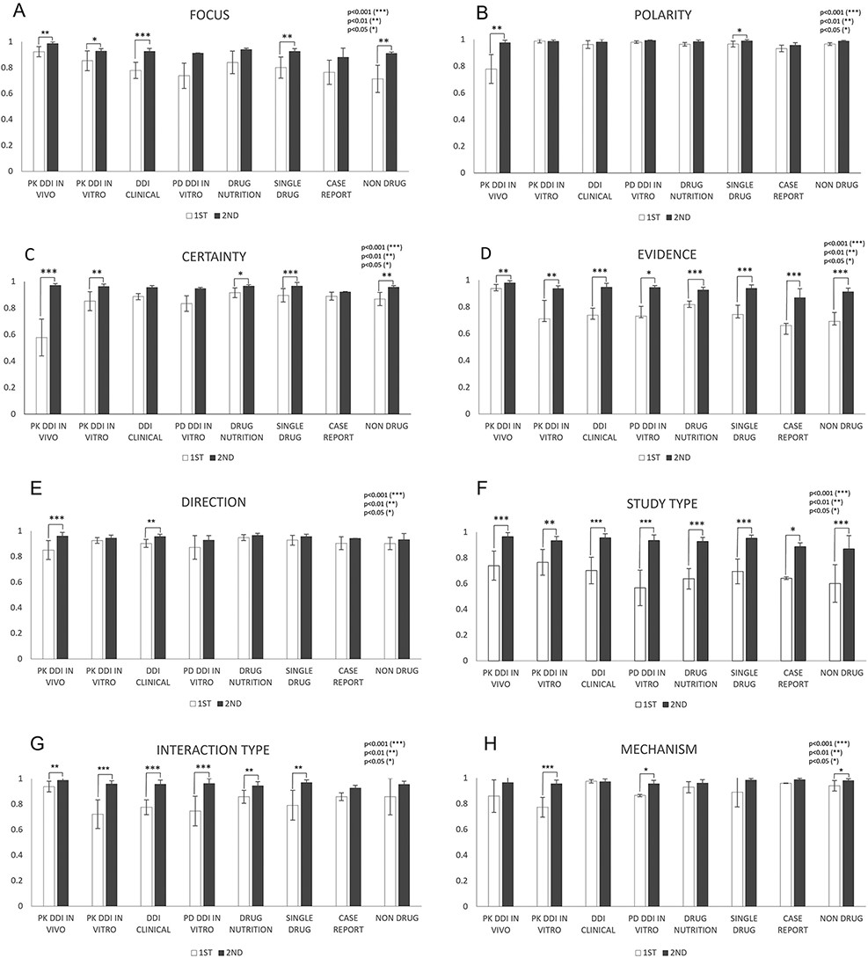
Figure 5. IAAs in eight annotation dimensions among different abstract subcategories. This figure shows IAAs ...
Notes:
Figure 5. IAAs in eight annotation dimensions among different abstract subcategories. This figure shows IAAs (mean ± SEM) for each dimension in different abstract subcategories. The IAAs of Round 1 are shown as white bars and the IAAs of Round 2 are black bars. The asterisk brackets added above the bars indicate statistically significant differences. Error bar represents the standard error of mean. The x-axis labels the eight annotation dimensions, and y-axis represents the IAA.
Unless provided in the caption above, the following copyright applies to the content of this slide: © The Author(s) 2022. Published by Oxford University Press.This is an Open Access article distributed under the terms of the Creative Commons Attribution-NonCommercial License (https://creativecommons.org/licenses/by-nc/4.0/), which permits non-commercial re-use, distribution, and reproduction in any medium, provided the original work is properly cited. For commercial re-use, please contact journals.permissions@oup.com

