Slide 1
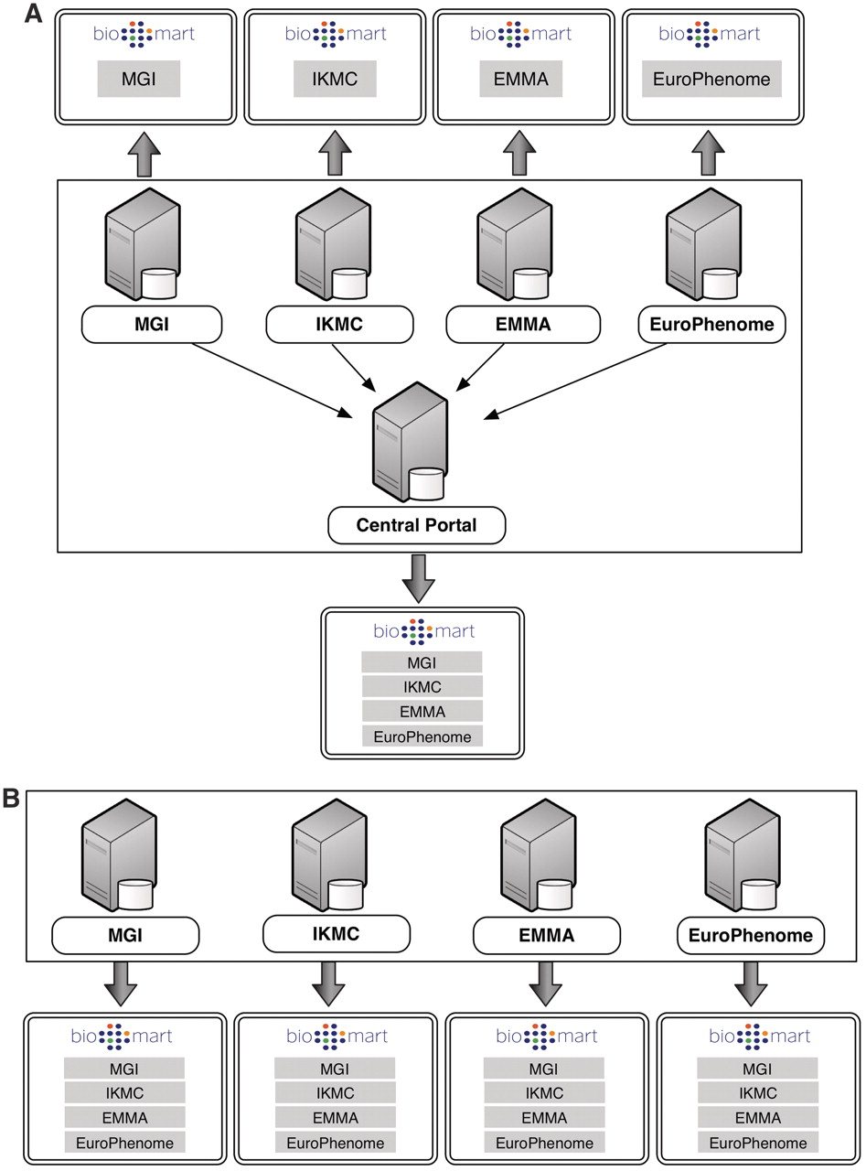
Figure 1. BioMart Portal architecture. The BioMart Portal can be deployed in either of two different types of server ...
Notes:
Figure 1. BioMart Portal architecture. The BioMart Portal can be deployed in either of two different types of server architectures. In the ‘master/slave’-like architecture (A) each ‘slave’ server only provides access to its own local data, while the ‘master’ server acts as a portal presenting a unified view over data residing on all the ‘slave’ servers. In the ‘peer-to-peer’-like architecture (B) each server not only provides data access to its own data source, but also data from all other servers. In this way, every server acts as a data portal providing access to all the data.
Unless provided in the caption above, the following copyright applies to the content of this slide: © The Author(s) 2011. Published by Oxford University Press.This is Open Access article distributed under the terms of the Creative Commons Attribution Non-Commercial License (http://creativecommons.org/licenses/by-nc/2.5), which permits unrestricted non-commercial use, distribution, and reproduction in any medium, provided the original work is properly cited.

