Slide 1
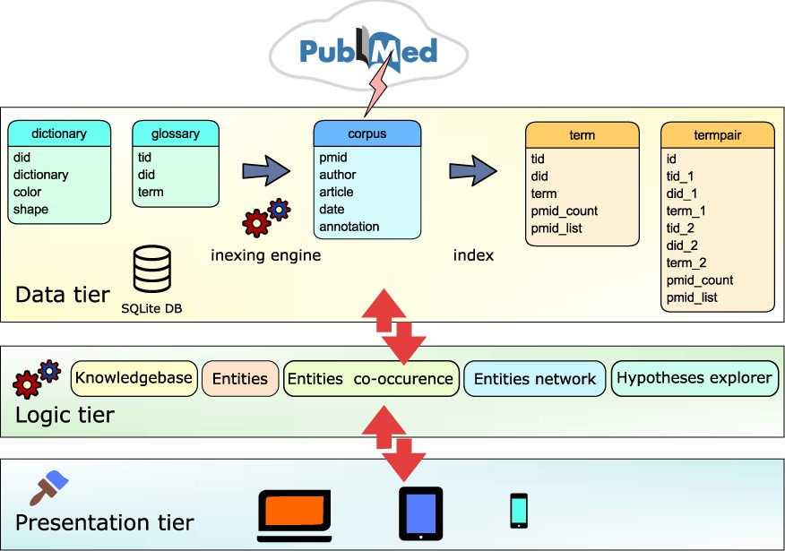
Figure 1. Text-mining module is based on 3-tier architecture. (i) Data tier database: dictionary table containing the ...
Notes:
Figure 1. Text-mining module is based on 3-tier architecture. (i) Data tier database: dictionary table containing the list of dictionary names and the glossary table containing list of biomedical terms is applied by the indexing engine to the corpus table containing PubMed abstracts. Indexing module updates the corpus table and produces two new tables: term table, containing indices of terms and termpair table containing indices of co-occurring terms in the PubMed corpus. (ii) Logic tier is driven by ajax calls that access tables and combine data. (iii) Presentation layer is based on the jQuery/Bootstrap framework producing responsive web pages that can be viewed on a variety of devices.
Unless provided in the caption above, the following copyright applies to the content of this slide: © The Author(s) 2021. Published by Oxford University Press.This is an Open Access article distributed under the terms of the Creative Commons Attribution License (http://creativecommons.org/licenses/by/4.0/), which permits unrestricted reuse, distribution, and reproduction in any medium, provided the original work is properly cited.

