Slide 1
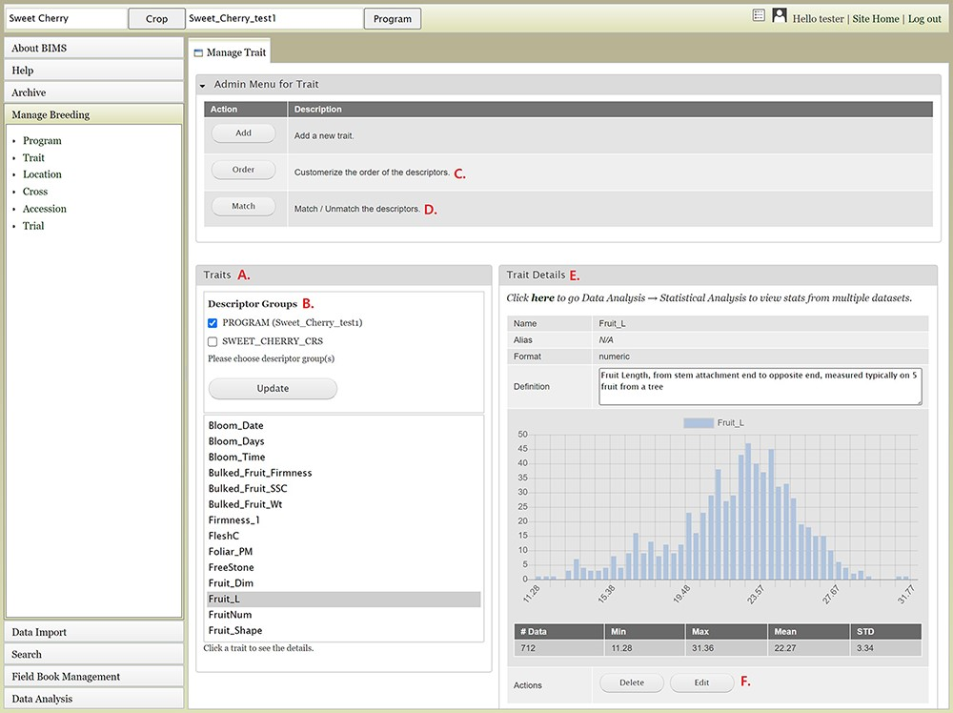
Figure 8. BIMS interface to view, create, or edit data for Trait. A. Trait section in Manage Trait tab where all the ...
Notes:
Figure 8. BIMS interface to view, create, or edit data for Trait. A. Trait section in Manage Trait tab where all the traits in the program are listed. B. Descriptor groups section where users can choose one to view the traits that belong to the descriptor. C. Order button under Admin Menu for Traits that opens up a new tab to change the order of trait descriptors in Traits section. D. Match button under Admin Menu for Traits that allows users to merge the same descriptor in different descriptor groups when they represent the same descriptor with the same unit and phenotyping method. E. Trait Details section that shows the details of the trait descriptor along with a graph that shows the distribution of the trait values in the entire data loaded to BIMS along with the statistical values. F. The Edit button in the Trait Details section that opens a new tab where users can edit the details of the trait.
Unless provided in the caption above, the following copyright applies to the content of this slide: © The Author(s) 2021. Published by Oxford University Press.This is an Open Access article distributed under the terms of the Creative Commons Attribution License (http://creativecommons.org/licenses/by/4.0/), which permits unrestricted reuse, distribution, and reproduction in any medium, provided the original work is properly cited.

