Slide 1
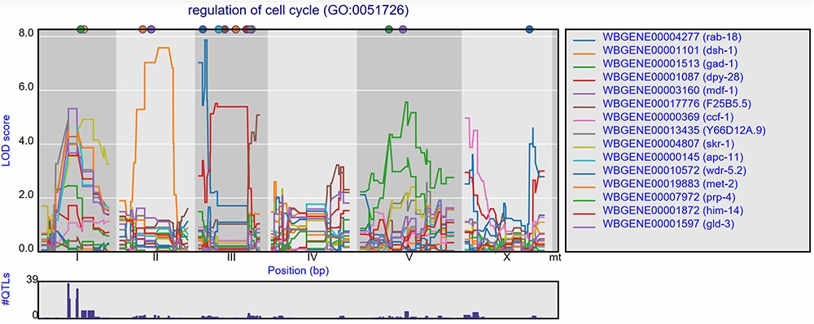
Figure 5 eQTL transband on chromosome X in Rockman et al. (67). The eQTL profiles of the top-15 highest eQTLs at ...
Notes:
Figure 5 eQTL transband on chromosome X in Rockman et al. (67). The eQTL profiles of the top-15 highest eQTLs at marker rmm1258 in Rockman et al. are shown as profiles. Colors indicate different genes. The legend is shown on the right. Chromosomes are indicated by different gray backgrounds and below the x-axis. The web-based plot is interactive; a mouse over provides the exact base pair position of each QTL or other point on the profile. Moreover, more than the top-15 can be added to the plot creating a custom overview.
Unless provided in the caption above, the following copyright applies to the content of this slide: © The Author(s) 2020. Published by Oxford University Press.This is an Open Access article distributed under the terms of the Creative Commons Attribution License (http://creativecommons.org/licenses/by/4.0/), which permits unrestricted reuse, distribution, and reproduction in any medium, provided the original work is properly cited.

