Slide 1
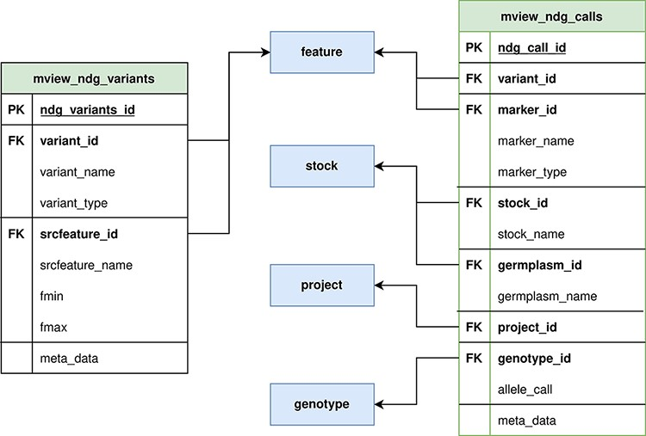
Figure 2. ND Genotypes materialized view implementation. Mview_ndg_variants (left) contains all variant locations ...
Notes:
Figure 2. ND Genotypes materialized view implementation. Mview_ndg_variants (left) contains all variant locations providing support for multiple genome assemblies without duplicating the allele data stored in mview_ndg_calls (right). Both these materialized views pull data from several Chado tables (center, blue) to prevent table joins in user-triggered queries. There are numerous foreign keys in these materialized views to allow retrieval of infrequently required metadata.
Unless provided in the caption above, the following copyright applies to the content of this slide: © The Author(s) 2021. Published by Oxford University Press.This is an Open Access article distributed under the terms of the Creative Commons Attribution License (http://creativecommons.org/licenses/by/4.0/), which permits unrestricted reuse, distribution, and reproduction in any medium, provided the original work is properly cited.

