Slide 1
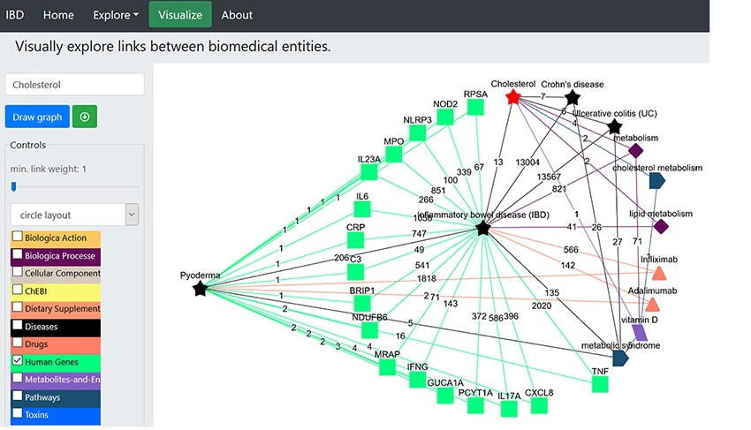
Figure 5. Illustration of the construction of network to identify the potential genes linked to pyoderma and IBD. The ...
Notes:
Figure 5. Illustration of the construction of network to identify the potential genes linked to pyoderma and IBD. The red star represents the searched term ‘cholesterol’. The green squares represent the ‘Human genes’ dictionary. The black stars represent the ‘Diseases’ dictionary, and the orange triangles represent ‘Drugs’ dictionary. The burgundy-coloured diamonds represent the ‘Biological Processes’ dictionary. The coral blue colour pentagon shape represents the ‘Pathways’ dictionary. The coloured edges represent the colours of their respective dictionaries. The number allocated on each edge showcase the number of publications that link to the associated nodes.
Unless provided in the caption above, the following copyright applies to the content of this slide: © The Author(s) 2021. Published by Oxford University Press.This is an Open Access article distributed under the terms of the Creative Commons Attribution License (http://creativecommons.org/licenses/by/4.0/), which permits unrestricted reuse, distribution, and reproduction in any medium, provided the original work is properly cited.

