Slide 1
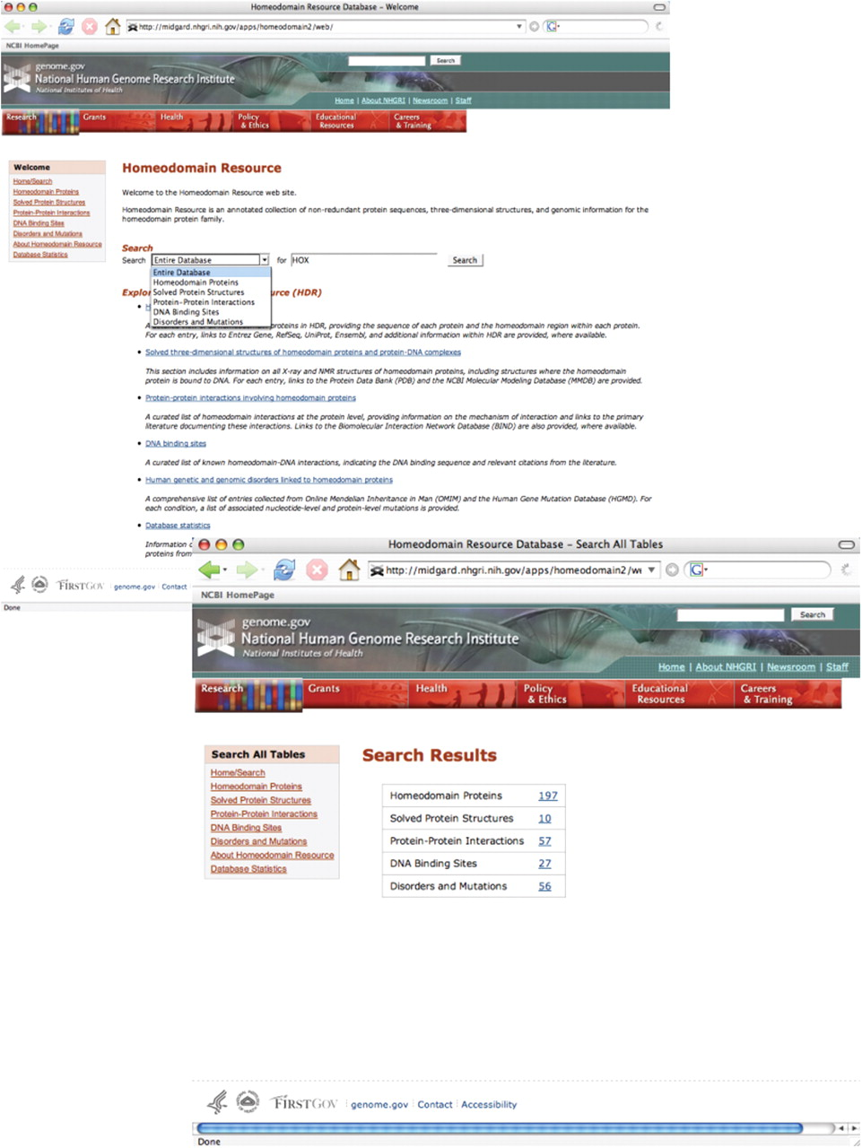
Figure 2. The Homeodomain Resource provides a simple search query interface, allowing the user to either query part or ...
Notes:
Figure 2. The Homeodomain Resource provides a simple search query interface, allowing the user to either query part or all of the Resource (top). Selecting ‘Entire Database’ from the pull-down menu returns a summary screen, indicating how many entries of each type were identified (bottom). Clicking on any of the hyperlinked numbers in the table takes the user directly to that set of results. In addition, overall navigation within the site has been improved with the addition of sidebar tools and links to complete datasets in each homeodomain category.
Unless provided in the caption above, the following copyright applies to the content of this slide: Published by Oxford University Press 2009.This is Open Access article distributed under the terms of the Creative Commons Attribution Non-Commercial License (http://creativecommons.org/licenses/by-nc/2.0/uk/) which permits unrestricted non-commercial use, distribution, and reproduction in any medium, provided the original work is properly cited.

