Slide 1
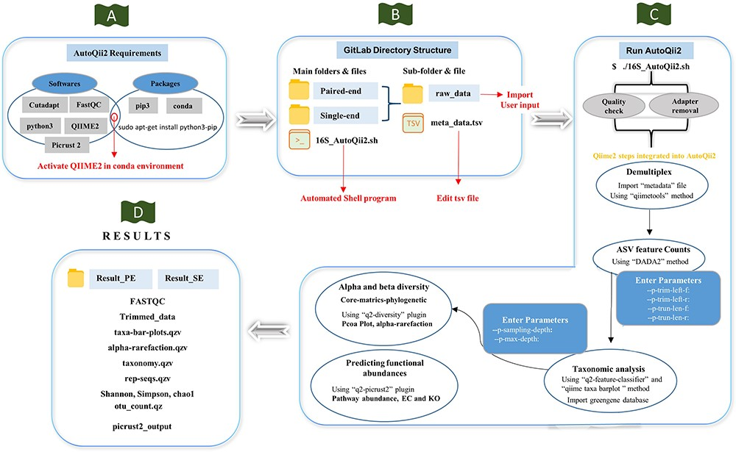
Figure 2. Workflow of AutoQii2 pipeline. (A) Third-party software requirement for AutoQii2. The users are required to ...
Notes:
Figure 2. Workflow of AutoQii2 pipeline. (A) Third-party software requirement for AutoQii2. The users are required to install FastQC, cutadapt and QIIME 2 and activate QIIME 2 under conda environment. (B) Open-source code available in GitLab for paired-end (PE) and single-end (SE) analysis. The users are required to edit metadata.tsv and subdirectory ‘raw_data’ available inside the PE and SE folder. ‘16SAutoQii2.sh’ is an automated shell script program. (C) Analysis steps of autoqii2. (D) Results of AutoQii2 Pipeline.
Unless provided in the caption above, the following copyright applies to the content of this slide: © The Author(s) 2023. Published by Oxford University Press.This is an Open Access article distributed under the terms of the Creative Commons Attribution License (https://creativecommons.org/licenses/by/4.0/), which permits unrestricted reuse, distribution, and reproduction in any medium, provided the original work is properly cited.

