Slide 1
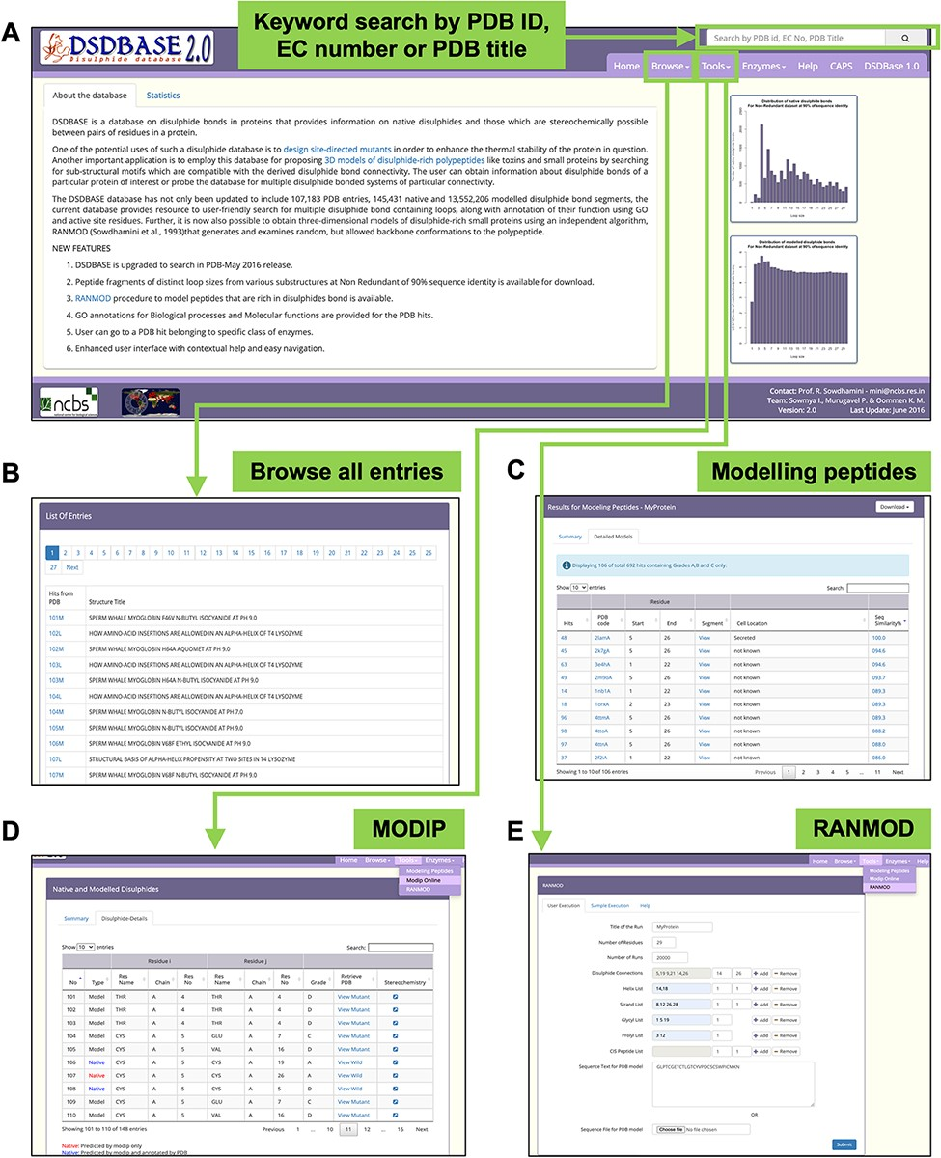
Figure 1. DSDBASE 2.0 database organization and features. Different features of the database have been shown here. (A) ...
Notes:
Figure 1. DSDBASE 2.0 database organization and features. Different features of the database have been shown here. (A) Database browser. The users can browse through the different modules of DSDBASE. The user can also perform keyword search by PDB ID, EC number or PDB title. The distribution of native and modelled disulphide bonds based on loop sizes is provided. (B) List of all entries. The user can also download peptide fragments of distinct loop sizes from various substructures from nr-db-90% (90% sequence identity). (C) Modelling peptide feature. (D) RANMOD feature.
Unless provided in the caption above, the following copyright applies to the content of this slide: © The Author(s) 2022. Published by Oxford University Press.This is an Open Access article distributed under the terms of the Creative Commons Attribution License (https://creativecommons.org/licenses/by/4.0/), which permits unrestricted reuse, distribution, and reproduction in any medium, provided the original work is properly cited.

