Slide 1
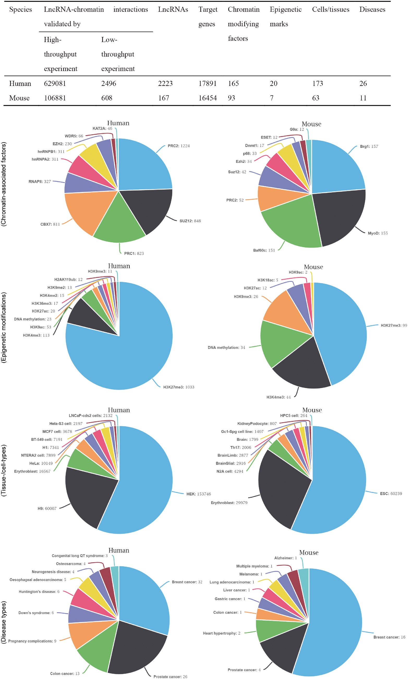
Figure 1. The statistics of lncRNA–chromatin interactions. The table shows the basic statistics of lncRNA–chromatin ...
Notes:
Figure 1. The statistics of lncRNA–chromatin interactions. The table shows the basic statistics of lncRNA–chromatin interactions. The pie chart shows the distribution of interactions based on cell/tissue types, disease types, chromatin-associated factors and epigenetic modifications. For each chart, the top 10 groups of interactions are shown.
Unless provided in the caption above, the following copyright applies to the content of this slide: © The Author(s) 2018. Published by Oxford University Press.This is an Open Access article distributed under the terms of the Creative Commons Attribution Non-Commercial License (http://creativecommons.org/licenses/by-nc/4.0/), which permits non-commercial re-use, distribution, and reproduction in any medium, provided the original work is properly cited. For commercial re-use, please contact journals.permissions@oup.com

