Slide 1
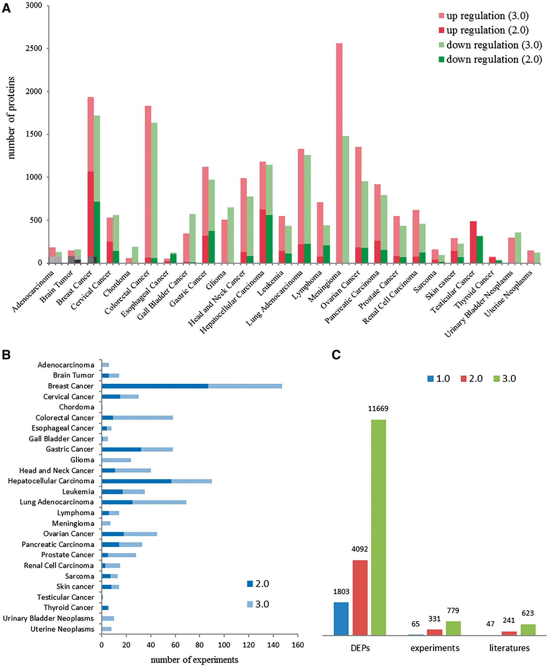
Figure 2. Data contents in dbDEPC 3.0. (A) The distribution of DEPs in each cancer in version 2.0 and 3.0. (B) Number ...
Notes:
Figure 2. Data contents in dbDEPC 3.0. (A) The distribution of DEPs in each cancer in version 2.0 and 3.0. (B) Number of experiments in each cancer. (C) Number of DEPs, MS experiments and related literatures in three version of dbDEPC.
Unless provided in the caption above, the following copyright applies to the content of this slide: © The Author(s) 2018. Published by Oxford University Press.This is an Open Access article distributed under the terms of the Creative Commons Attribution License (http://creativecommons.org/licenses/by/4.0/), which permits unrestricted reuse, distribution, and reproduction in any medium, provided the original work is properly cited.

