Slide 1
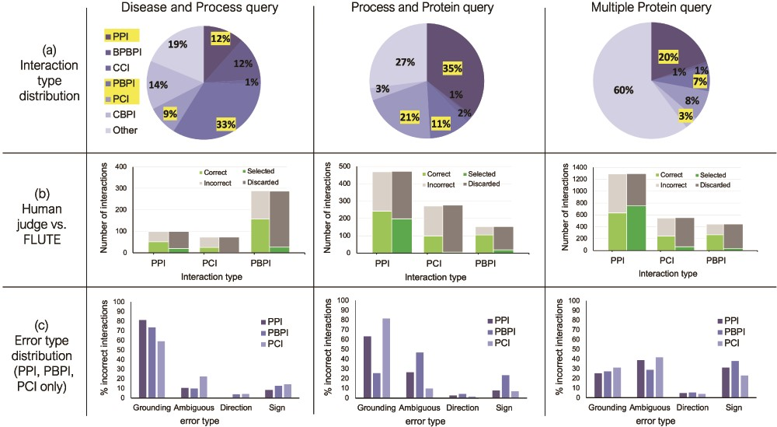
Figure 6 The influence of interaction type and machine reading errors on the number of selected interactions. (a) ...
Notes:
Figure 6 The influence of interaction type and machine reading errors on the number of selected interactions. (a) Overall distribution of interaction types for the three different queries, disease and biological process query, biological process and protein query and multiple protein query. (b) The comparison between FLUTE and manual selection; human judge decides whether interaction is correct given literature evidence, and FLUTE selects the interactions that are supported by databases. (c) The distribution of errors types in machine extraction of PPIs, PBPIs and PCIs for the three different queries.
Unless provided in the caption above, the following copyright applies to the content of this slide: © The Author(s) 2020. Published by Oxford University Press.This is an Open Access article distributed under the terms of the Creative Commons Attribution License (http://creativecommons.org/licenses/by/4.0/), which permits unrestricted reuse, distribution, and reproduction in any medium, provided the original work is properly cited.

